Slide 1

BMS with applications
Béatrice Bonga

Slide 2
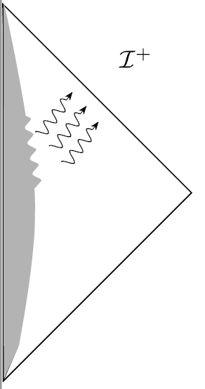


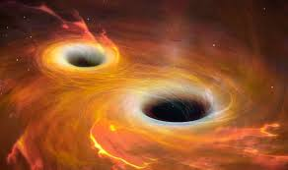
From messy physics to a peaceful realm

Slide 3
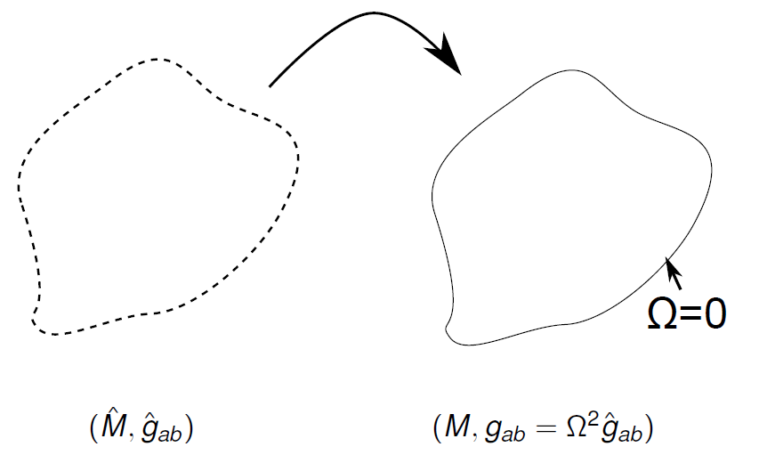
Key idea: bring infinity to a finite distance
Conformal completion

Slide 4
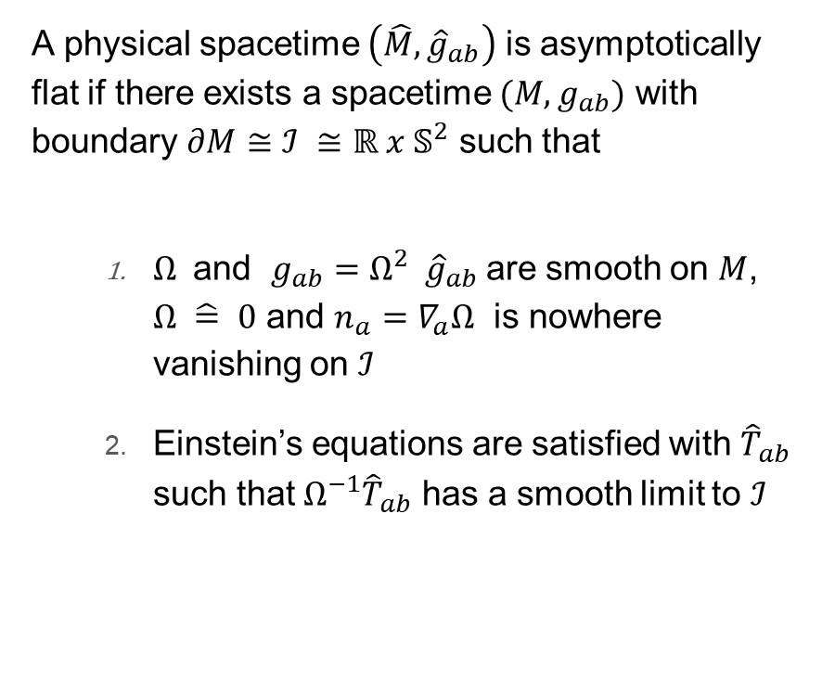
Asymptotic flatness
A physical spacetime $\left(\hat{M},{\hat{g}}_{ab}\right)$ is asymptotically flat if there exists a spacetime $(M,g_{ab})$ with boundary $∂M≅ℐ ≅ℝ x 𝕊^{2}$ such that
  $Ω^{ }$ and $g_{ab}=Ω^{2} {\hat{g}}_{ab}$are smooth on $M$, $Ω \hat{=} 0$ and $n_{a}=∇_{a}Ω$ is nowhere vanishing on $ℐ$
  Einstein’s equations are satisfied with ${\hat{T}}_{ab}$ such that ${Ω^{−1}\hat{T}}_{ab}$ has a smooth limit to $ℐ$

Slide 5



Consequences
Einstein’s equation $n^{a}$is null on $ℐ$
$q_{ab}$ = induced metric on $ℐ$ is degenerate: 0 + +
$$n^{a}$$
Conformal freedom
$$Ω→Ω^{′}=ω Ω$$
$$g_{ab}→g_{ab}^{′}=ω^{2}g_{ab}$$
$$n^{a}→n^{a}′=ω^{−1}n^{a}$$

Slide 6
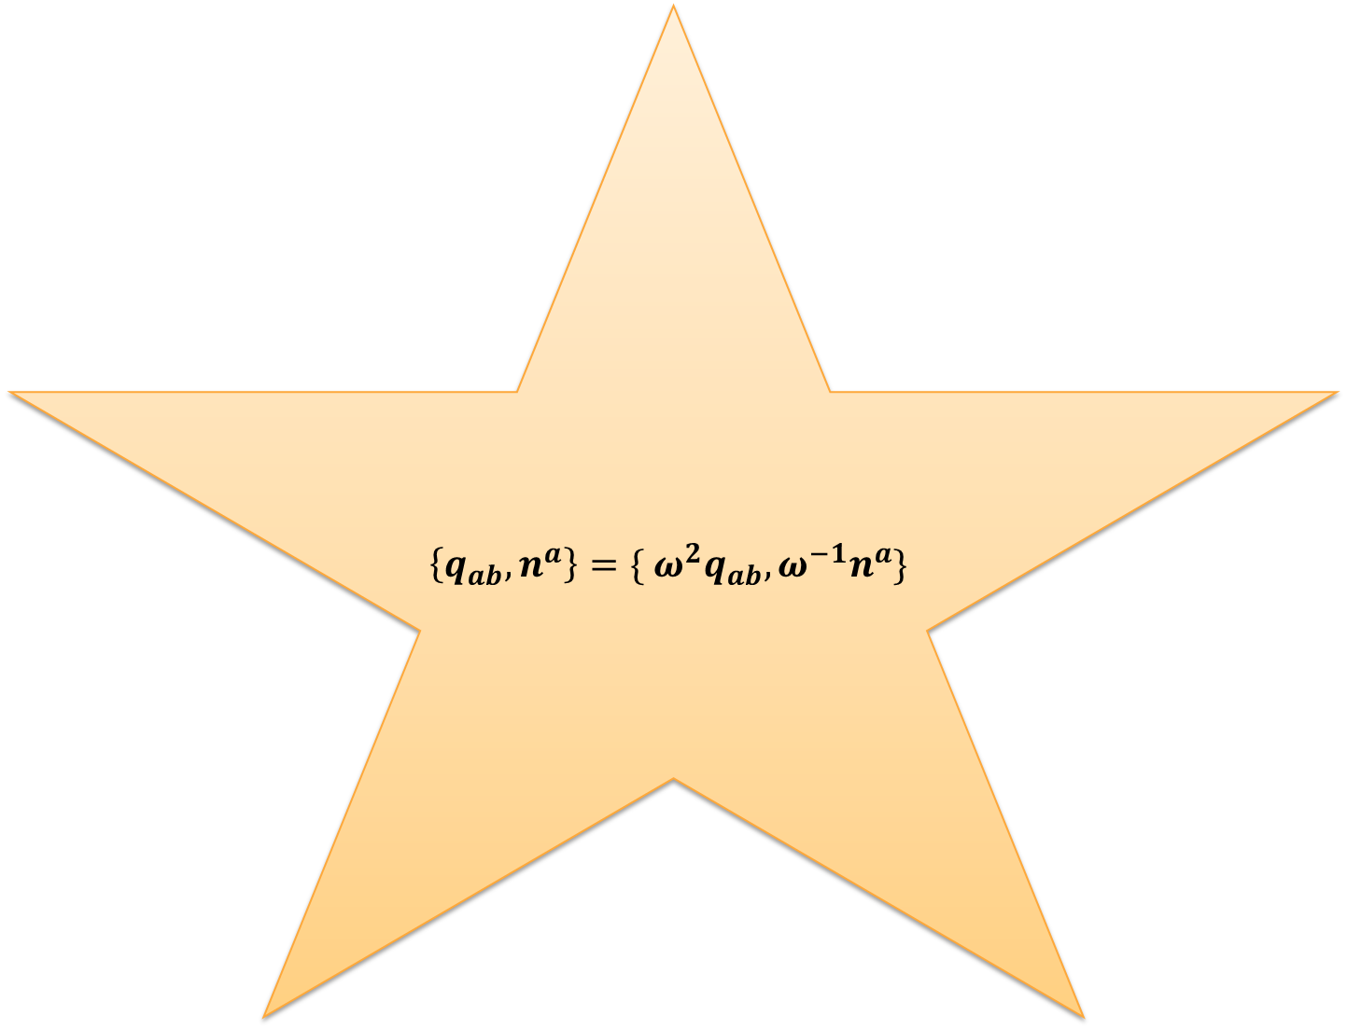
Universal structure
$$\left\{q_{ab}, n^{a}\right\}=\{ ω^{2}q_{ab}, ω^{−1}n^{a}\}$$

Slide 7


Example: Minkowski spacetime
$Ω= \frac{1}{r}$
$$dr=−Ω^{−2}dΩ$$
$$d{\hat{s}}^{2}=−dt^{2}+dr^{2}+r^{2} \left(dθ^{2}+\sin^{2}{θ} dφ^{2}\right)$$
𝑑𝑠 ̂^2=−𝑑𝑡^2+𝑑𝑟^2+𝑟^2 (𝑑𝜃^2+sin^2⁡𝜃 𝑑𝜙^2 )
$$d{\hat{s}}^{2}=−du^{2}−2du dr+r^{2} \left(dθ^{2}+\sin^{2}{θ} dφ^{2}\right)$$
𝑑𝑠 ̂^2=−𝑑𝑢^2−2𝑑𝑢 𝑑𝑟+𝑟^2 (𝑑𝜃^2+sin^2⁡𝜃 𝑑𝜙^2 )
$$ds^{2}={−Ω}^{2} du^{2}+2 du dΩ+dθ^{2}+\sin^{2}{θ} dφ^{2}$$
𝑑𝑠^2=〖−Ω〗^2 𝑑𝑢^2+2 𝑑𝑢 𝑑Ω+𝑑𝜃^2+sin^2⁡𝜃 𝑑𝜙^2
$$ds^{2}\hat{=} 2 du dΩ+dθ^{2}+\sin^{2}{θ} dφ^{2}$$
Others examples: Kerr-Newman spacetimes, Weyl spacetimes, etc.

Slide 8
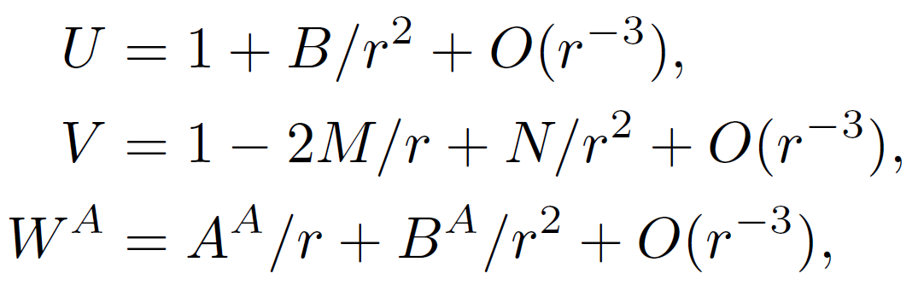
Generic asymptotically flat spacetime
^
Flat Space
Mass aspect
Radiative modes
Angular momentum aspect

Slide 9
Asymptotic symmetry group
“Spacetime diffeomorphism that leave the universal structure at Scri invariant”
Universal structure
$ℒ_{ξ}q_{ab}\hat{=}2 α{ q}_{ab}$ with $ℒ_{n}α\hat{=}0$
$ℒ_{ξ}n^{a}\hat{=} −α n^{a}$
Universal structure
ℒ_𝜉 𝑞_𝑎𝑏 = ̂2 𝛼〖 𝑞〗_𝑎𝑏 with ℒ_𝑛 𝛼= ̂0
ℒ_𝜉 𝑛^𝑎 = ̂ −𝛼 𝑛^𝑎
Coordinates
$$Ω^{2}ℒ_{ξ}{\hat{g}}_{ab}\hat{=} 0$$
Coordinates
Ω^2 ℒ_𝜉 𝑔 ̂_𝑎𝑏 = ̂ 0

Slide 10



Bondi-Metzner-Sachs group (BMS)
Bigger than Poincare (=translations & rotations)
BMS = supertranslations & rotations
$$\frac{1}{2}$$
super-translations
rotations

Slide 11
What is BMS good for?
Provides quantities with a physical interpretation!
BMS
translation subgroup
Mass
Linear momentum
(many) rotation subgroups
Angular momentum (up to supertranslations)
supertranslations subgroup
Memory effect

Slide 12
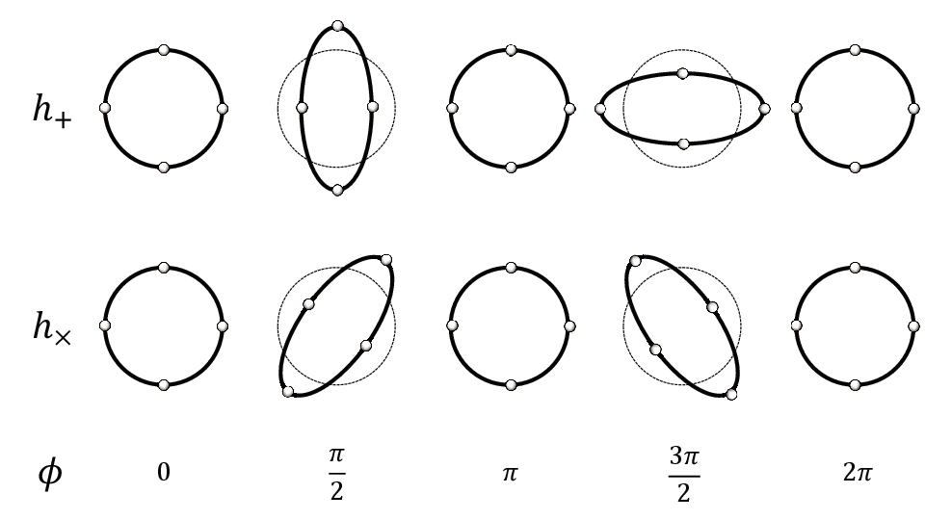
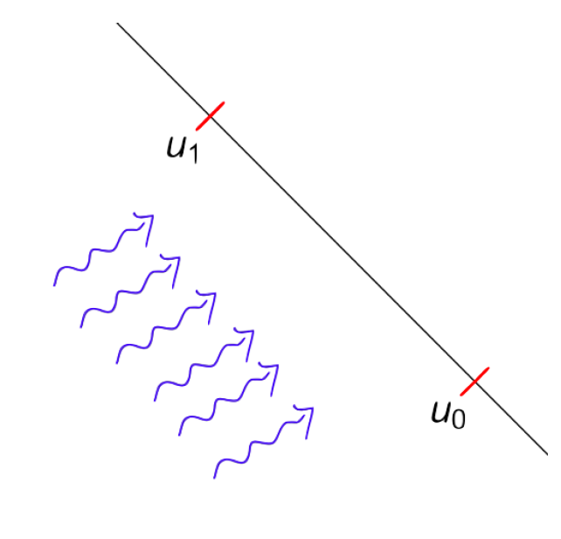
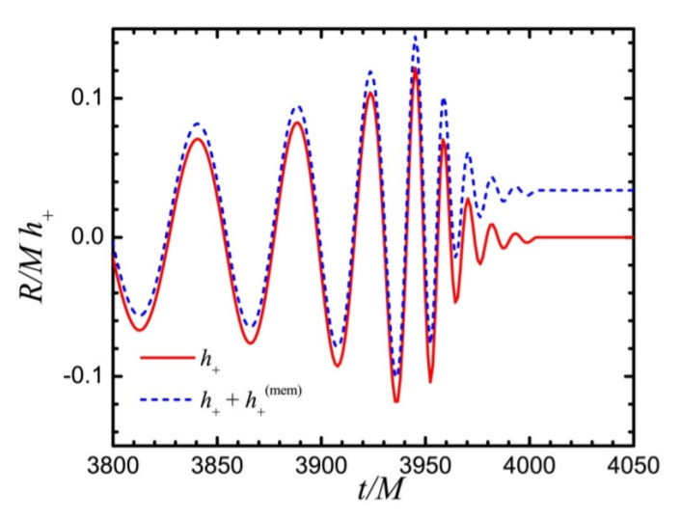
Memory effect ~ DC while wave ~ AC
The memory effect is the permanent relative displacement of an array of test particles brought about by the passage of a burst of gravitational radiation and/or null stress energy.

Slide 13

Memory tensor
Integrating the geodesic deviation equation twice, the change of the relative displacement is
$Δξ_{a}=Δ_{ab} ξ_{initial}^{b}$
$$Δ_{ab}=−\int_{u_{0}}^{u_{1}}{du^{′}}\int_{u_{0}}^{u^{′}}{du^{′′} }R_{0a0b}$$

Slide 14
How is memory related to supertranslations?
It is generated by it!
Supertranslation

Slide 15
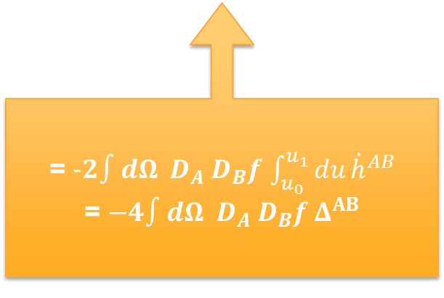

Another diagnostic: flux of super-momentum
$$ℱ_{f}=−\frac{1}{32 π G} \int_{u_{0}}^{u_{1}}{du}∫dΩ \left(f {\dot{h}}_{AB}{\dot{h}}^{AB} −2 {\dot{h}}^{AB}D_{A}D_{B}f\right)$$
“Hard” part
“Soft” part
= $-2∫dΩ D_{A} D_{B}f$ $\int_{u_{0}}^{u_{1}}{du}{\dot{h}}^{AB}$
= $−4∫dΩ D_{A} D_{B}f Δ^{AB}$

Slide 16
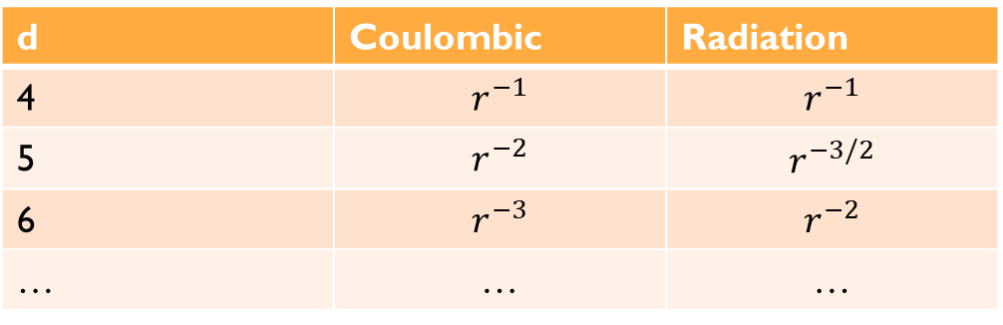
Is this also true in higher dimensions?
Some background
Coulombic
$$\frac{1}{r^{d−3}}$$
Coulombic
1/𝑟^(𝑑−3)
Radiation
$$\frac{1}{r^{\frac{d}{2}−1}}$$
Radiation
1/𝑟^(𝑑/2−1)
d | Coulombic | Radiation
4 | $$r^{−1}$$ | $$r^{−1}$$
5 | $$r^{−2}$$ | $$r^{−3/2}$$
6 | $$r^{−3}$$ | $$r^{−2}$$
… | … | …

Slide 17
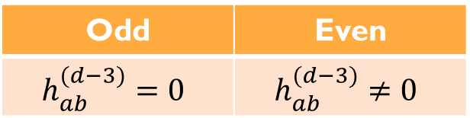
Memory effect for d>4
All radiative processes up to leading Coulombic order vanish, but leading Coulombic order is:
Odd | Even
$$h_{ab}^{(d−3)}=0$$ | $$h_{ab}^{(d−3)}≠0$$
No memory effect in odd dimensions!
(Ordinary and null memory cancel each other exactly.)
Memory tensor is no longer determined by only a scalar, also vector and tensor parts.

Slide 18
Scalar memory effect for d>4: gauge!
Trivial diffeomorphism!

Slide 19
BMS in other contexts
BMS
Generic null surface
[Chandrasekaran, Flanagan, Prabhu, Giribet, Donnay, …]
BH horizons
[Rahman, Wald; Giribet, Donnay, Gonzalez, Pino; Strominger, Hawking, Perry; …]
Boundary conditions are as much an art as a science!

Slide 20
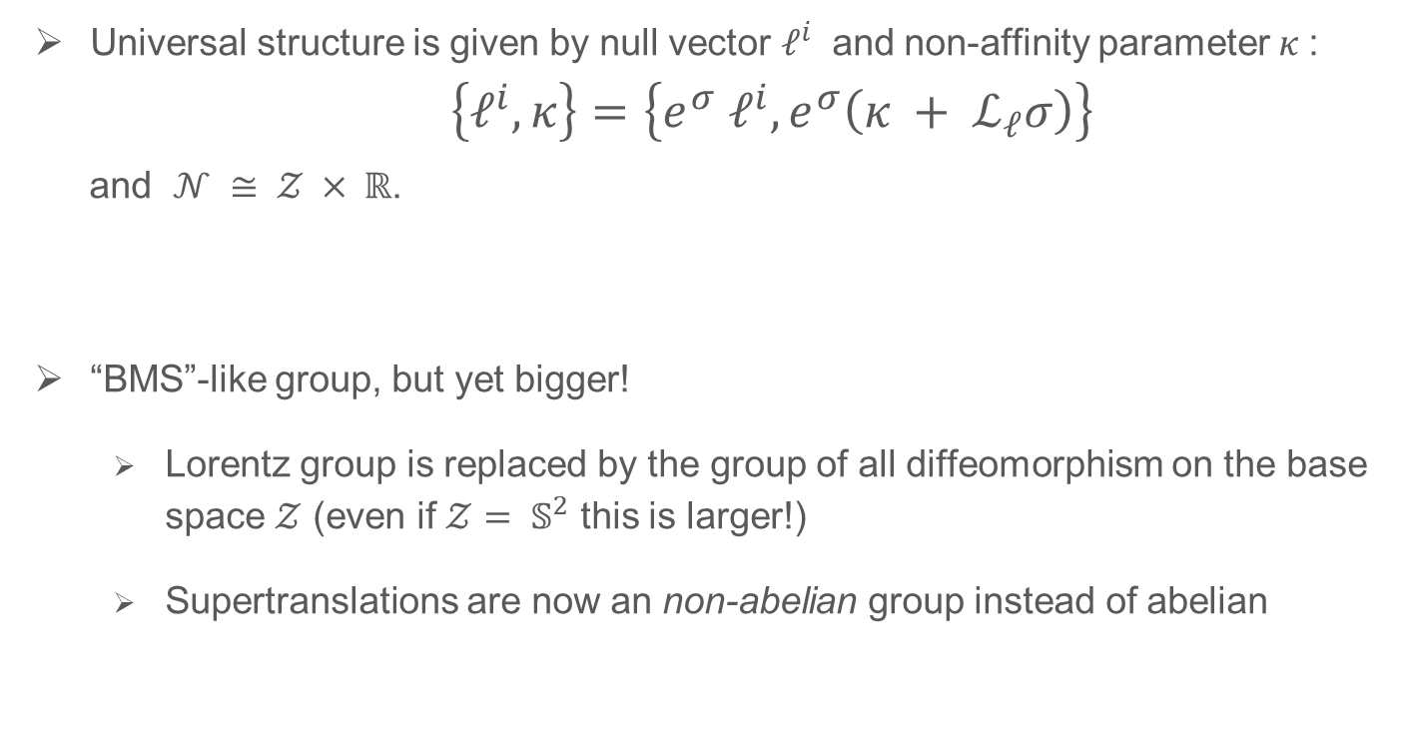
Generic null surface $𝒩$
Universal structure is given by null vector $ℓ^{i}$ and non-affinity parameter $κ$:
$\left\{ℓ^{i}, κ\right\}=\left\{e^{σ} ℓ^{i}, e^{σ}\left(κ + ℒ_{ℓ}σ\right)\right\}$
and $𝒩 ≅ 𝒵 × ℝ$.
“BMS”-like group, but yet bigger!
  Lorentz group is replaced by the group of all diffeomorphism on the base space $𝒵$ (even if $𝒵= 𝕊^{2}$ this is larger!)
  Supertranslations are now an non-abelian group instead of abelian

Slide 21
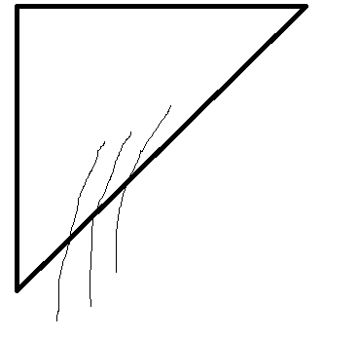

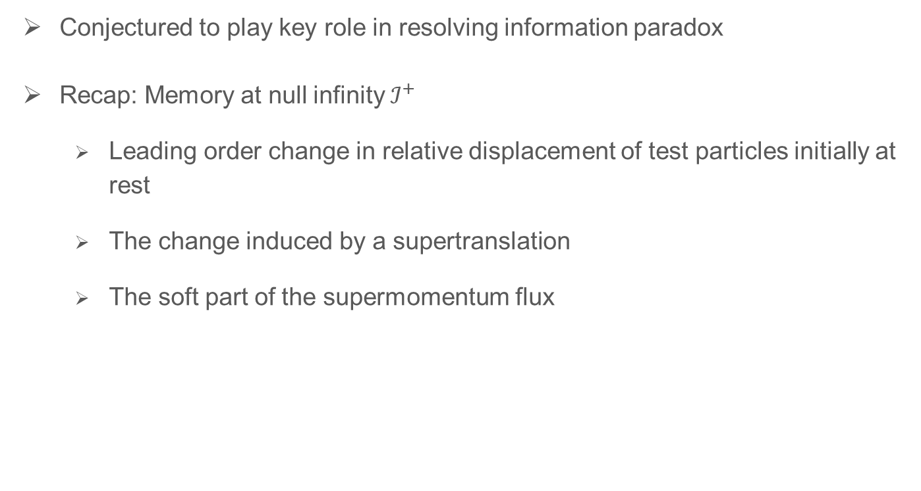

Black hole memory
Conjectured to play key role in resolving information paradox
Recap: Memory at null infinity $ℐ^{+}$
  Leading order change in relative displacement of test particles initially at rest
  The change induced by a supertranslation
  The soft part of the supermomentum flux
$$𝓗^{+}$$

Slide 22
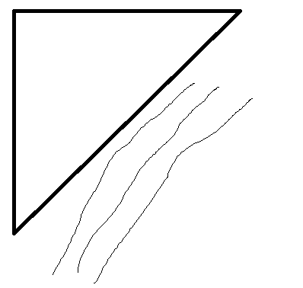



Black hole memory
Stationary timelike geodesics cannot be used to define memory
Accelerated worldlines can stay outside, but displacement depends on acceleration
Null generators on $ℋ^{+}$ can be used to define a relative displacement
$$𝓗^{+}$$

Slide 23
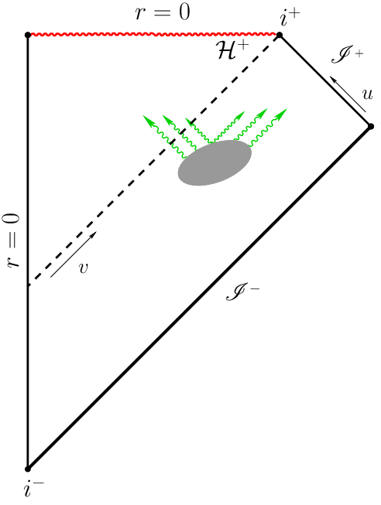
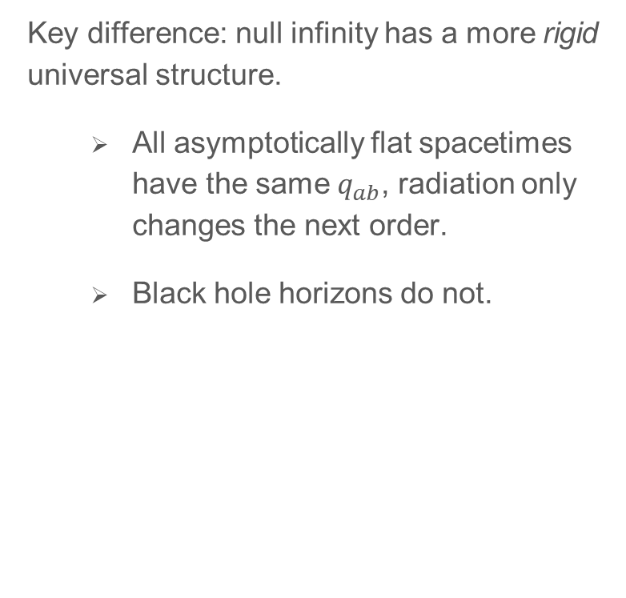
Black hole memory not related to supertranslations
Key difference: null infinity has a more rigid universal structure.
  All asymptotically flat spacetimes have the same $q_{ab}$, radiation only changes the next order.
  Black hole horizons do not.

Slide 24
Beyond asymptotic flatness
Relax boundary conditions to include defects (e.g. cosmic string)
BMS plus super rotations [Barnich & Troessart; …]

Slide 25
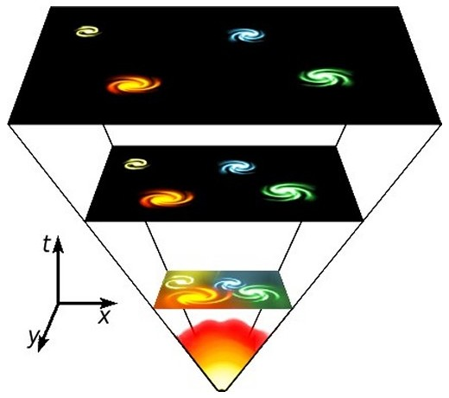
Beyond asymptotic flatness: cosmology
Expanding spacetimes are not asymptotically flat!

Slide 26
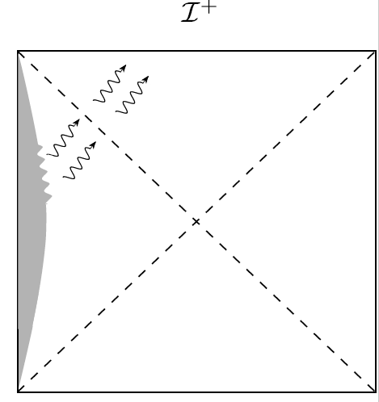
Positive cosmological constant
The asymptotic region is now spacelike
Asymptotic symmetry group is no longer BMS! [Penrose; Anninos; Ashtekar, Bonga, Kesevan; …]

Slide 27
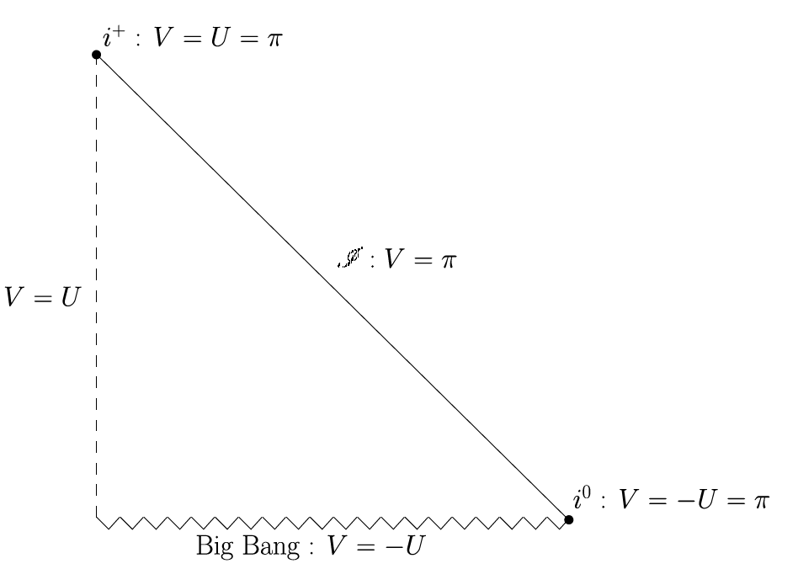
Decelerating FLRW spacetimes
Universal structure very similar to asymptotically flat spacetimes [Bonga, Prabhu]

Slide 28
Conclusion
BMS group is the asymptotic symmetry group of asymptotically flat spacetimes
BMS-like structures appear in many different contexts with null surfaces
Thank you for listening!

