Slide 1
Environmental Effects on
BH-BH GW Waveforms
Cole Miller
University of Maryland

Slide 2
Plan of Talk
Some overall scales and scalings
Stellar-mass binary BH, seen with ET
Perturbation from third object?
Can gas ever have a significant effect?
SMBHB with LISA
Will gas or 3-body encounters be significant?
EMRIs with LISA
~10³-10⁶ cycles; potentially sensitive to env.
Key question: can we see these effects uniquely?

Slide 3
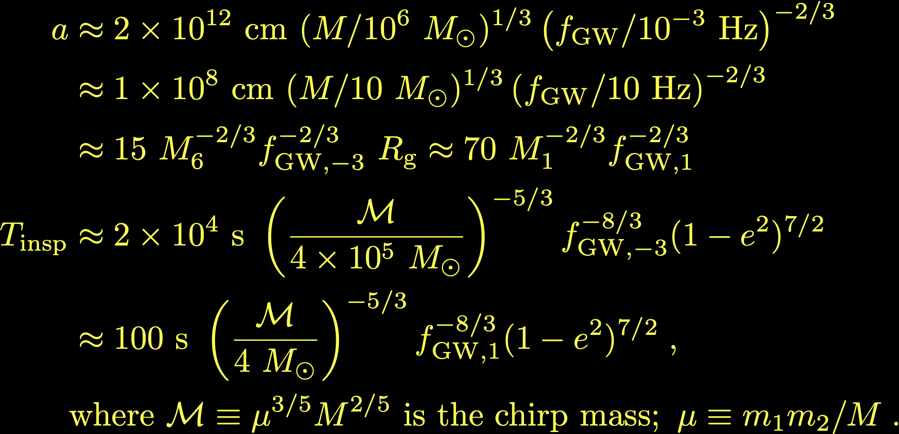
Useful Scales

Slide 4
Does gas have a major effect?
LVK: no. LISA comparable-mass: no
Why? Eddington time (eff=0.1)~40 Myr. Much longer than 2x10⁴ s or 100 sec.
Thus gas mass is negligible vs. MBH
But see Garg talk tomorrow; few cycles possible
However, at lower frequencies for SMBH, gas is expected to align the spins More later
EMRI? Maybe: predominantly planetary migration but irrelevant for expected geom. thick disks (e.g., Barausse+ 2014)

Slide 5
What about magnetic fields?
Could magnetic fields have an effect?
No, not really
Take a high average B=10⁵ G, over the 2x10¹² cm realm for LISA sources. U_{B}=B²/8π, so total B energy is only
~10⁴⁶ erg, << Mc²~2x10⁶⁰ erg.
Amplification by winding?
No, field lines balloon out to release tension; amplification is at most factor ~few

Slide 6
Perturbations from third object
Consider a hierarchical triple: binary mass = M₁, companion = m_{c} (units of both = M_{sun}); semimajor axis of companion = a₂ (units R_{sun}); binary starts at f_{min} (units 10 Hz).
Keep in mind: only known triple compact object system has a₂~200 R_{sun}.
Follow Meiron+ 2016
Effects include Doppler, varying grav redshift, Shapiro delay, nodal precession, change in binary eccentricity

Slide 7
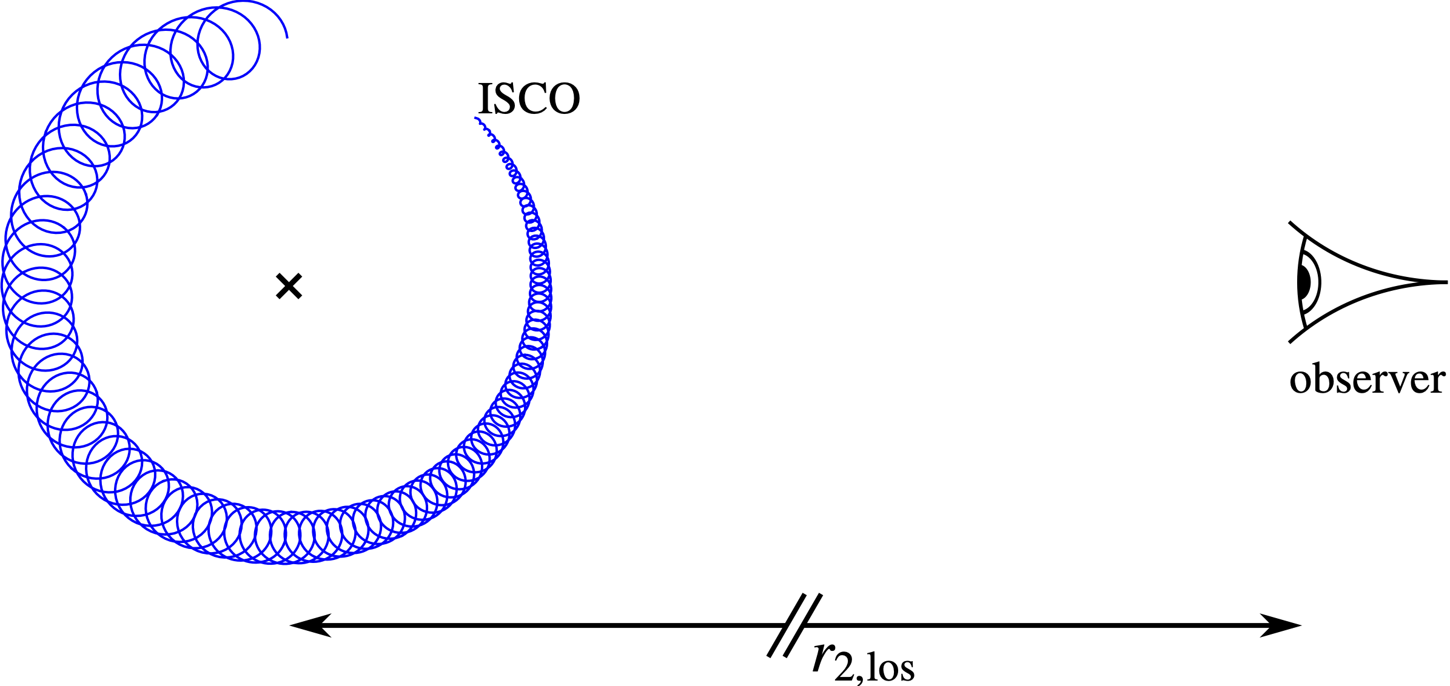
Stylized 3-body figure
From Meiron+ 2016; not to scale. X is COM of system

Slide 8
Doppler shift
Velocity: absorbed in redshift definition
Phase difference from acceleration:
Looks promising... but part of this is absorbed by chirp mass freedom (Yunes+)
Open Q: can a system evolve to this state with a₂~R_{sun}? For stellar-mass, binary will shrink much faster than triple

Slide 9
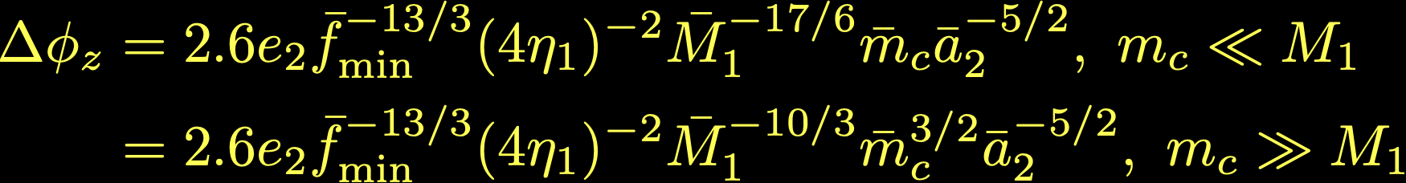
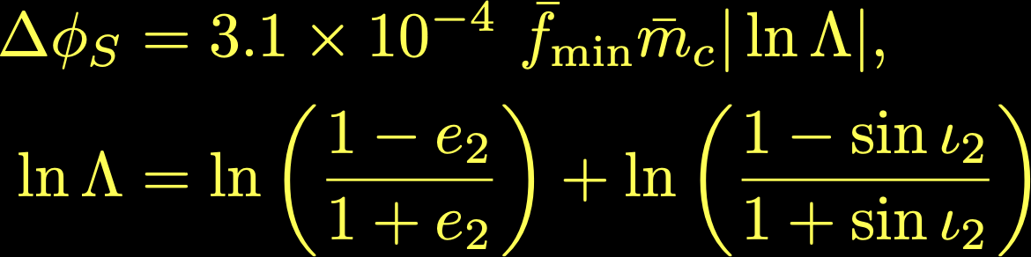
Grav. z and Shapiro Delay
z: Need eccentric outer orbit. For e₂<<1 and much less than one tertiary orbit:
Shapiro:
Both small compared with Doppler
Maybe lensing, rarely? D’Orazio+

Slide 10

Nodal precess., induced ecc
Nodal: Misalignment of binary, tertiary can cause binary axis to precess
Ecc: Tidal force from the perturber can affect the orbital shape of the binary.
Both therefore likely to be small

Slide 11
Summary for stellar-mass
Need a relatively close, relatively massive perturber for even the most significant of these effects on a BH-BH binary (Doppler), e.g., 10⁶ M_{sun} at few x 10¹² cm.
Probable? No. But it is possible, and the more events we see the more likely it is that one will be in this magical spot
Not discussed here: effect on ringdowns
E.g., Barausse+ 2014
What about for SMBHB?

Slide 12
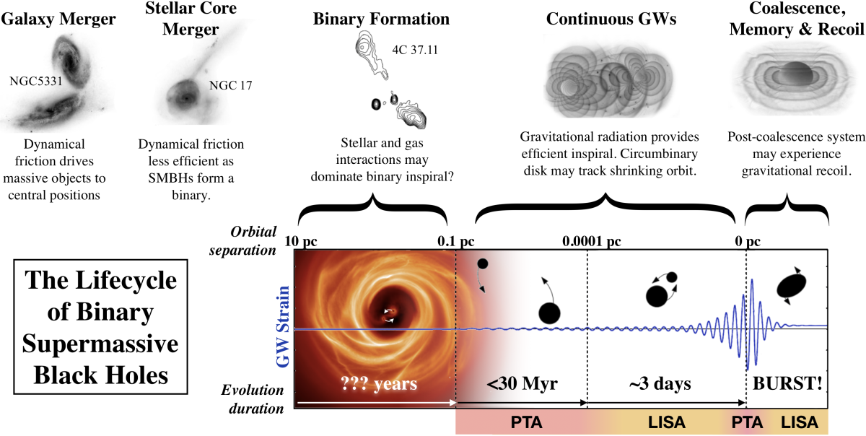
Evolution of SMBHB
Figure by Sarah Burke-Spolaor

Slide 13
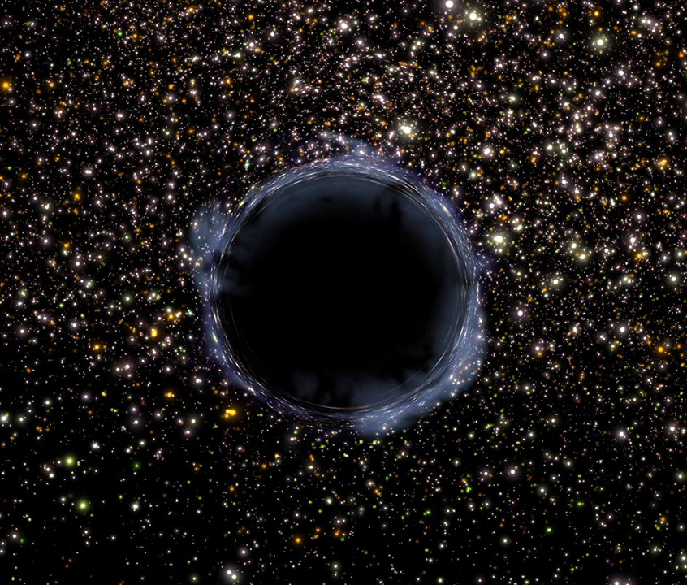
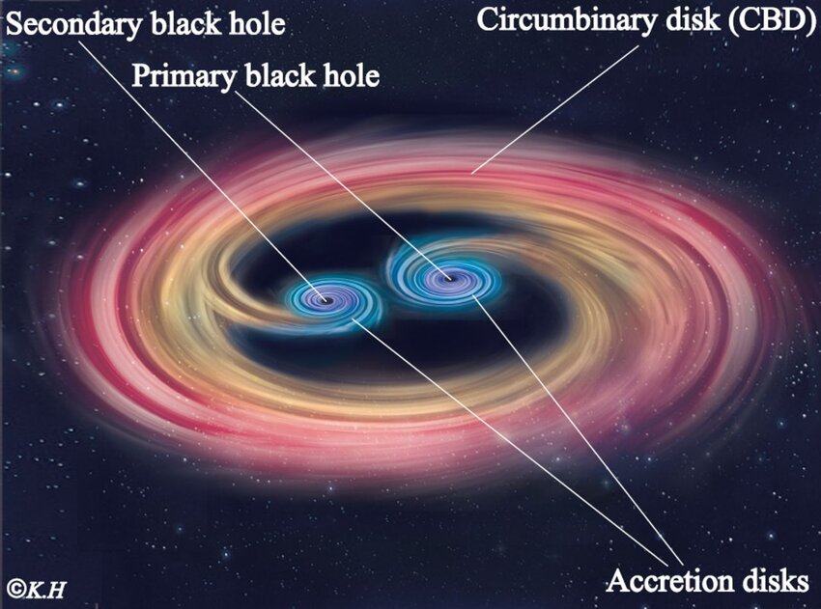
Dry and Wet Mergers
Greg Bacon, STScI
Although GW could bring SMBHB together from LISA frequencies, to get there requires other effects
Dry: collisionless (stars or DM); no loss of energy
Wet: collisional (gas, loss of energy)
Let’s examine these in turn
K. Morimoto

Slide 14
Dry Mergers
Well inside the radius of influence
dynamical friction has given way to individual interactions
Timescale is determined by how long it takes to refill “loss cone”
Post-galactic-merger triaxiality can shorten timescale dramatically
Individual orbits need not conserve angular momentum (Kelly Holley-Bockelmann et al.)
Greg Bacon, STScI

Slide 15
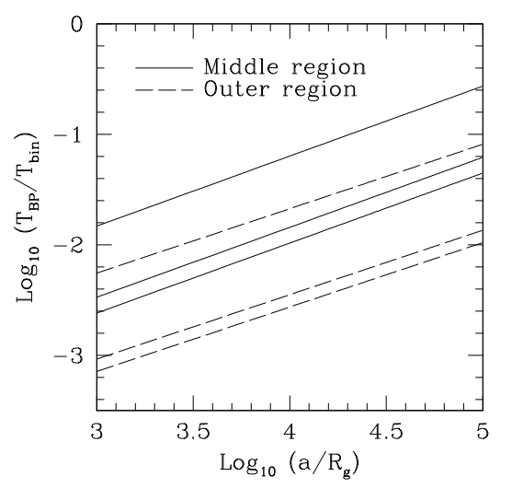
Wet Mergers: Alignment
Galaxy mergers have arbitrary orientation; BH mergers?
Bogdanović+ 2007: indep. alignment from accretion prior to formation of binary (B-P)
Miller+Krolik 2013: alignment of spins with orbit during binary phase (esp. secondary)
Unless q<<1, thus expect aligned spins, low kicks in gas-driven coalescences
Miller+Krolik 2013

Slide 16
SMBHB summary
At <10⁻⁸ Hz, environment (gas, stars) could affect the waveform. But at LISA frequencies, expect no effect at all.
However, we do expect that gas would have aligned spins at lower frequency, and this will persist to LISA frequencies

Slide 17
Effect on EMRIs
Extreme mass ratio inspirals, say 10 M_{sun} BH into 10⁶ M_{sun} BH, in LISA band.
η=μ/M<<1 means a large number of cycles in the LISA band. Thus smaller effects could be seen.
Example: massive perturber at ~0.1 pc (Yunes+ 2011); even gas if disk is geometrically thin (Barausse+ 2014)

Slide 18
Overall summary
Environmental effects (third object, gas) could maybe be detectable in some circumstances if we push parameters to their limits
Unless this has already been done, it seems to me that an important study would be a full-parameter fit to affected waveforms, to see how much of the phase shift can be accommodated by changes in other parameters

