Slide 1

Long term pulse profile variability in millisecond pulsars
MeerKAT Pulsar Timing Array
Bhavnesh Bhat
University of Manchester
Supervisors
Dr. Michael Keith
Prof. Benjamin Stappers

Slide 2
Millisecond Pulsars in PTAs
Millisecond pulsars (MSPs) are recycled pulsars with high spin-frequencies and low spin-down rates.
They are assumed to have highly stable spin period and average profile shape.
The combination of their precise arrival times and apparently low degree of timing noise, makes them good for precision timing experiments such as the search for a gravitational wave background.
However, changes in the profile or spin period of MSPs could lead to unmodelled changes in the pulse arrival time.
Are they so different from the canonical pulsars?

Slide 3
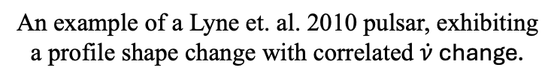
Profile Variation in Canonical pulsars
An example of a Lyne et. al. 2010 pulsar, exhibiting a profile shape change with correlated $\dot{ν}$ change.
Canonical Pulsars are known to exhibit short term variability such as mode-changing and nulling.
There is a sub-population of pulsars that show long term profile variations.
These variation are sometimes correlated with the changes in the spin-down rate as shown by e.g. Lyne et al. 2010, Brook et. al. 2016, Basu et. al. 2022, Lower et. al. 2025,Keith et al. 2025.
These variations in spin-down rate can contribute to red (low-frequency) noise, due to the slow, correlated trends in timing residuals.
More about it in the next talk by Patrick!!
Are there any MSPs showing such changes?
Ref: Keith et. al. 2025

Slide 4
MSPs with known variation
There have been a few MSPs seen to exhibit profile variations.
For example:

Slide 5
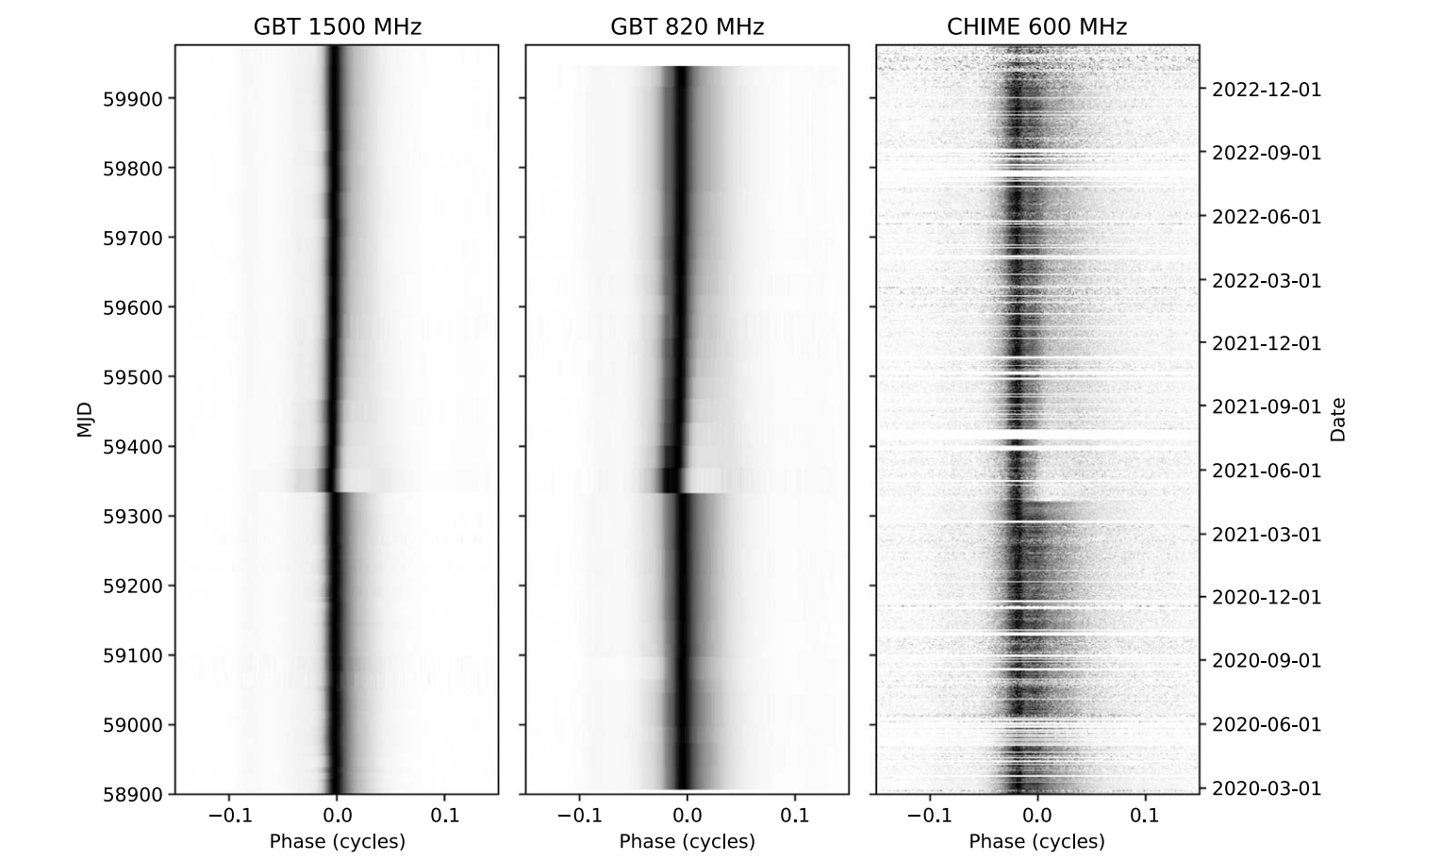
MSPs with known variation
There have been a few MSPs seen to exhibit profile variations.
For example:
J1713+0747 (Singha et. al. 2021, Lin et. al. 2021, Jennings et. al. 2024)
Ref: Jennings et. al. 2024

Slide 6
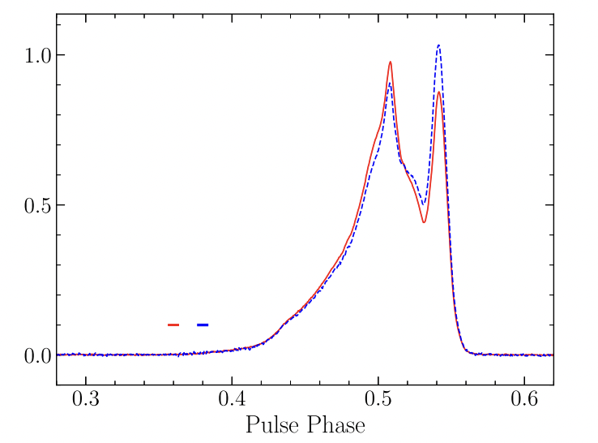
MSPs with known variation
There have been a few MSPs seen to exhibit profile variations.
For example:
J1713+0747 (Singha et. al. 2021, Lin et. al. 2021, Jennings et. al. 2024)
J1022+1001 (Kramer et. al. 1999, Hotan et. al. 2004, Shao et. al. 2017, Fiore et. al. 2020, Padmanabh et. al. 2021, etc.)
Ref: Fiore et. al. 2025

Slide 7
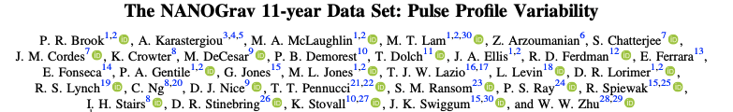
MSPs with known variation
There have been a few MSPs seen to exhibit profile variations.
For example:
J1713+0747 (Singha et. al. 2021, Lin et. al. 2021, Jennings et. al. 2024)
J1022+1001 (Kramer et. al. 1999, Hotan et. al. 2004, Shao et. al. 2017, Fiore et. al. 2020, Padmanabh et. al. 2021, etc.)
Also, a published study exists for the systematic study of MSP profile variations i.e. Brook et. al. 2018.

Slide 8
Why study the Profile Variation in MSPs now?
There has been significant increase in the number of MSPs observed for the Pulsar Timing Array experiment.
And there has been an increase in the data collected for these MSPs.
There is new data from the MeerKAT PTA experiment.

Slide 9
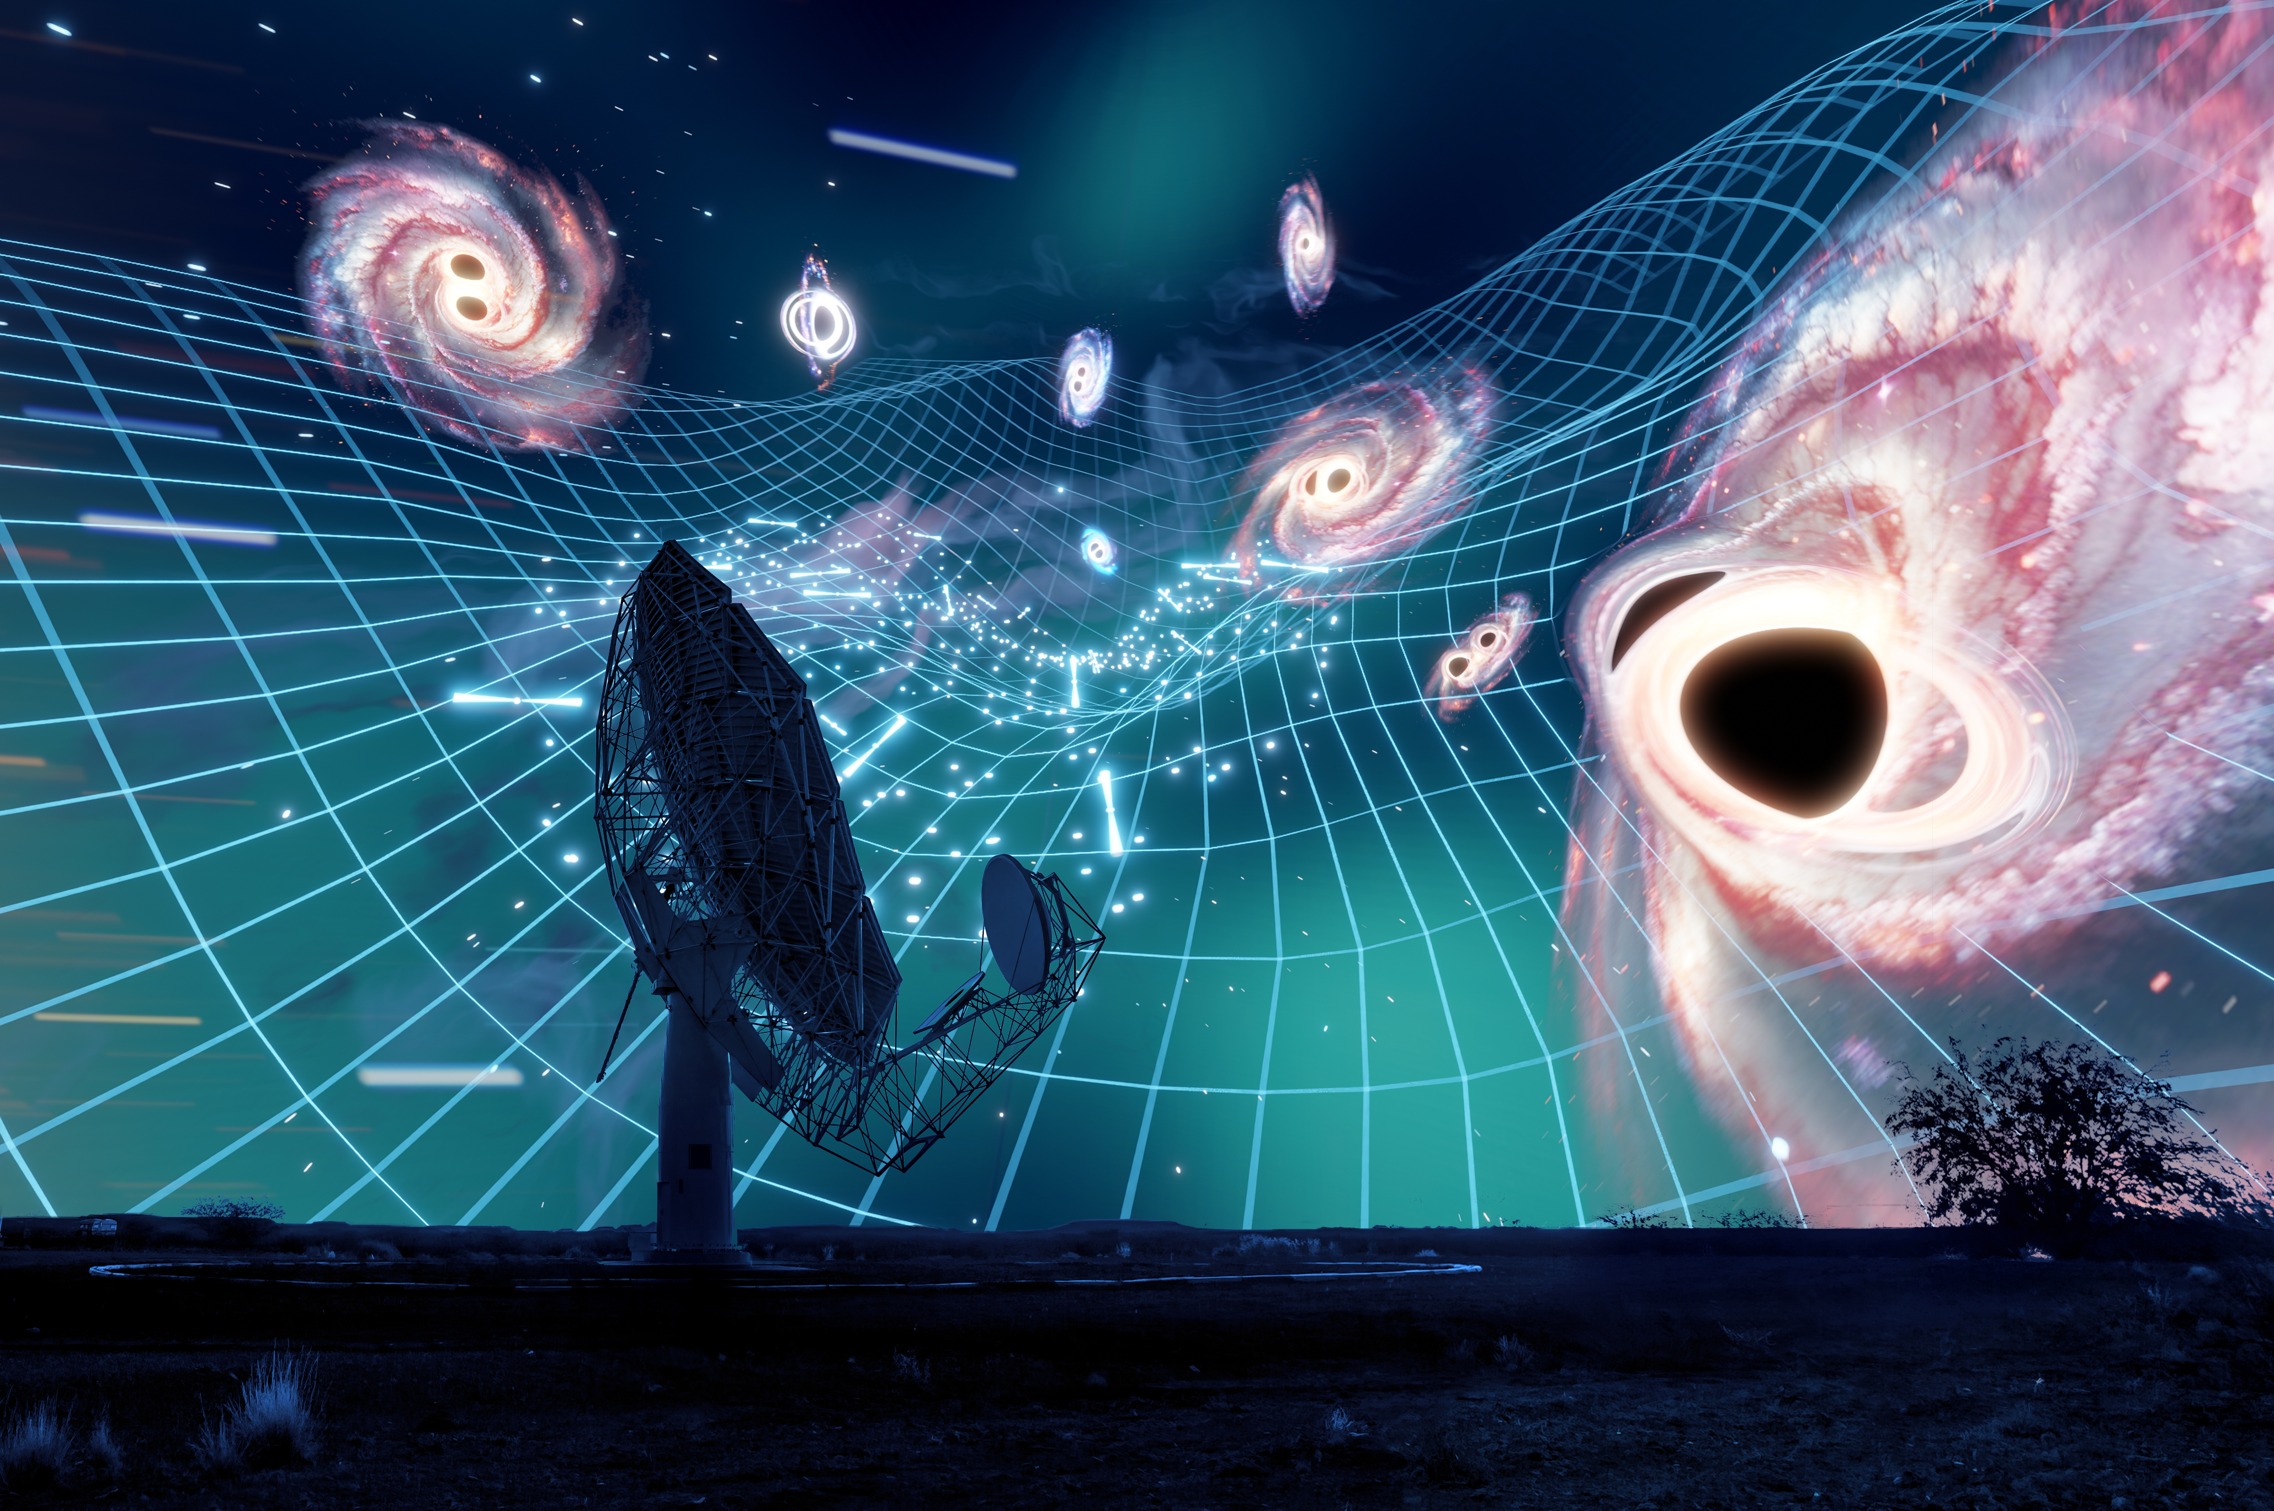
Why is MeerKAT good for observing MSPs
Credit: Carl Knox
Large collecting area
Excellent sensitivity
Observe 83 pulsars on bi-weekly basis for MPTA
Wide bandwidth at L-Band (0.856 – 1.712 GHz)

Slide 10
Why study the Profile Variation in MSPs now?
There has been significant increase in the number of MSPs observed for the Pulsar Timing Array experiment.
And there has been an increase in the data collected for these MSPs.
There is new data from the MeerKAT PTA experiment.
To improve the precision of pulsar timing by incorporating these subtle profile changes into our timing analysis.
New analysis tools: The 2D Gaussian Process based method developed by Keith et al. 2025, offers a powerful way to probe subtle, long-term profile variations.

Slide 11
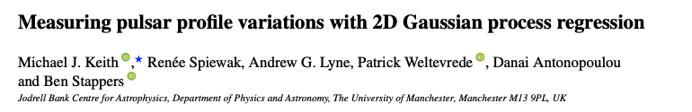
Why study the Profile Variation in MSPs now?
There has been significant increase in the number of MSPs observed for the Pulsar Timing Array experiment.
And there has been an increase in the data collected for these MSPs.
There is new data from the MeerKAT PTA experiment.
To improve the precision of pulsar timing by incorporating these subtle profile changes into our timing analysis.
New analysis tools: The 2D Gaussian Process based method developed by Keith et al. 2025, offers a powerful way to probe subtle, long-term profile variations.

Slide 12
Some examples of Profile Variability in MSPs

Slide 13
J0437-4715
Epoch by Epoch stacking of frequency averaged, aligned observation
Difference of the epoch-by-epoch stack by the weighted average of all the observation
MeerKAT Data at L-Band

Slide 14
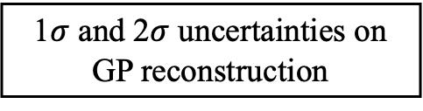
J0437-4715
2-D GP Kernel
Median Profile, Most Variability, 1st Eigen profile from PCA
2D GP Realization of the difference plot using the differential evolution
Principal Component Time Series corresponding to 1st Eigenvalue using PCA
1$σ$ and 2$σ$ uncertainties on GP reconstruction

Slide 15
J0437-4715
Strong profile change event around April 2022
MeerKAT Data at L-Band

Slide 16
J1022+1001
Short timescale variations
MeerKAT Data at L-Band

Slide 17
J1713+0747
One-off event in 5-year MPTA pulsar dataset
As seen also by the other PTA experiments
Very strong variation around MJD 59386.97 or June 2021

Slide 18
J1713+0747
J1547-5709
The second peak gets stronger, but starts to weaken

Slide 19
J1713+0747
J1547-5709
J1017-7156
Interesting Switching Behavior

Slide 20
J1103-5403
Repeated Switching Behavior in MPTA pulsar dataset
Repeated switching

Slide 21
J1103-5403
J0900-3144
Repeating variations

Slide 22
Difficulty in measuring spin-down rate change
In some of the Lyne et al. pulsars, correlated variations with spindown rate are seen.
MSPs have extremely small spin-down rates compared to young pulsars.
Other variations such as DM and scattering introduce uncertainties.

Slide 23
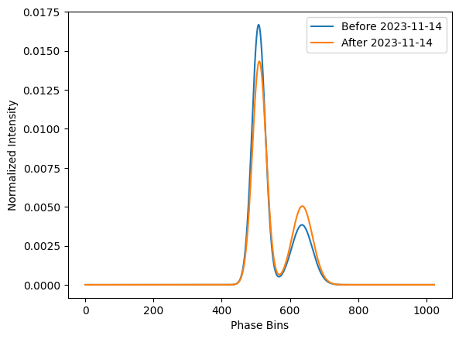
Simulating Archives to see effect on the Timing Residual (very pre-liminary/ needs to be refined)
Using simulator developed by Keith et. al. to simulate archives.
We are using Bayesian fitting to get the Von-mises distribution parameters for the high SNR profile.
We then simulate these profiles using the simulator, with very basic ISM model in a single frequency band (we are planning to. Also include scattering, and other frequency dependent delays in future).
For now, to see the effect on the timing residuals, using template by paas for frequency, polarization scrunched data.

Slide 24
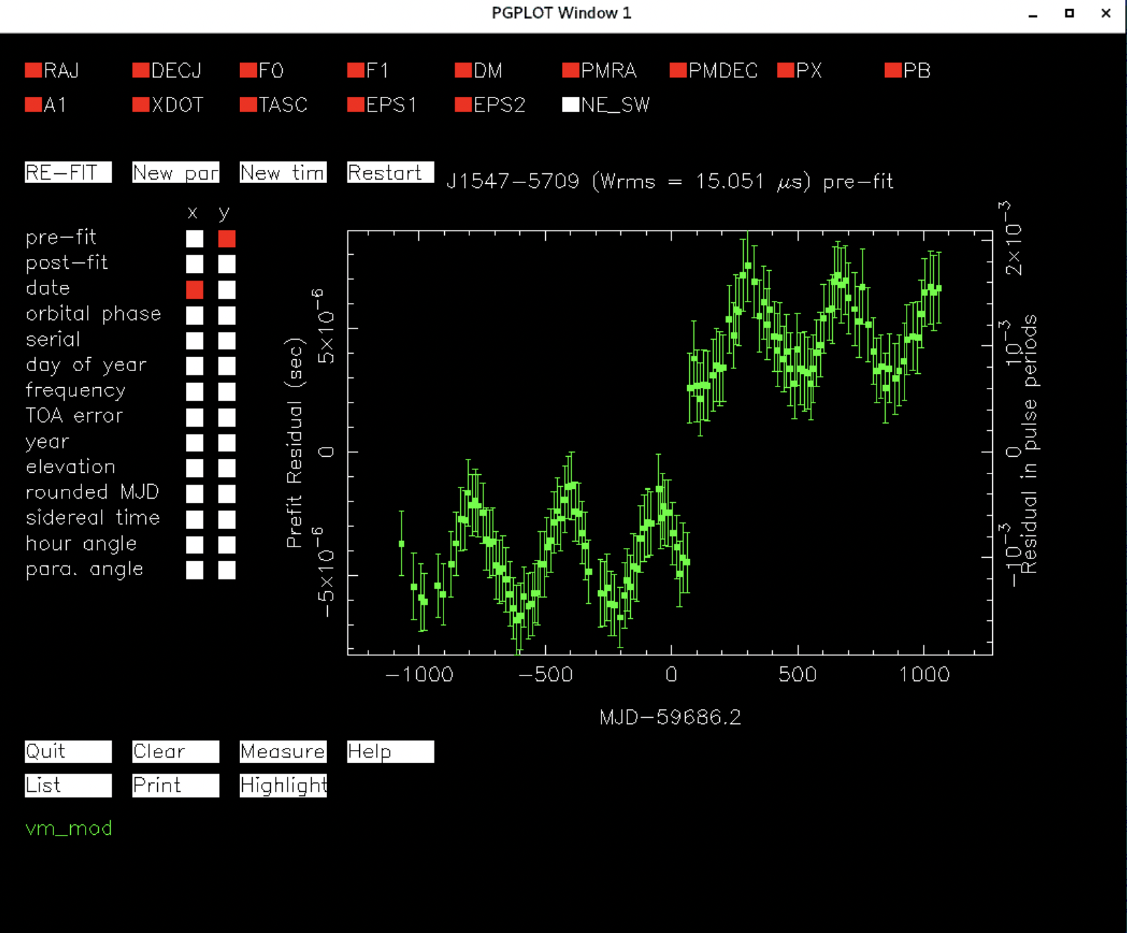
Effect on Timing residuals in TEMPO2
Fitting JUMP between the two epochs to see how much is the variation.

Slide 25
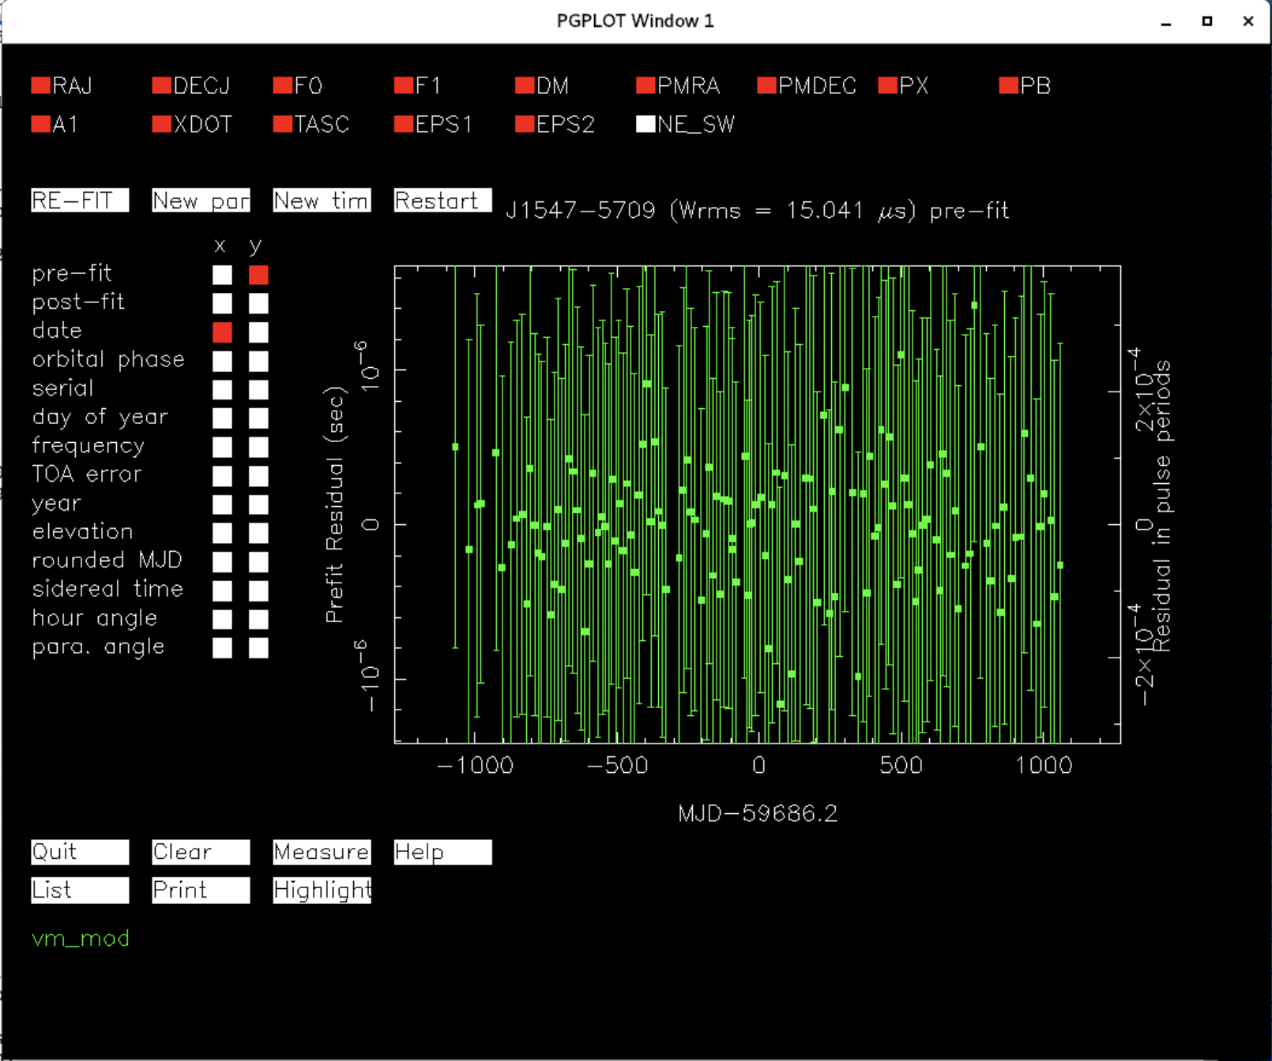
Effect on Timing residuals in TEMPO2
Fitting JUMP between the two epochs to see how much is the variation.
The JUMP fits comes out to be JUMP -fprof vm_mod 8.9572355148071e-06 1
Although, a very pre-liminary work, planning to refine it.
Also, planning to use toasim to simulate nudot variation in the MSP timing residual to look how the length of data and variation are correlated.

Slide 26
Future Work
Perform full polarization analysis to see if the variation are polarization state dependent.
Simulate archives to test how best to measure the spindown rate changes.
And see the influence of pulse shape variations on the timing.
Open to feedback and suggestions, insights are highly welcome.

Slide 27
Conclusion
MSPs exhibit profile variability, like canonical pulsars.
Some MSPs (e.g., J0437−4715, J1547−5709, J1017-7150, J1713+0747) show sudden infrequent events.
Others (e.g., J0900−3144, J1103−5407, J1022+1001) show a kind of repeating behaviour reminiscent of canonical pulsar.
Variations are generally small but can be detected effectively with 2D Gaussian Process modelling (e.g., J1017−7150).
These results suggest that not all MSPs are as profile-stable as assumed.
Thanking Aditya Parthasarathy, Willem van Straten, and Selah Melfor for their insightful discussions and guidance regarding this topic.

Slide 28
Thank You!!
Any questions welcome at bhavnesh.bhat@postgrad.manchester.ac.uk

Slide 29
Backup Slide

Slide 30
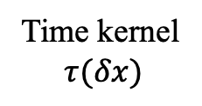
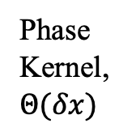
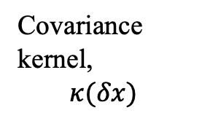
2D Gaussian Process application in this study
Flattening 2D stack of profile pulses into 1D train of pulses (turning this to 1D non-continuous time series).
Taking only data from the on-pulse region.
Getting 2D kernel using outer-product of two 1-D kernel.
The use of Matern-3/2 for time and Gaussian kernel for phase.
Phase Kernel, $Θ(δx)$
Covariance kernel,
$$κ(δx)$$
Time kernel
$$τ(δx)$$

