Slide 1
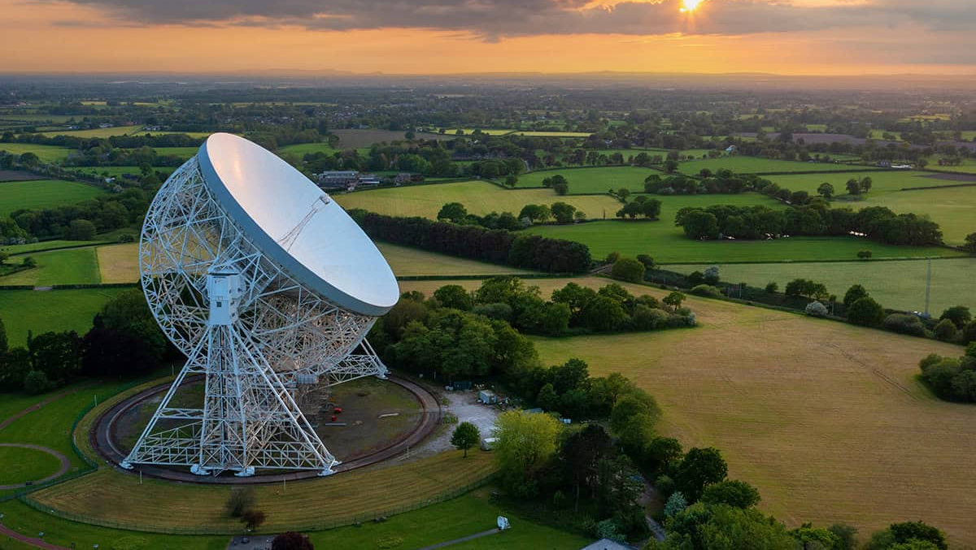
JBO/Manchester Update
Bhavnesh Bhat + Mike Keith

Slide 2
Observatory update.
Any recent upgrades/updates to the instruments and operations?
New Backend update (next slide)
Telescope will be down for extended maintenance again to replace access to the focus (Scaffolding in the dish = no astronomy)
Timeline for the next data release to EPTA
Mike says “I was going to send some data to Aditya, but I got distracted trying to automate the processing pipeline so that it could send the data every week or so”. There is no reason we can’t do it “by hand” though.

Slide 3
New backend update
Hardware and network infrastructure now exists.
Can in theory stream data from any eMerlin telescope to the pulsar backends
New backend is still work in progress due to delays in getting the new samplers working.
Some added complications since this is also an upgrade to e-Merlin so there are some back-and-forth changes to have all required capabilities

Slide 4
Group update
Active PTA Group members and their interests
Michael Keith – Pulsar Noise, General Timing, Modelling.
Ben Stappers – Pulsars in general.
Bhavnesh Bhat – PhD student. Timing, profile changes, …
Mitch Mickaliger – Observing support; Sotiris Sanidas – Scientific computing support
(+ a large group doing other pulsar/binary/exoplanet/FRB science)
Ongoing short-author and EPTA projects / Plans for the near future
Mike + Bhavnesh: Thinking about profile variation of MSPs. (see other talk)
Probably a MPTA paper because the data is so much nicer. Maybe we can apply this to EPTA too later though.
Polarisation calibration?
(applying and extending Patrick Weltevrede’s codes)
Glitch paper accepted in MNRAS.

Slide 5
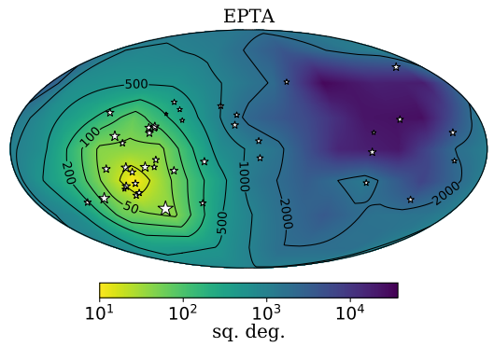
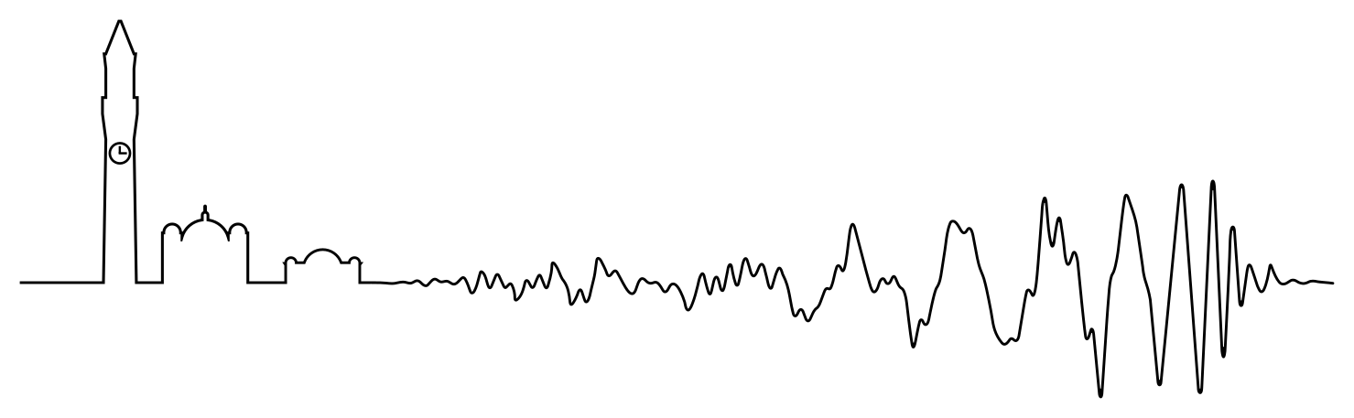

Ongoing PTA work at the University of Birmingham
Analysis of inflationary parameters using EPTA DR2new
Work by new PhD student Philippe Turgeon in collaboration with University of Geneva’s Chiara Caprini, Martin Kunz and Anton Chudaykin, with the help of Delphine Perrodin.
Philippe Turgeon <pxt561@student.bham.ac.uk>
Nullstream Analysis - A technique for detecting
continuous waves
Building on work of ex-Birmingham grad. Student
Janna Goldstein et al.
Paul Brook <p.brook@bham.ac.uk>
Goldstein et al. 2017
Fast Bayesian searches for continuous waves Extending QuickCW [1] and FurgeHullam [2] packages to include HD correlations, eccentric binaries, multiple binaries, coherence test, data scrambling, etc.
Bence Bécsy <b.becsy@bham.ac.uk>
[1] https://github.com/nanograv/QuickCW ; [2] https://github.com/bencebecsy/FurgeHullam
EPTA Update

