Slide 1
Advice for women PhD candidates and beyond
M.G. Veldhuizen
The John B. Pierce Laboratory
Yale University School of Medicine
Women in Olfactory Science
Trieste Oct 6 2017

Slide 2
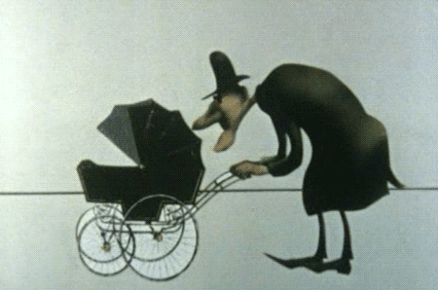
And now for something completely different….
science

Slide 3
Dichotomy of the senses
virtuous
science
analytical
noble
sensual
touch
male
near brain
distracting
distal
taste
primitive
virtues
animalistic
reasoning
impulses
female
smell
vices
urges

Slide 4
What you may hear… (from men particularly)
That is such a difficult subject
But you’re so young
Isn’t that too late now?
Be stubborn! Don’t give up and show ‘em!

Slide 6
Find (many) mentors
Women and men
Different background (science, teaching, industry)
Different career stages
Think of peers or junior people too
Buddy accountability – 1 month, 3 months, 1 year, 5 year goals
Make yourself available as a mentor too

Slide 7
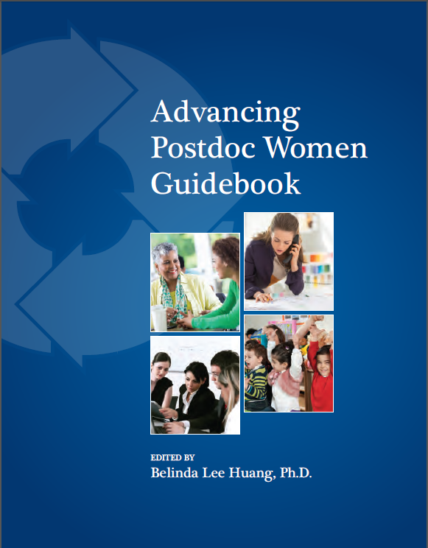
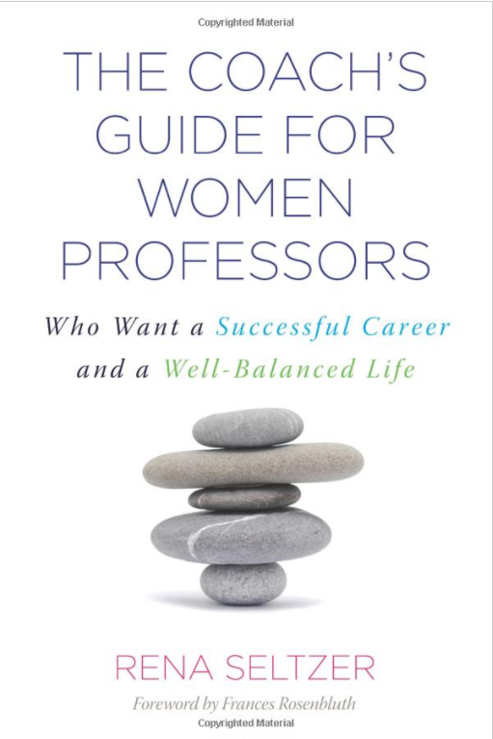
How to stay in science…

Slide 8
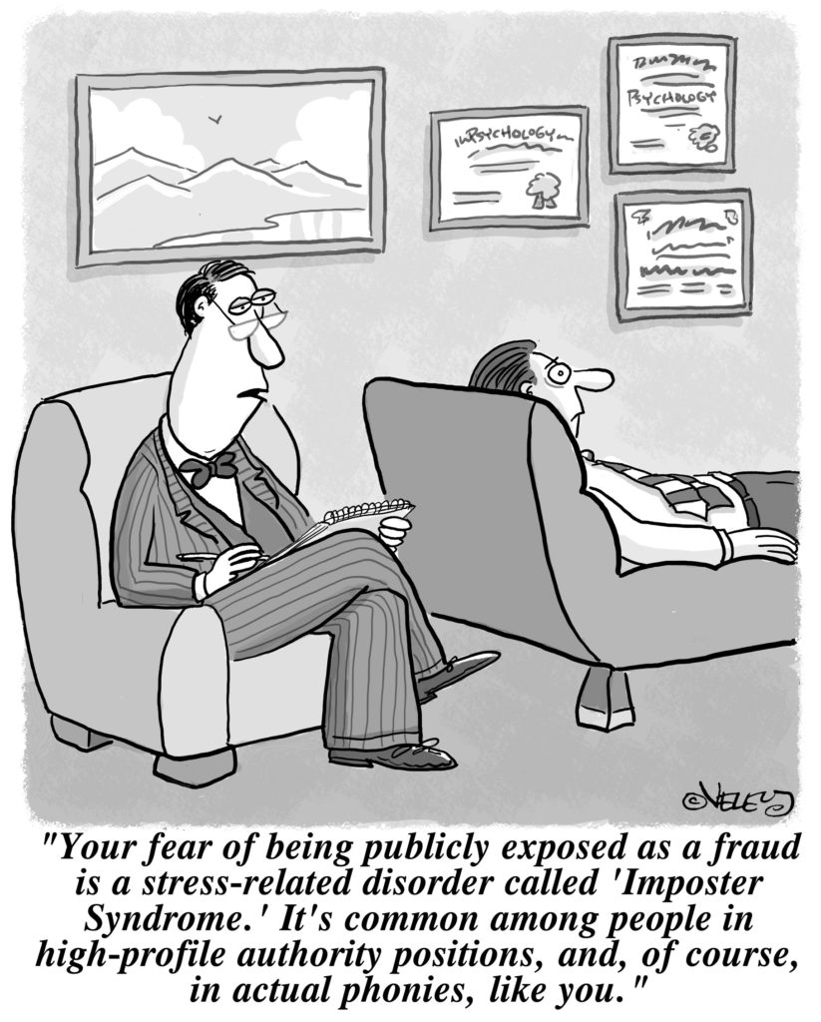
Be aware of insidious self-perception

