Slide 1


Impact of sky localization uncertainty on ringdown inference
Kallol Dey
Collaborators: Enrico Barausse, Marco Crisostomi and Roberto Trotta
arXiv:2605.18595

Slide 2
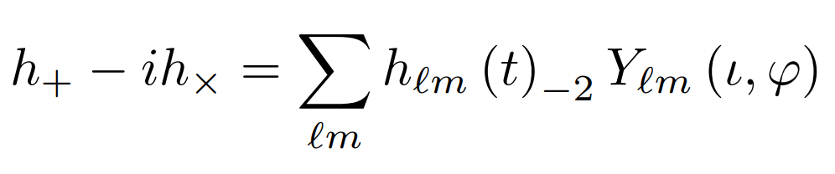
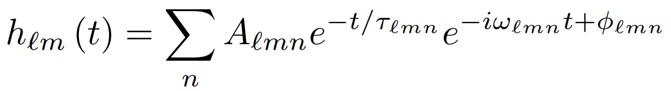
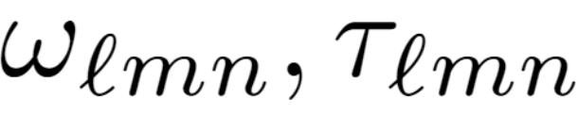
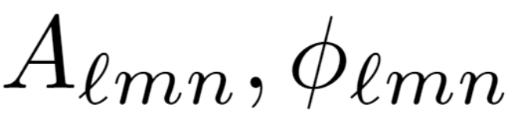
Ringdown
Last stage of BBH merger
Damped sinusoids
Spacetime geometry
Initial conditions

Slide 3
Ringdown
Kerr BH ringdown frequencies depend on only the remnant mass and spin
For other geometries these may depend on extra parameters
Posterior distribution of these parameters can test the validity of Kerr solution at a given confidence level
Simple model. Great for testing gravity!
Maximiliano Isi et al., Phys. Rev. Lett. 123, 111102 (2019)

Slide 4
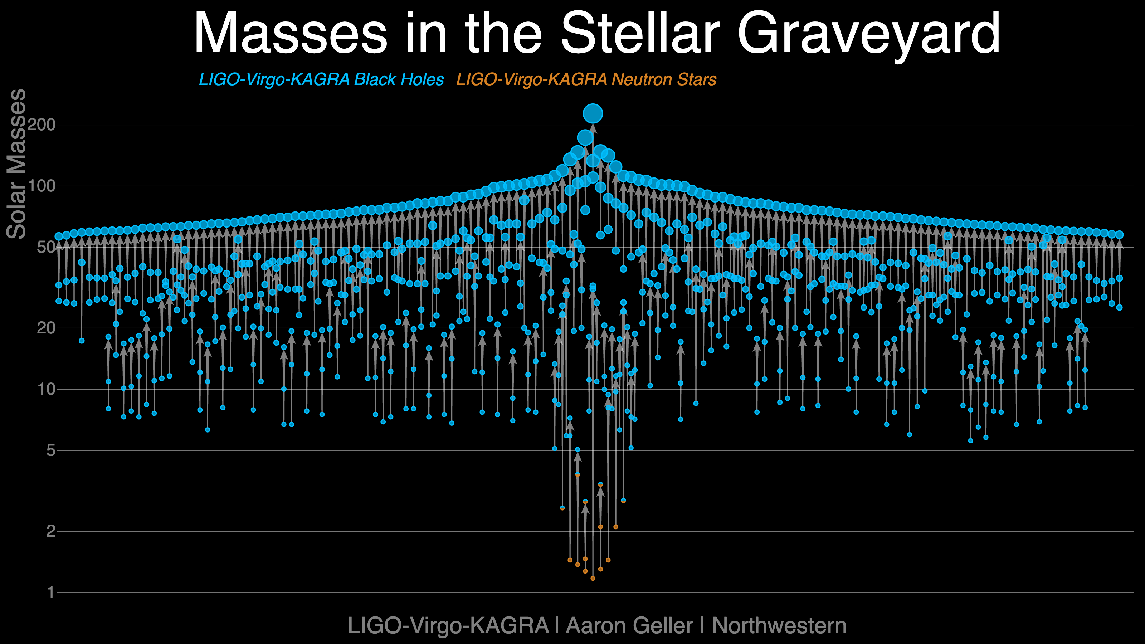

Slide 5
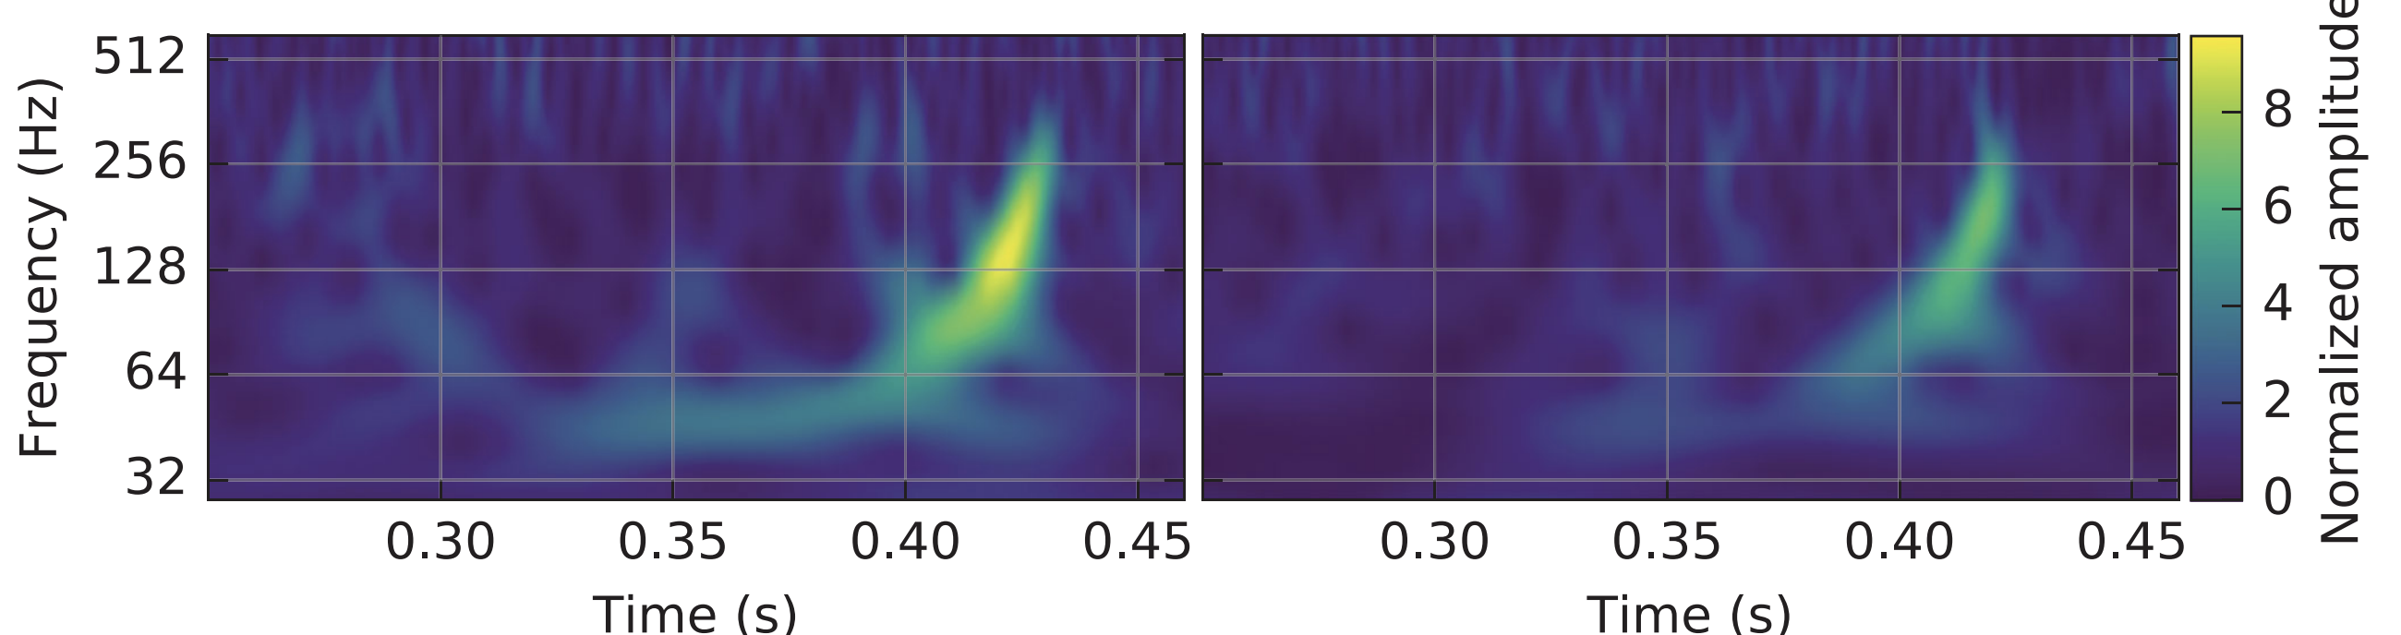
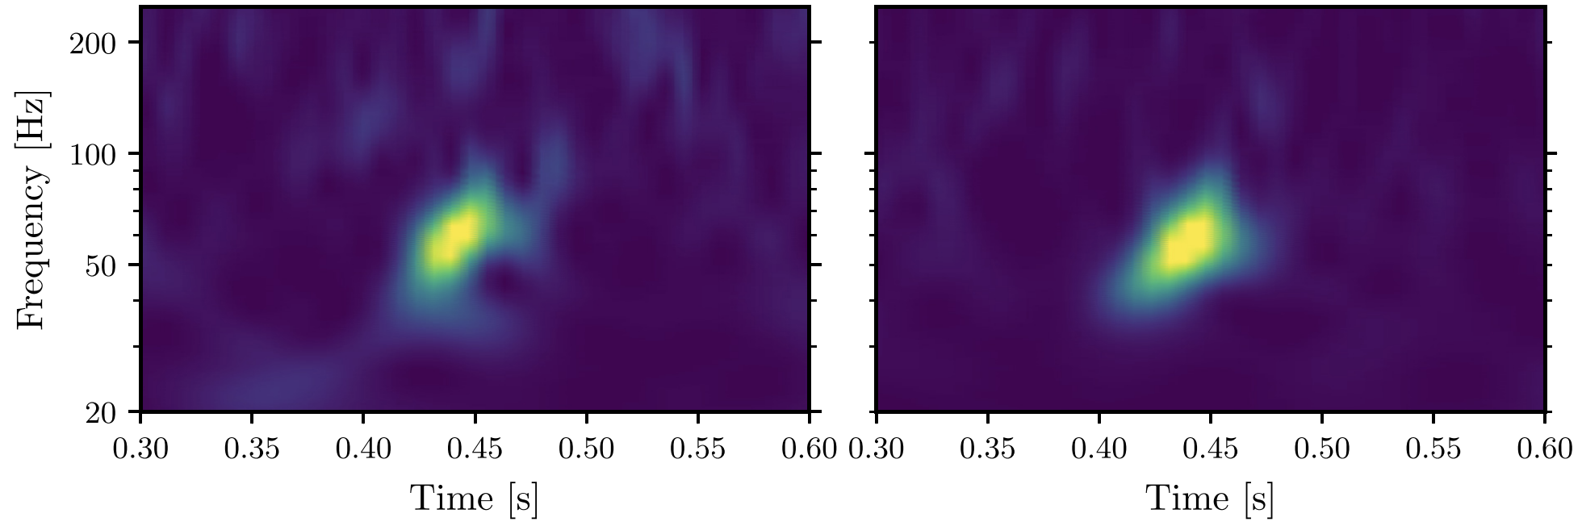
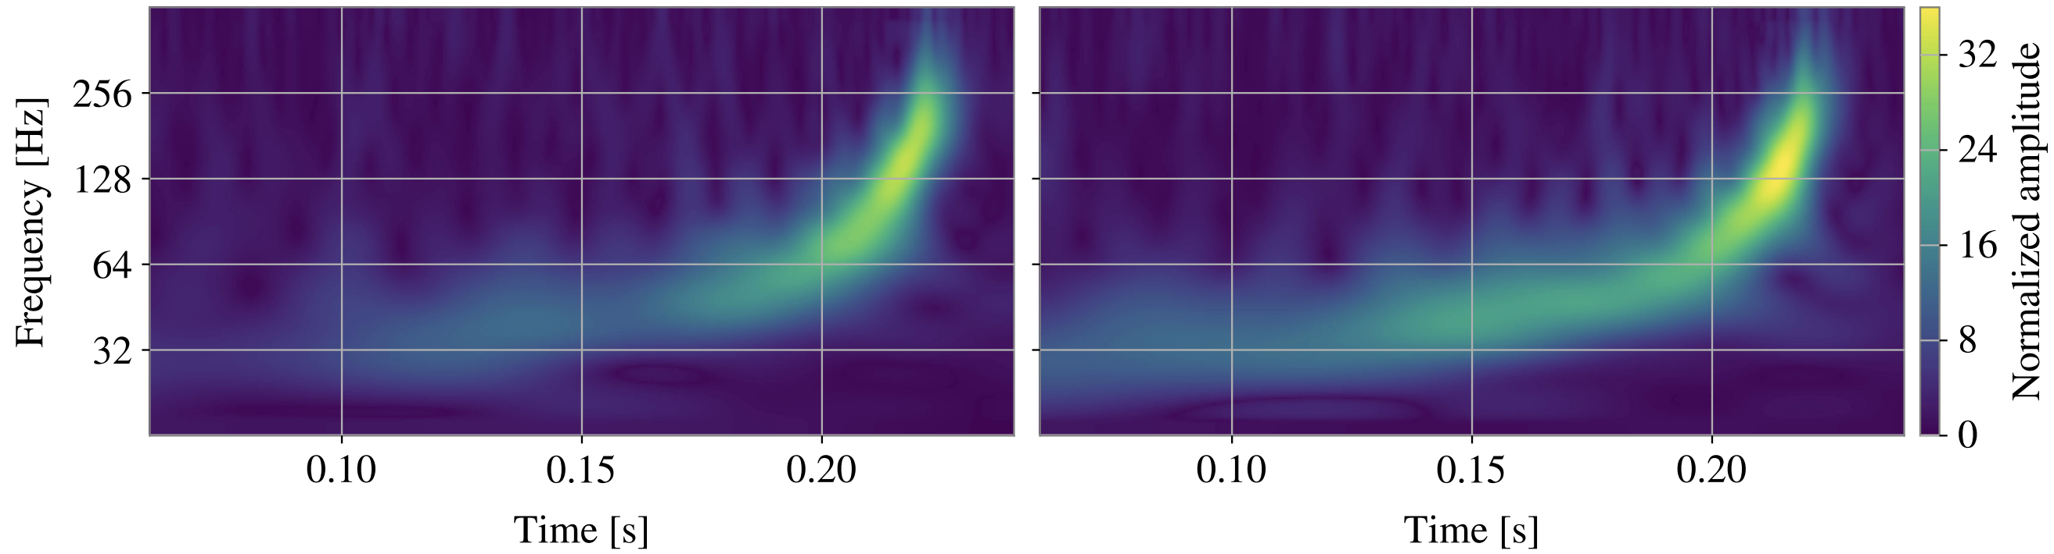
Notable events so far…
GW150914^{[1]}
GW190521^{[2]}
GW250114^{[3]}
[1] Abbott et al. arXiv:1602.03837
[2] Abbott et al. arXiv:2009.01075
[3] Abac at al. arXiv:2509.08054

Slide 6
Notable events so far…
GW150914 - 220+221^{[1]} modes
GW190521 - 220+330^{[2]} modes
GW250114 - 220+221 (+440^{[3]}) modes
Surprisingly few events, especially before O4.
Not enough post-merger SNR to detect multiple modes
Subdominant mode amplitudes are much smaller than the dominant
[1] Isi et al. arXiv:1905.00869
[2] Capano et al. arXiv:2105.05238
[3] Abac et al. arXiv:2509.08099

Slide 7
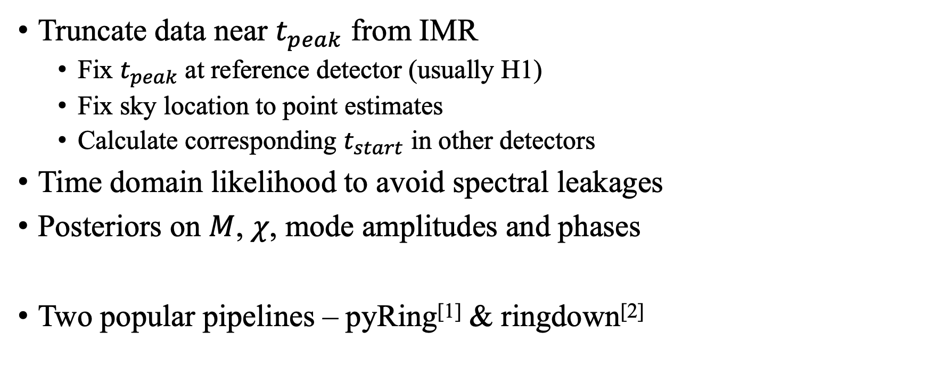
Usual analysis methodology
Truncate data near $t_{peak}$ from IMR
  Fix $t_{peak}$ at reference detector (usually H1)
  Fix sky location to point estimates
  Calculate corresponding $t_{start}$ in other detectors
Time domain likelihood to avoid spectral leakages
Posteriors on $M$, $χ$, mode amplitudes and phases
Two popular pipelines – pyRing^{[1]} & ringdown^{[2]}
[1] https://git.ligo.org/lscsoft/pyring
[2] https://github.com/maxisi/ringdown

Slide 8
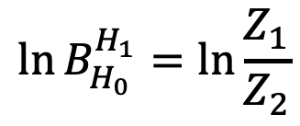
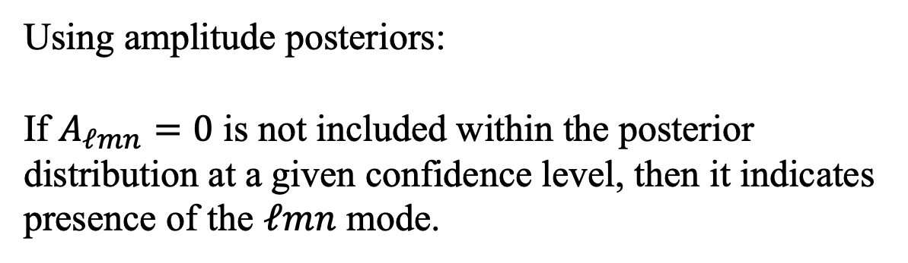
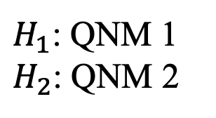
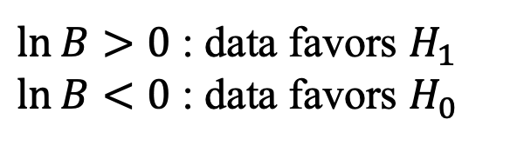

Two ways to determine the presence of modes:
Using Bayes factor:
$H_{1}$: QNM 1
$H_{2}$: QNM 2
$$\ln{B_{H_{0}}^{H_{1}}=\ln{\frac{Z_{1}}{Z_{2}}}}$$
$$Z_{i}=p(d|H_{i})$$
$\ln{B}>0$ : data favors $H_{1}$
$\ln{B}<0$ : data favors $H_{0}$
Using amplitude posteriors:
If $A_{ℓmn}=0$ is not included within the posterior distribution at a given confidence level, then it indicates presence of the $ℓmn$ mode.

Slide 9
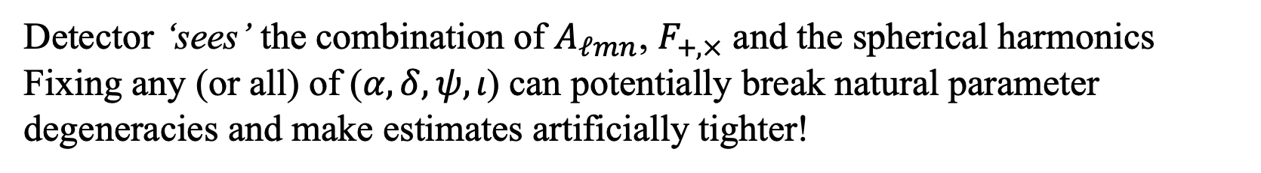
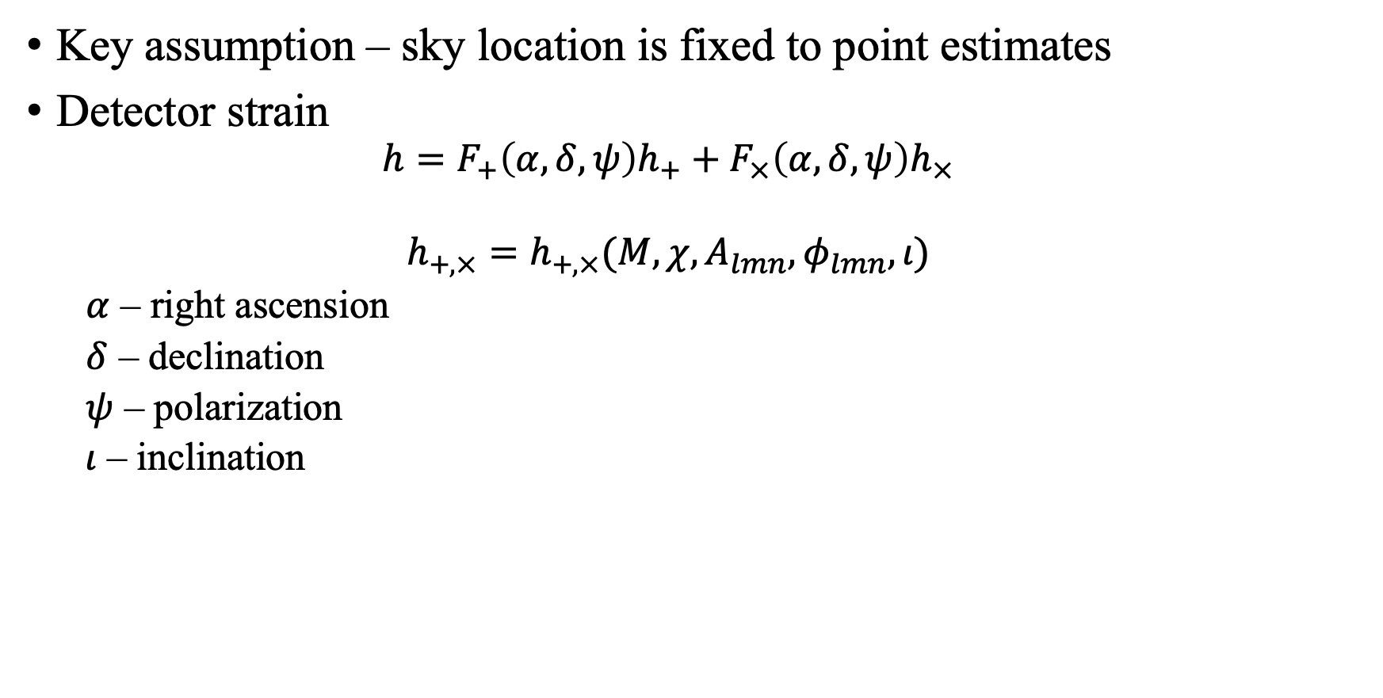
Key assumption – sky location is fixed to point estimates
Detector strain
  $$h=F_{+}{\left(α,δ,ψ\right)h}_{+}+F_{×}\left(α,δ,ψ\right)h_{×}$$
  $$h_{+,×}=h_{+,×}(M,χ,A_{lmn},φ_{lmn},ι)$$
  $α$ – right ascension
  $δ$ – declination
  $ψ$ – polarization
  $ι$ – inclination
Detector ‘sees’ the combination of $A_{ℓmn}$, $F_{+,×}$ and the spherical harmonics
Fixing any (or all) of ($α,δ,ψ,ι$) can potentially break natural parameter degeneracies and make estimates artificially tighter!

Slide 10
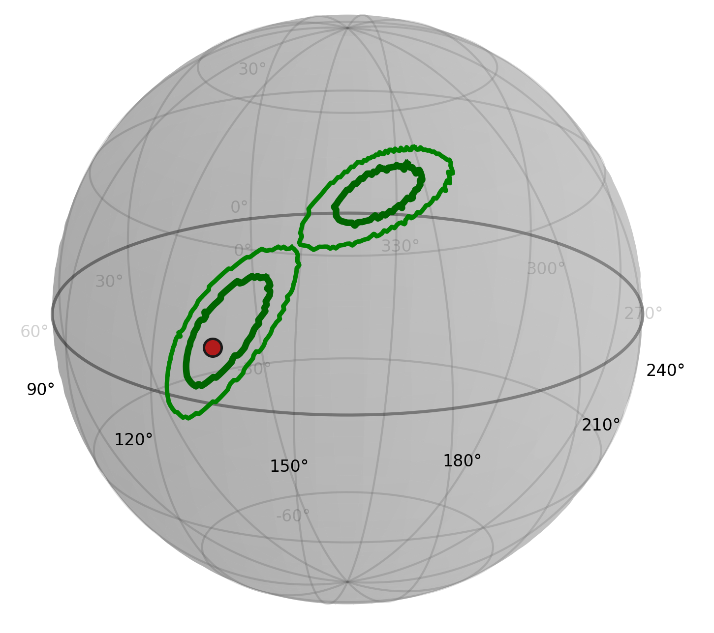
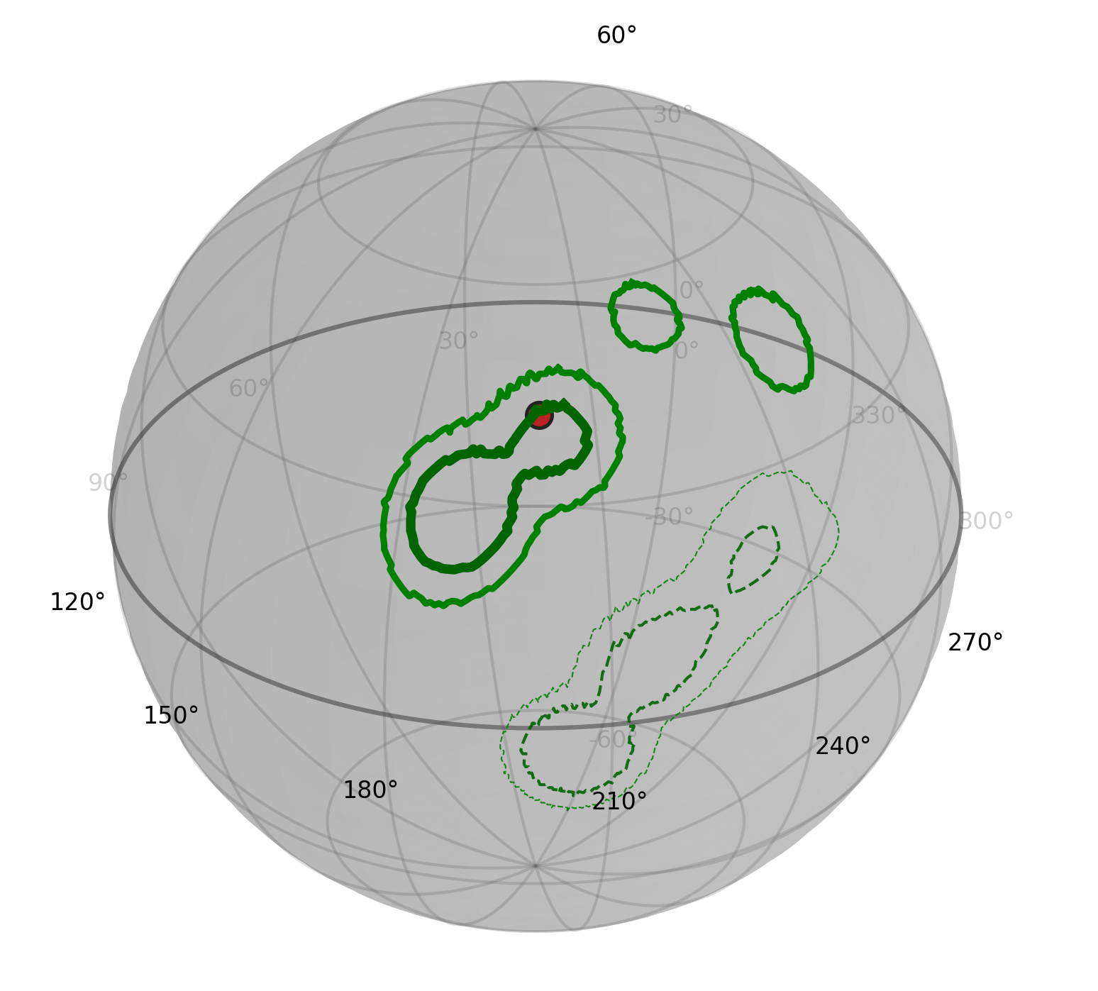
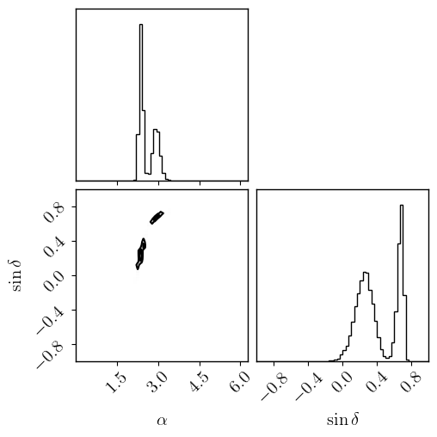
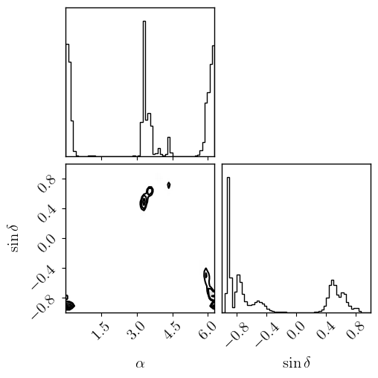
Problems in fixing sky location
GW250114
GW190521
Events with multimodal IMR sky posteriors can lead to ambiguities

Slide 11
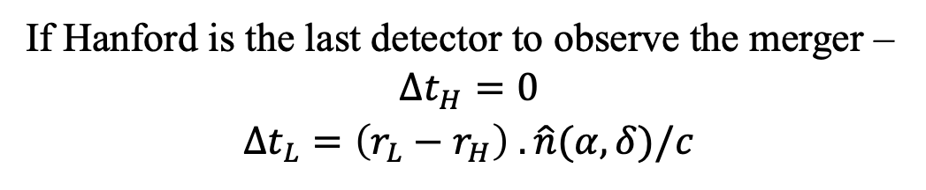
Including sky location …
$Δt_{I}$ - arrival time delay relative to the last-observing detector
If Hanford is the last detector to observe the merger –
$$Δt_{H}=0$$
$$Δt_{L}=\left(r_{L}−r_{H}\right) . \hat{n}(α,δ)/c$$
Sky location can now be fed as a parameter to the template and sampled
We call this FULL-SKY

Slide 12

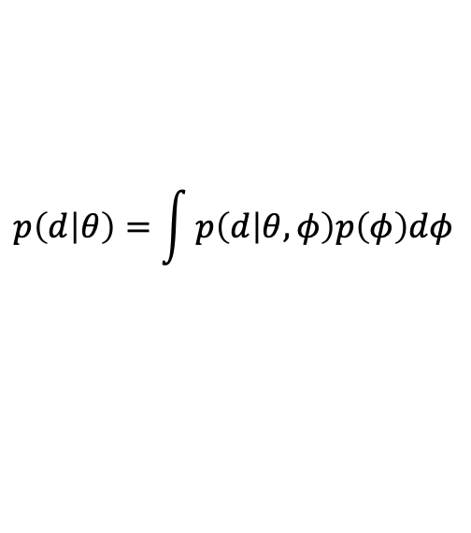
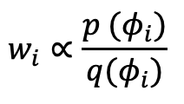
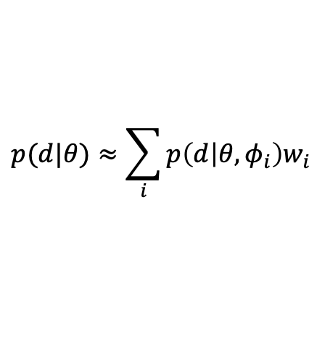

Including sky location …
Another alternative: Marginalize over IMR sky posteriors
$$p\left(d | θ\right)=\int{p\left(d | θ,φ\right)p\left(φ\right)dφ}$$
$$φ=(α,δ)$$
Can only be used when most of the sky constraints are from inspiral-merger.
$$φ_{i}\sim q\left(φ\right)=p_{IMR}(φ|d_{IMR})$$
$$p(d|θ)≈\sum_{i}{p\left(d | θ,φ_{i}\right)w_{i}}$$
$$w_{i}∝\frac{p (φ_{i})}{q(φ_{i})}$$
We call this INFORMED-SKY
Essentially, we marginalize over sky location using IMR posterior samples as quadrature points

Slide 13
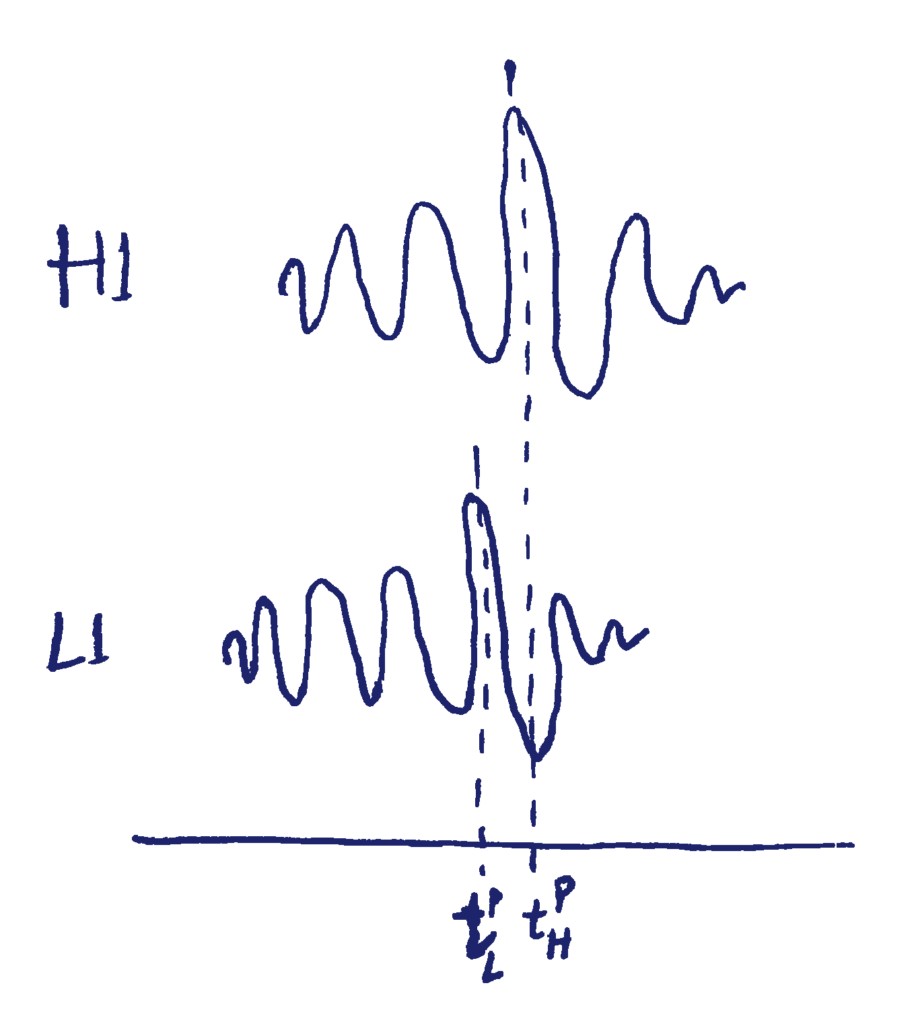
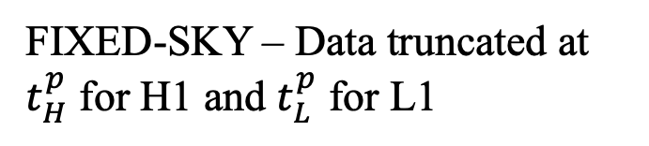
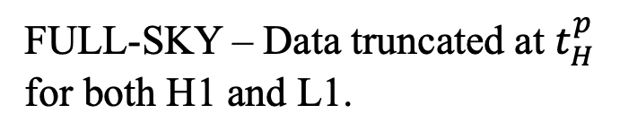
Caveat
Lose a bit of the early ringdown signal
FIXED-SKY – Data truncated at $t_{H}^{p}$ for H1 and $t_{L}^{p}$ for L1
FULL-SKY – Data truncated at $t_{H}^{p}$ for both H1 and L1.
INFORMED-SKY – Uses the same data as FULL-SKY.

Slide 14
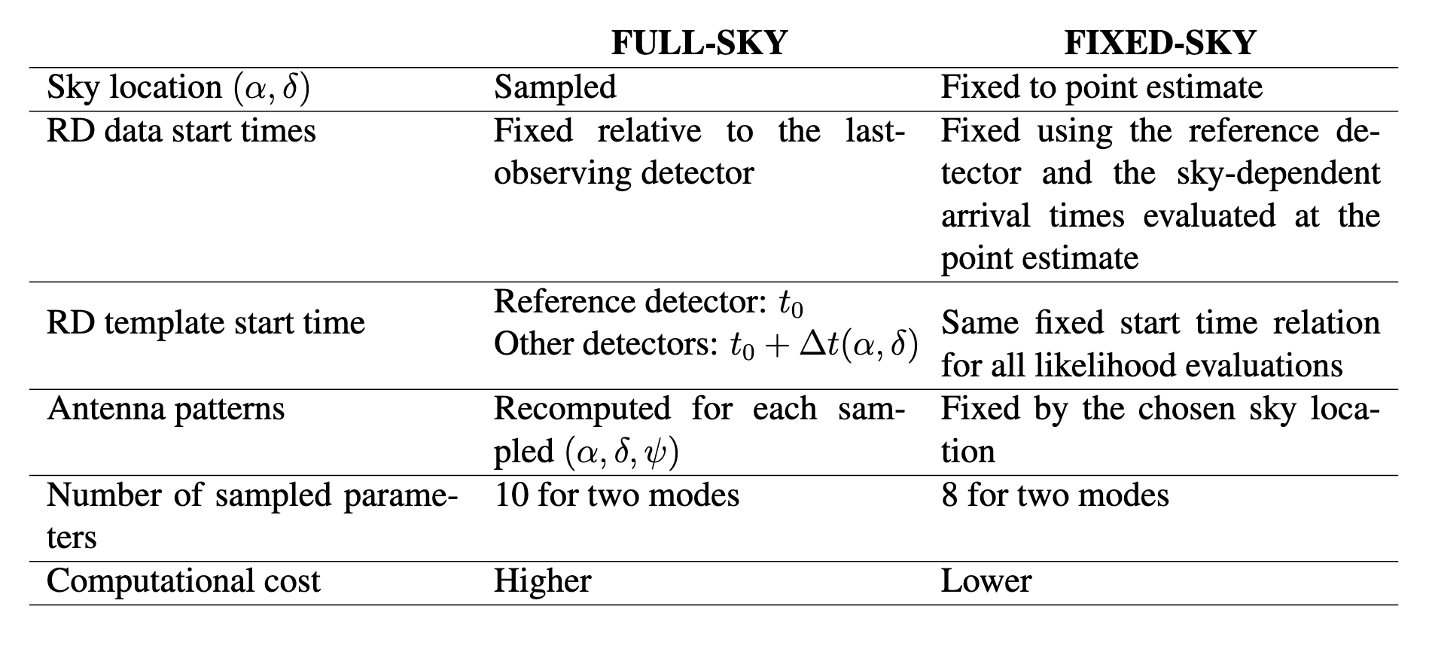
Including the sky location …

Slide 15
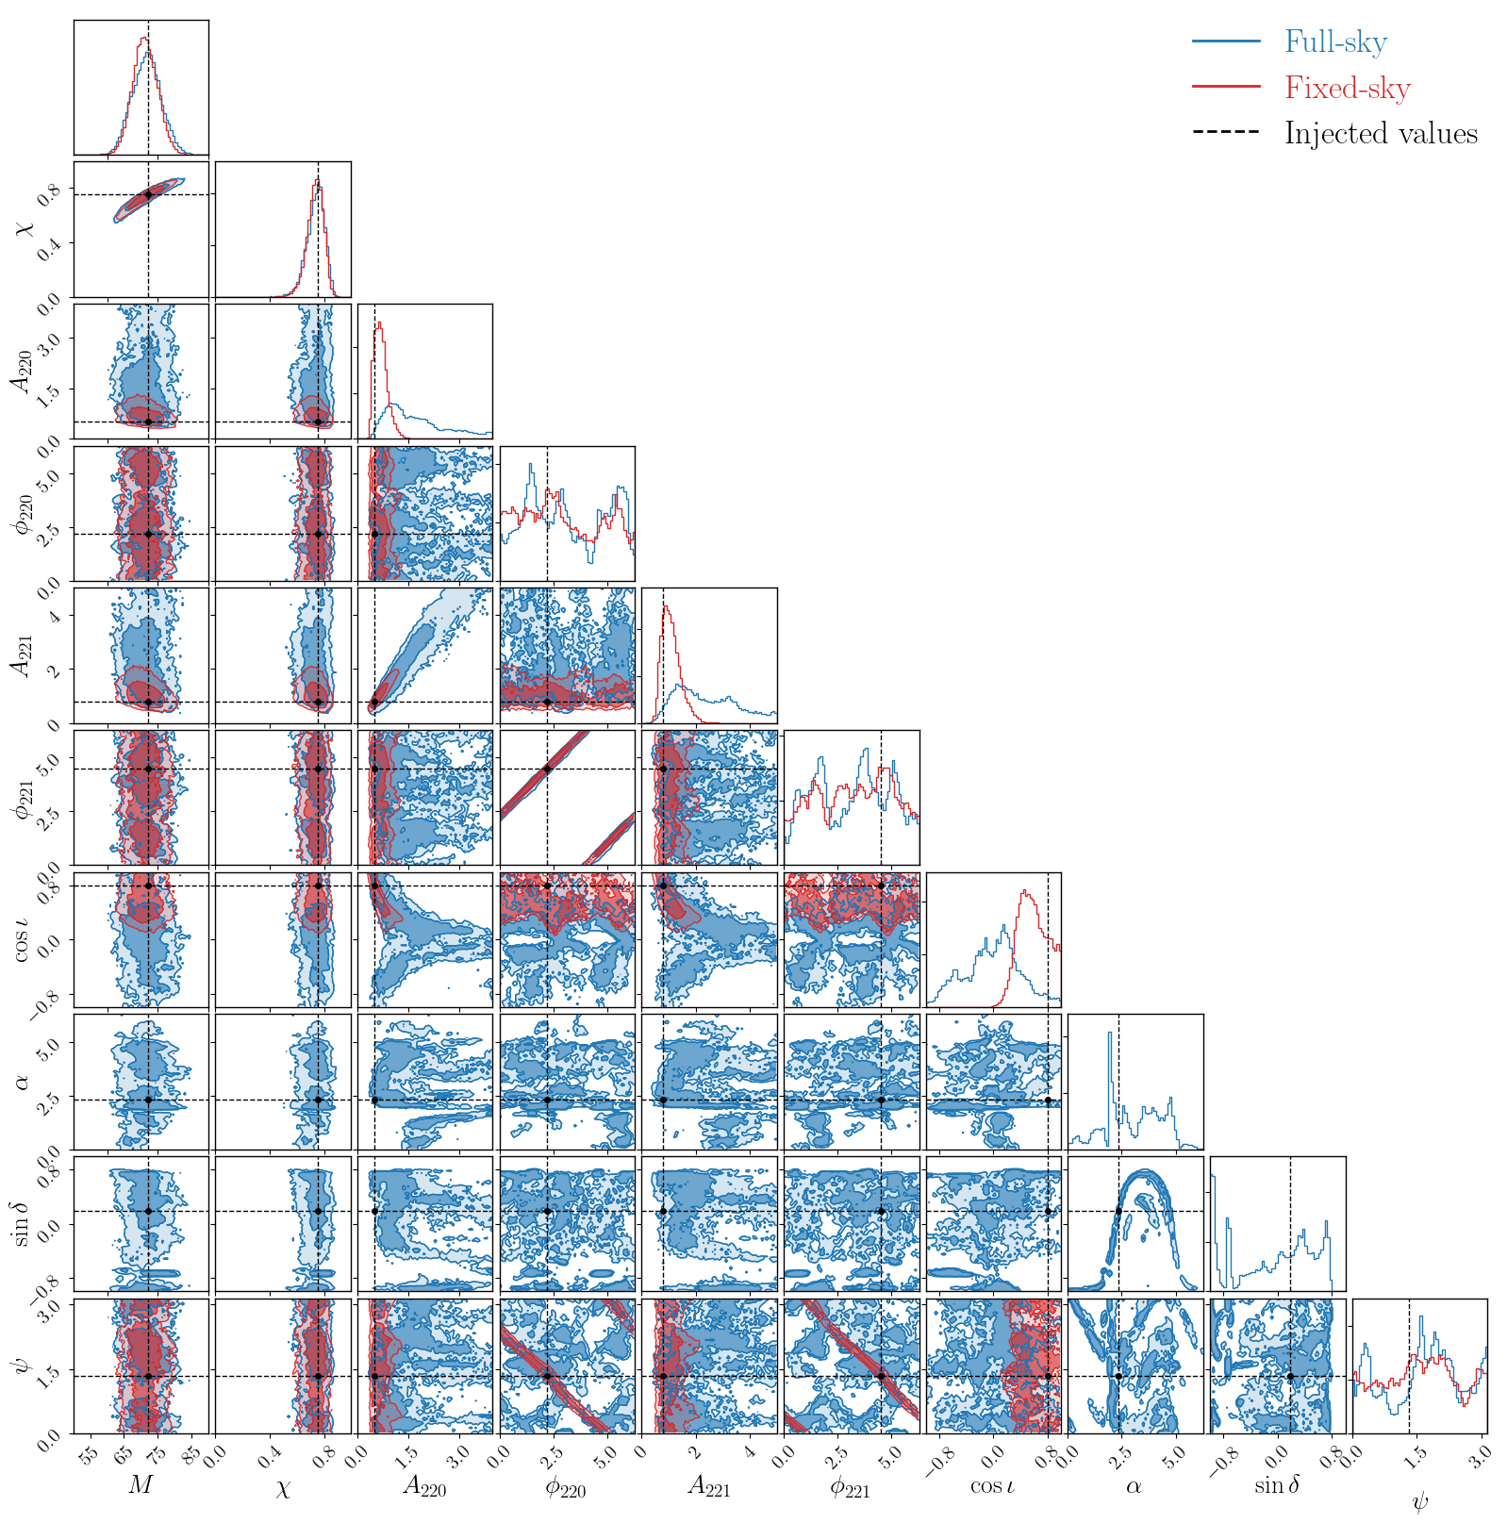
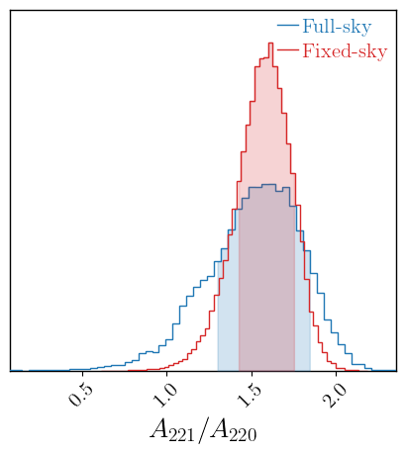
Simulation tests
(220)+(221) injection

Slide 16
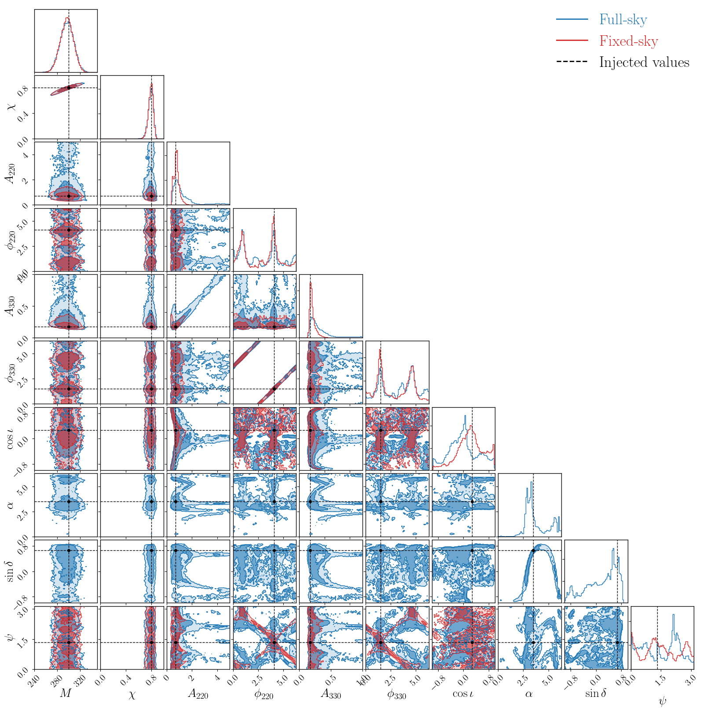
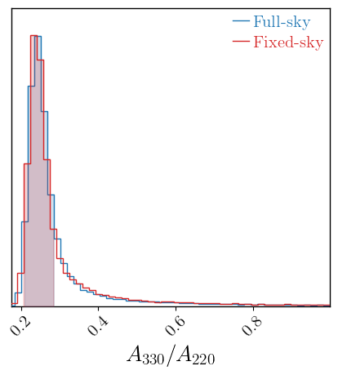
Simulation tests
(220)+(330) injection

Slide 17
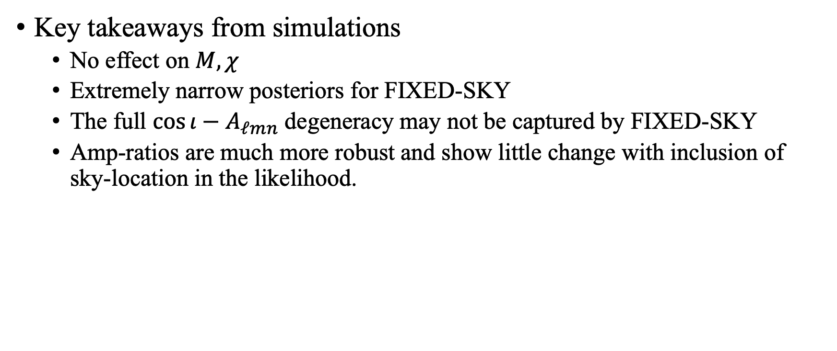
Key takeaways from simulations
  No effect on $M,χ$
  Extremely narrow posteriors for FIXED-SKY
  The full $\cos{ι}−A_{ℓmn}$ degeneracy may not be captured by FIXED-SKY
  Amp-ratios are much more robust and show little change with inclusion of sky-location in the likelihood.

Slide 18
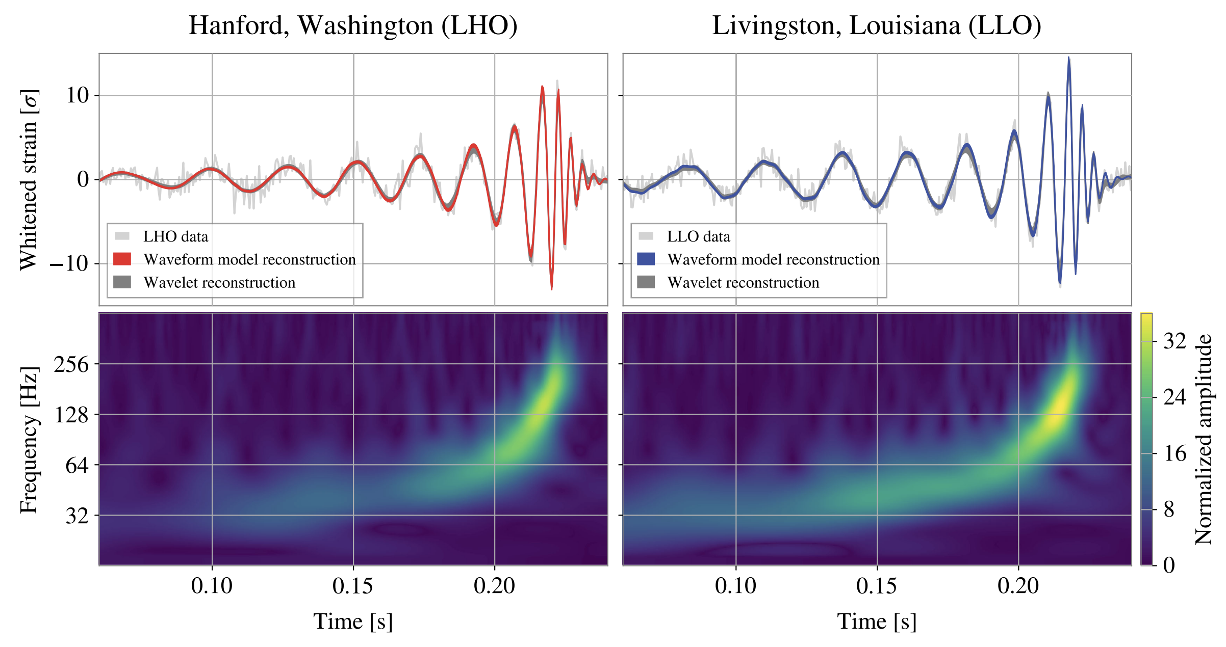
GW250114
Very similar to GW150914, but with better LIGO sensitivity
Loudest event till date.
At least two modes – (220)+(221)
Possible (440) modes as well
Precision black hole spectroscopy with no ambiguity

Slide 19
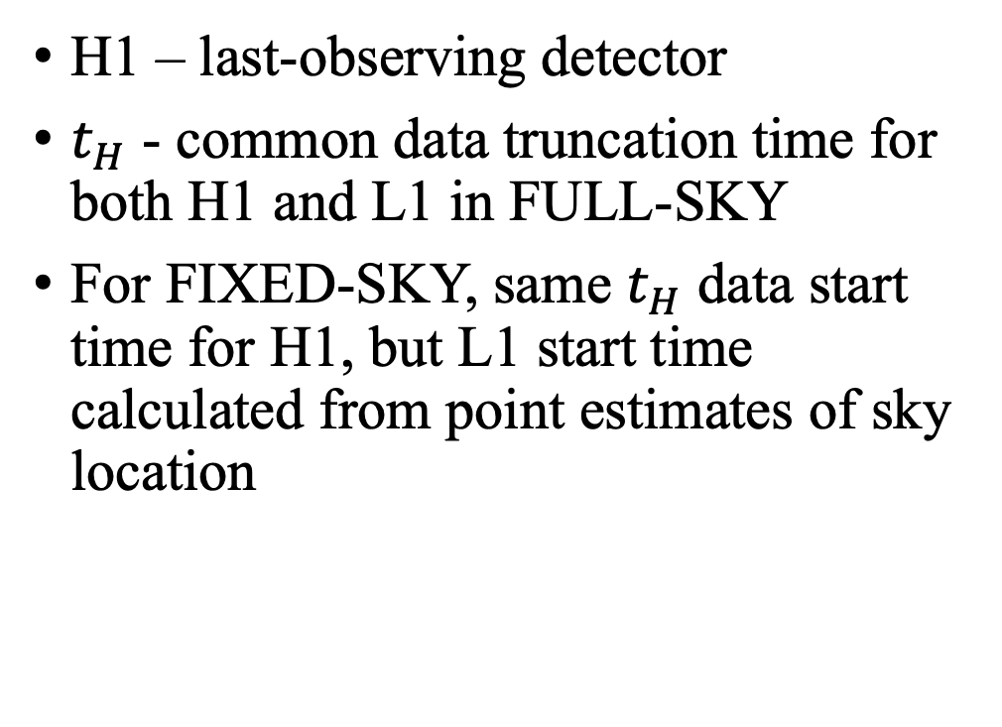

GW250114
H1 – last-observing detector
$t_{H}$ - common data truncation time for both H1 and L1 in FULL-SKY
For FIXED-SKY, same $t_{H}$ data start time for H1, but L1 start time calculated from point estimates of sky location
$$t_{H}=t_{H}^{p}+6t_{M}$$

Slide 20
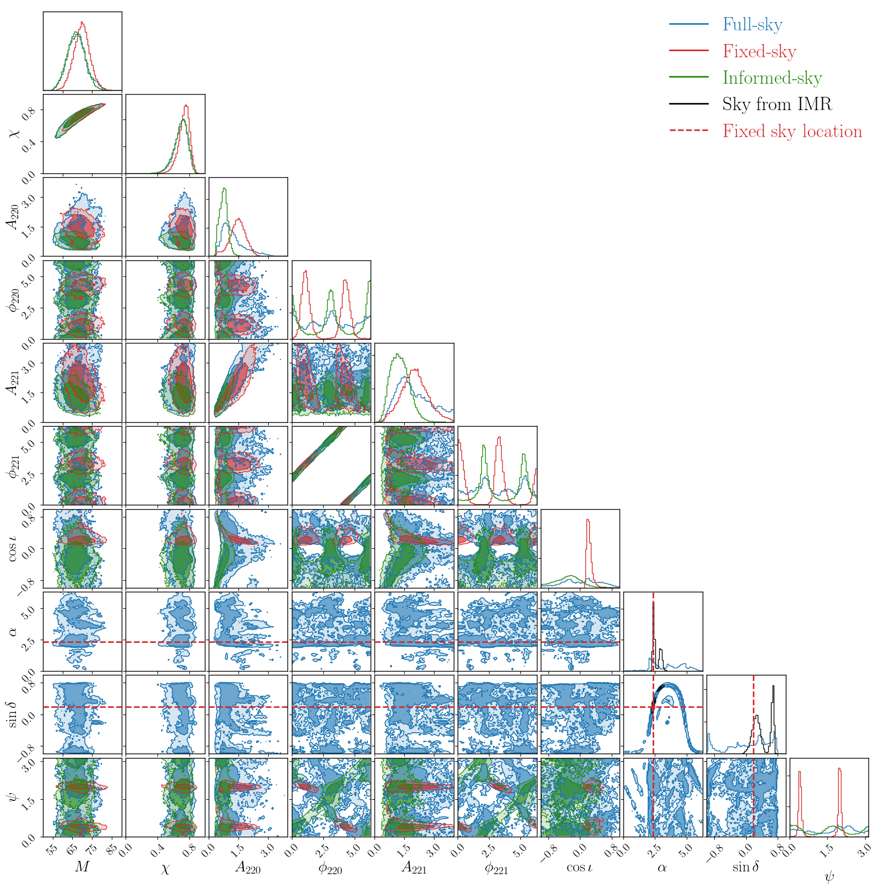
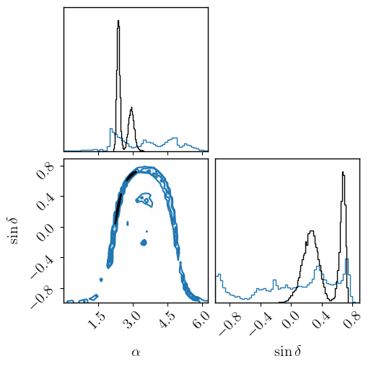
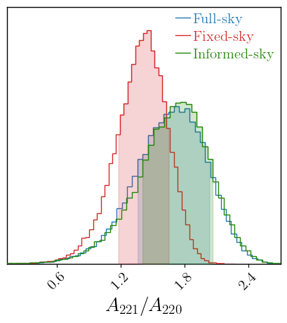
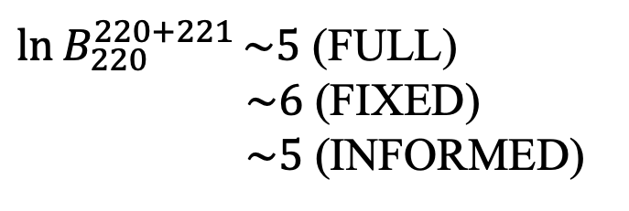
GW250114
$\ln{B_{220}^{220+221}}\sim 5$ (FULL)
$\sim 6$ (FIXED)
$\sim 5$ (INFORMED)

Slide 21
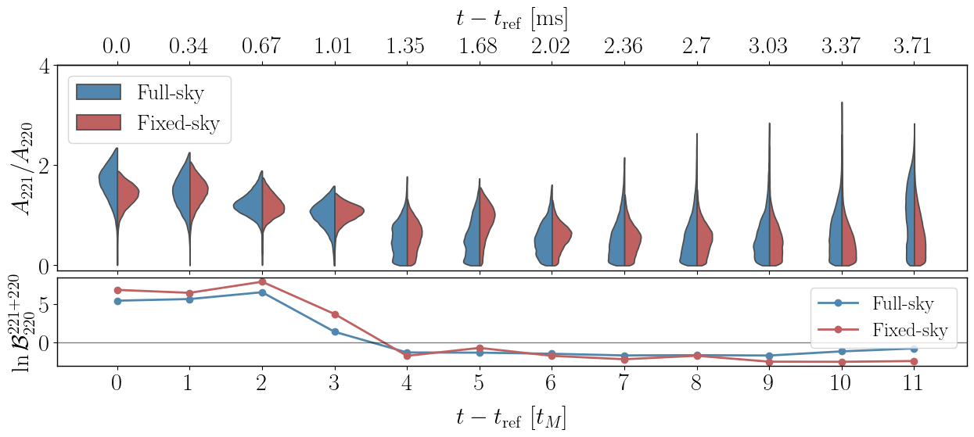

Slide 22
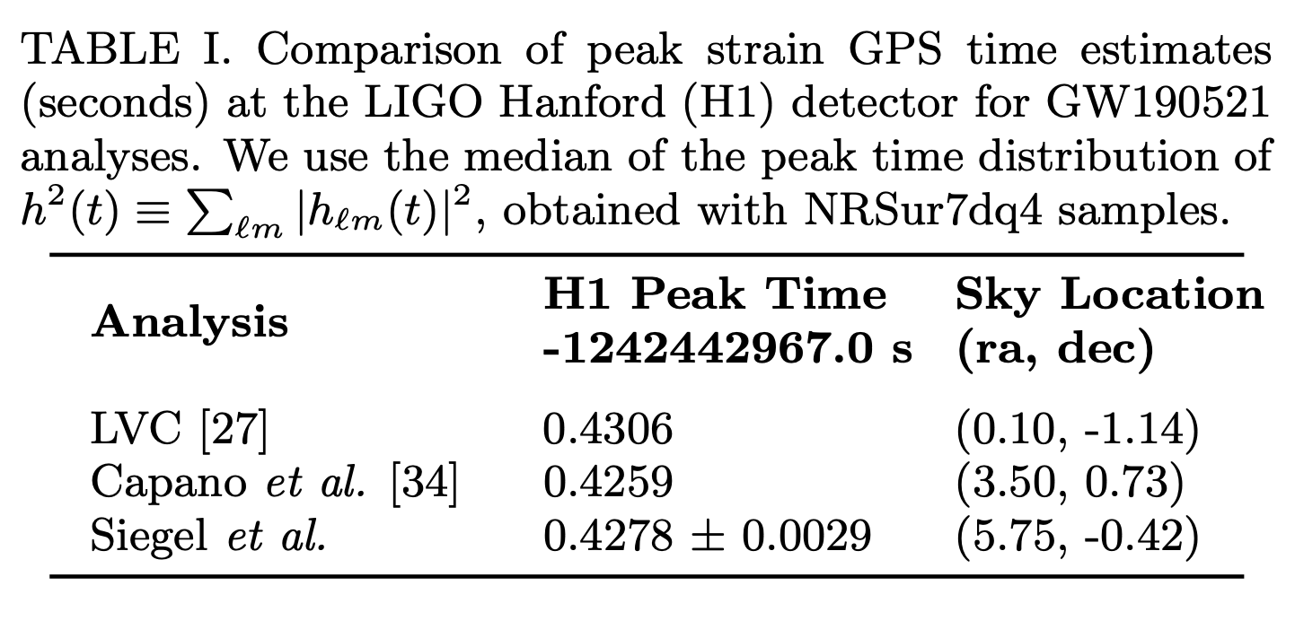
GW190521
First event with (330) detection (?)
High mass system. Very few cycles in LIGO band
Multimodal sky posteriors from IMR
Fixing to point estimates lacks consensus
Seigel et al. 2307.11975

Slide 23
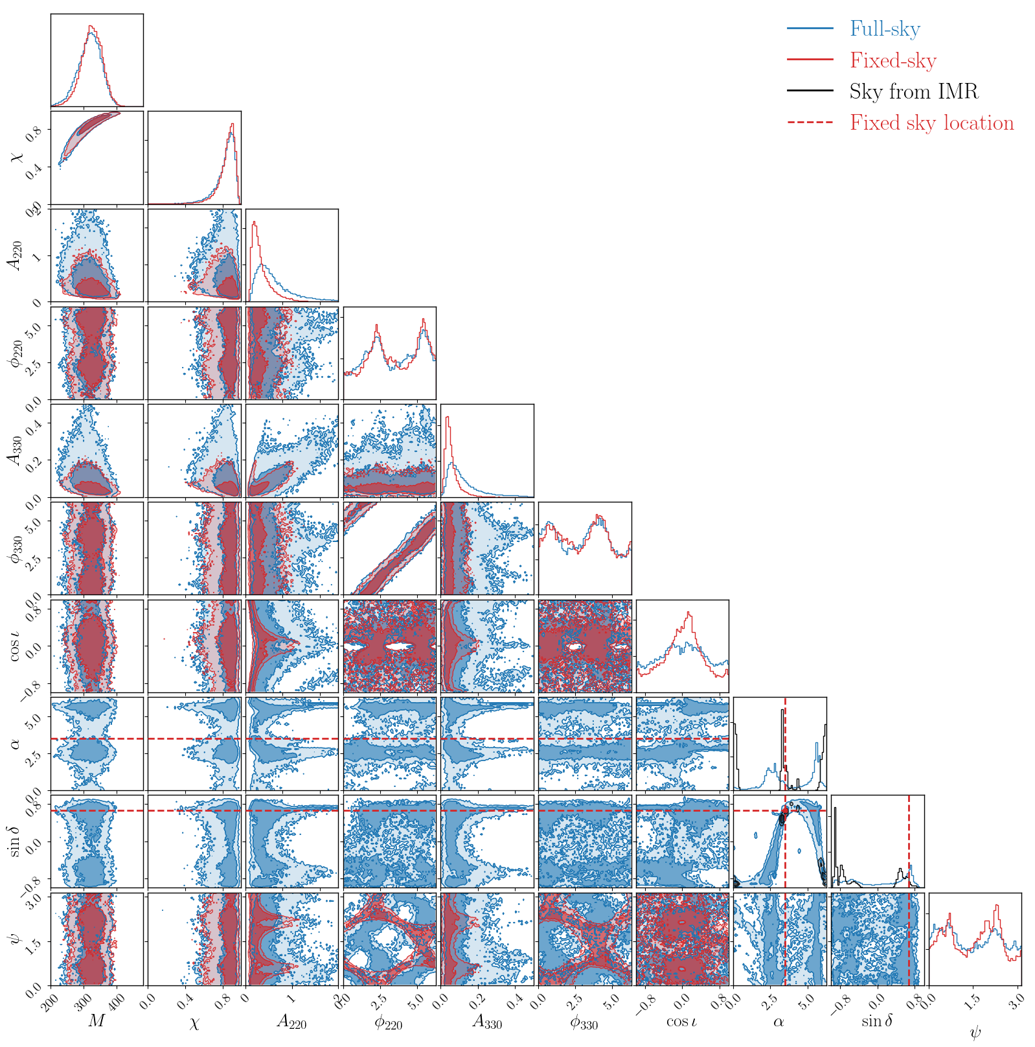
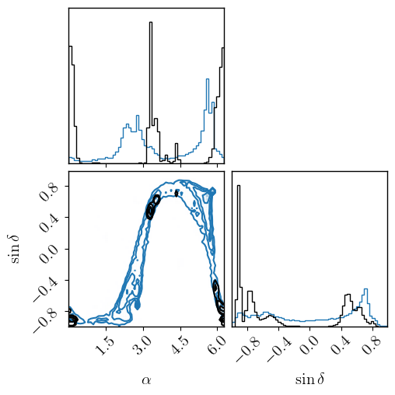
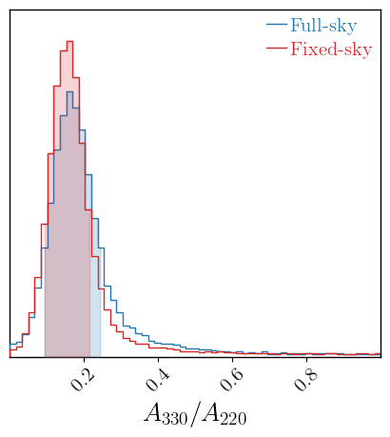
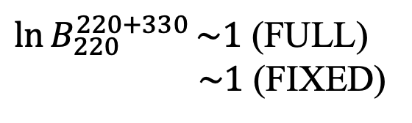
GW190521
$\ln{B_{220}^{220+330}}\sim 1$ (FULL)
$\sim 1$ (FIXED)
No INFORMED-SKY for this event!

Slide 24
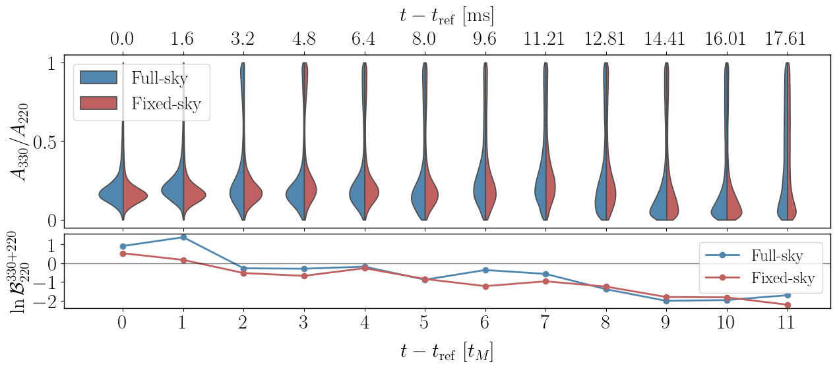

Slide 25
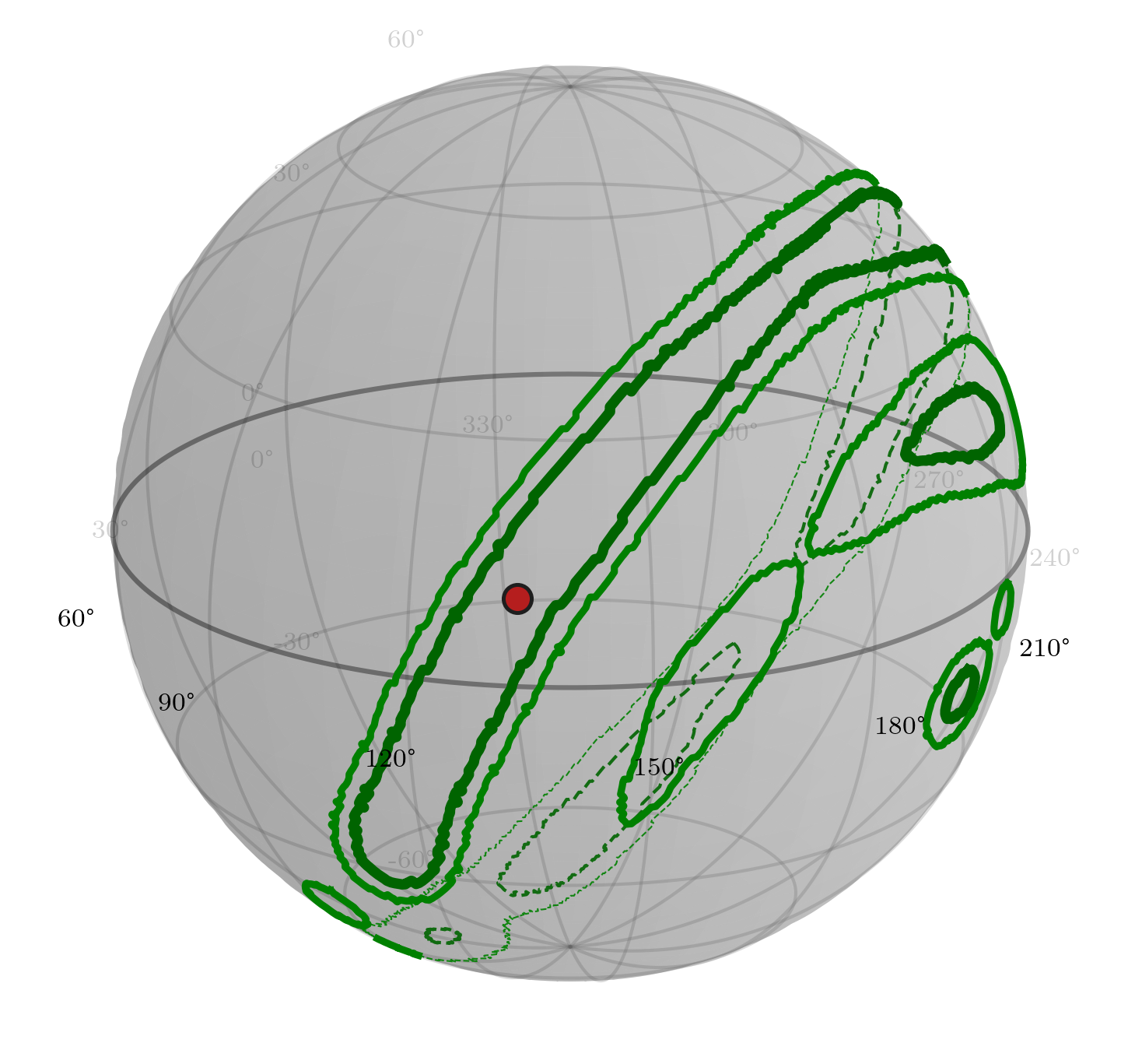
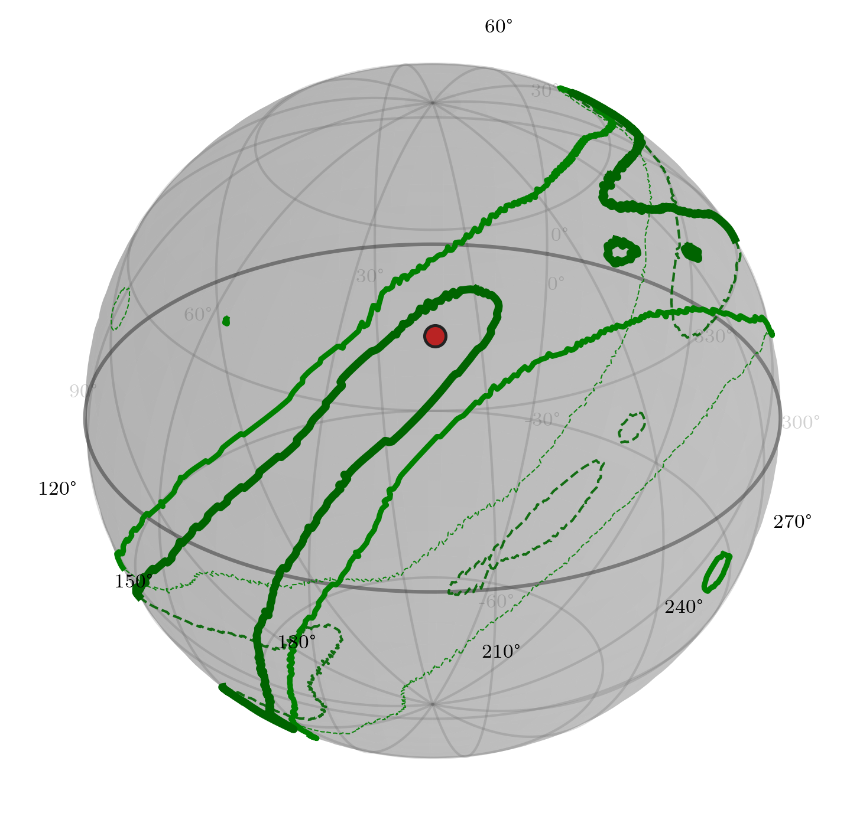
GW250114
GW190521

Slide 26
The code…
JAX- based pipeline (https://github.com/kallolD/skyRing)
Nested sampling using jaxns
Extremely efficient.
  ~20 mins for FIXED-SKY
  ~40 mins for FULL-SKY
  … on a laptop!!
Currently only (2,2) and (3,3) modes, but more to come soon!

Slide 27
Conclusions
First analysis to include sky location in the analysis!
FIXED-SKY posterior volume smaller than FULL-SKY, particularly for amplitudes.
Mode amplitude ratios are less sensitive to sky localization treatment. Better indicators of presence of particular QNM modes.
Bayes factor largely unaffected. No reason to worry!
Strong evidence for 221 mode in GW250114 (ln Bayes~5-6)
Mild evidence for 330 mode in GW190521 (ln Bayes~1)

