Slide 1
Model Order Reduction and Computational Homogenisation of Magnetorheological Elastomers
Benjamin Brands, Julia Mergheim, Denis Davydov and Paul Steinmann
Chair of Applied Mechanics
Friedrich-Alexander Universität Erlangen-Nürnberg
6th deal.II Users and Developers Workshop 2018,
Trieste, 23rd - 27th July

Slide 2
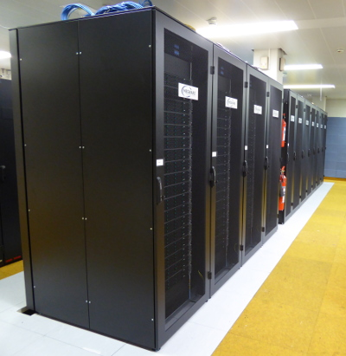
Model Order Reduction
Replacing expensive numerical model (e.g FEM) by cheaper reduced model of acceptable accuracy
Offline Stage
setting up the reduced model
Online Stage
employing the reduced model
Meggy Computing Cluster at RRZE Erlangen

Slide 3
1. Multiscale Modelling of MREs: Homogenisation
2. Model Order Reduction for Magnetomechanics
2.1 Reduced Basis Construction
2.2 Galerkin Reduced Model
2.3 DEIM Reduced Model
2.4 GappyPOD Reduced Model
2.5 EC Reduced Model
3. Numerical Studies
4. Conclusion

Slide 4
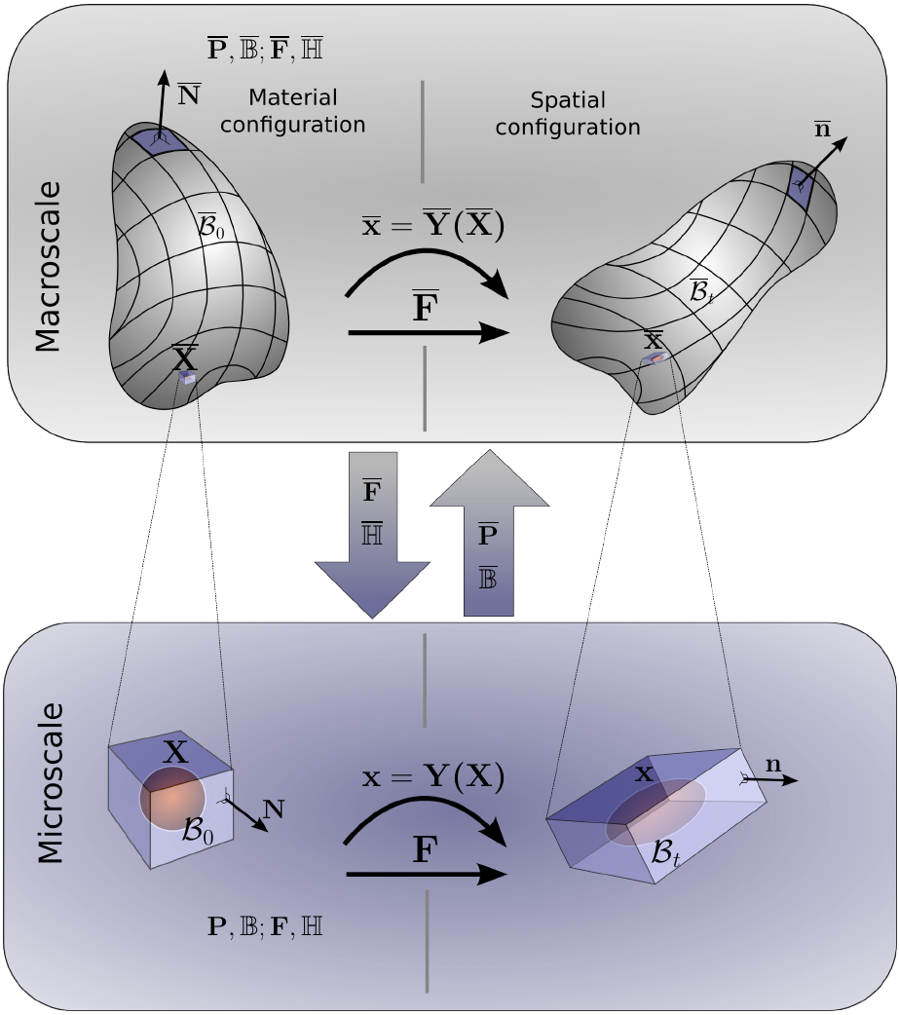
1. Multiscale Modelling of MREs: Homogenisation
replace FEM microscale model
with reduced model
➔ reducing computational cost

Slide 5
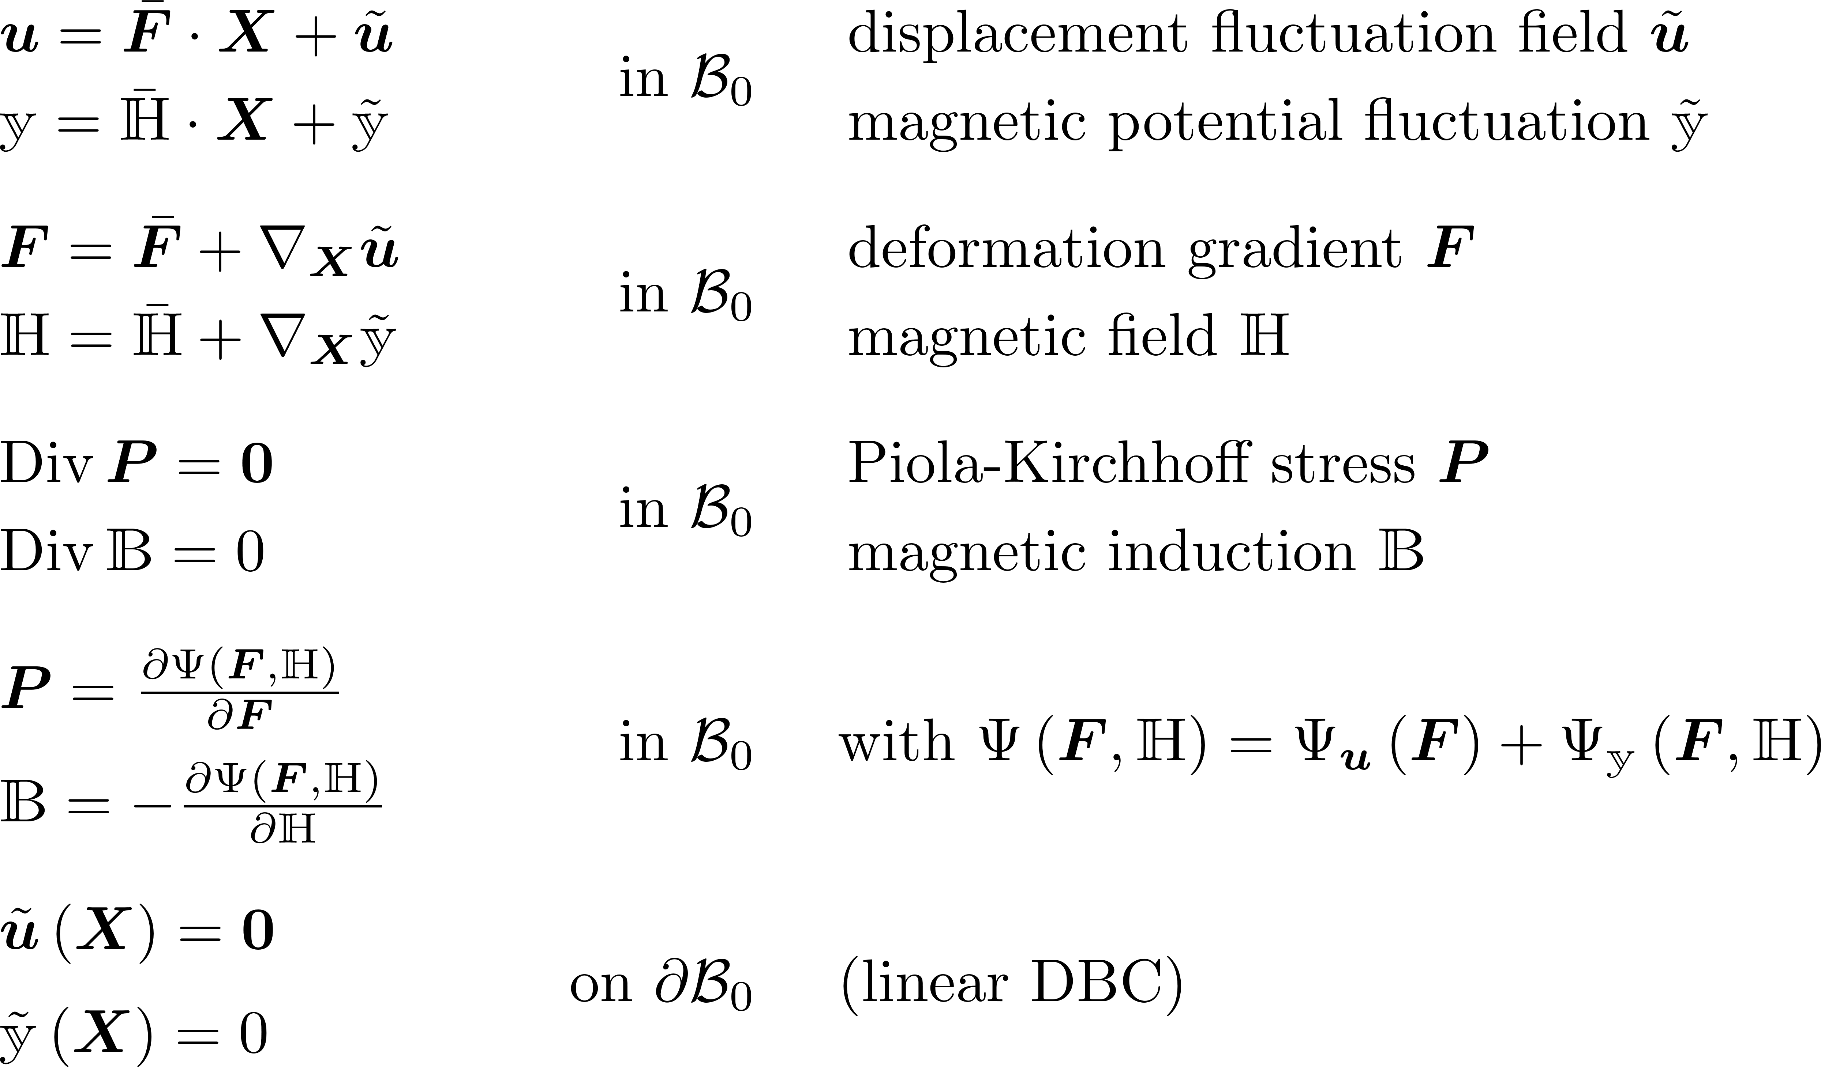
1. Multiscale Modelling of MREs: Homogenisation
Micro-scale problem
Micro to macro transition: homogenised quantities

Slide 6
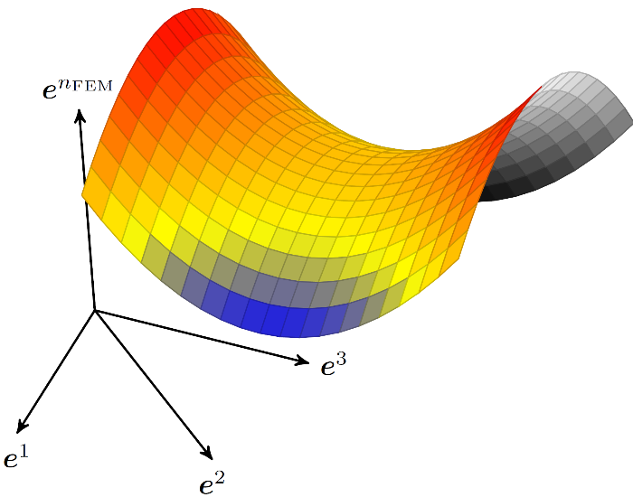
2. Model Order Reduction for Magnetomechanics
Fundamental assumption:
Solution of the problem (e.g pPDE) resides in
manifold of small dimension

Slide 7
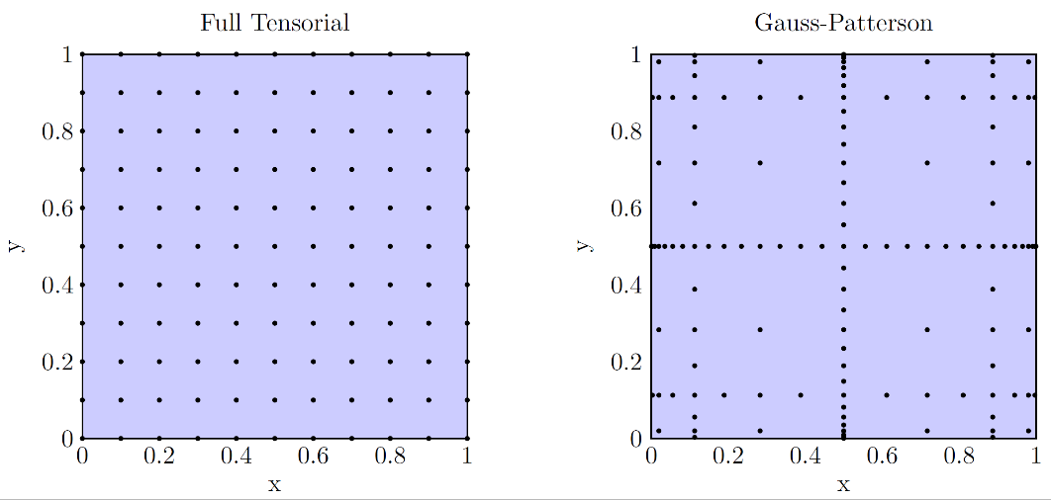
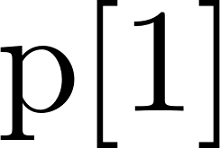
2.1 Reduced Basis Construction

Slide 8
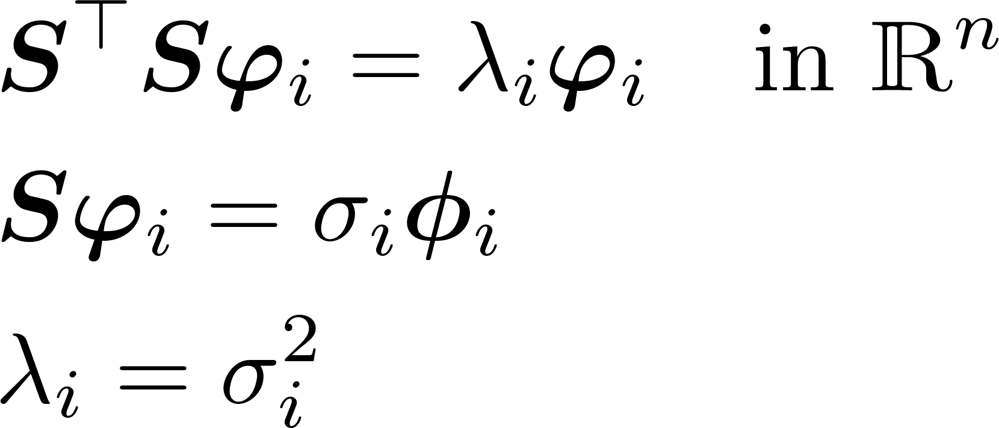
2.1 Reduced Basis Construction: SVD and POD
Singular Value Decomposition (SVD)
Proper Orthogonal Decomposition (POD)
Using deal.II‘s ScaLAPACK wrappers for fast computation of SVD/POD

Slide 9
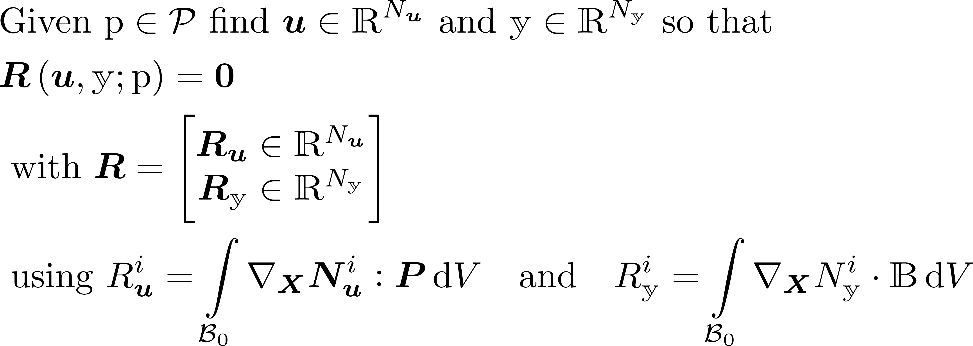
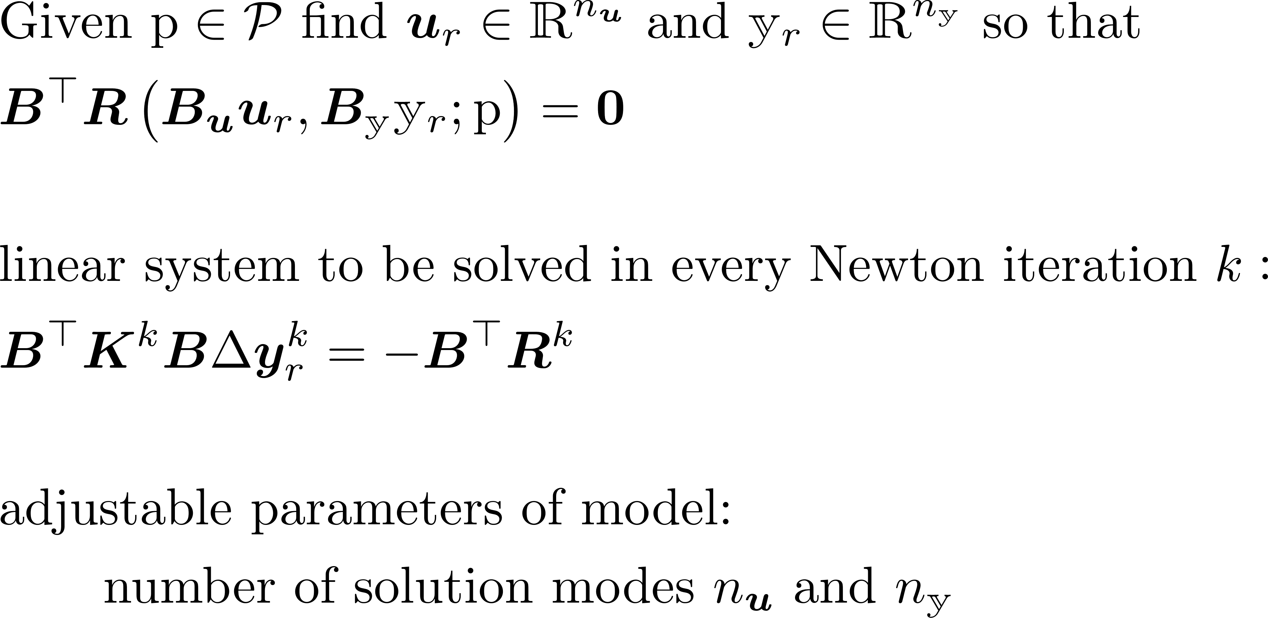
2.2 Galerkin Reduced Model
FEM model
Galerkin ROM
computation of residuum and tangent matrix and subsequent projection renders the Galerkin ROM inefficient

Slide 10
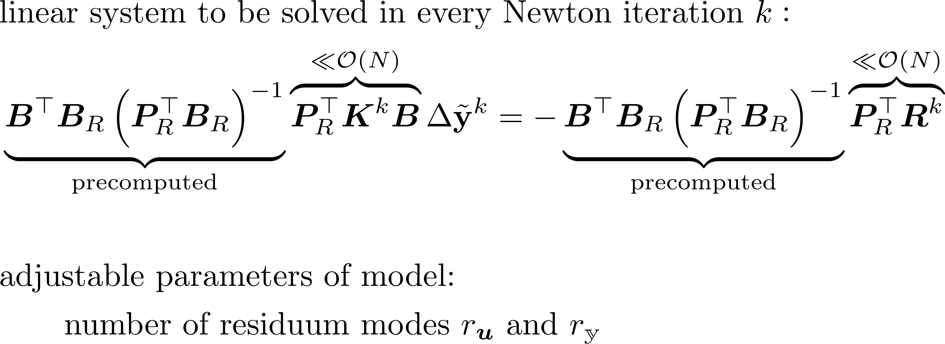
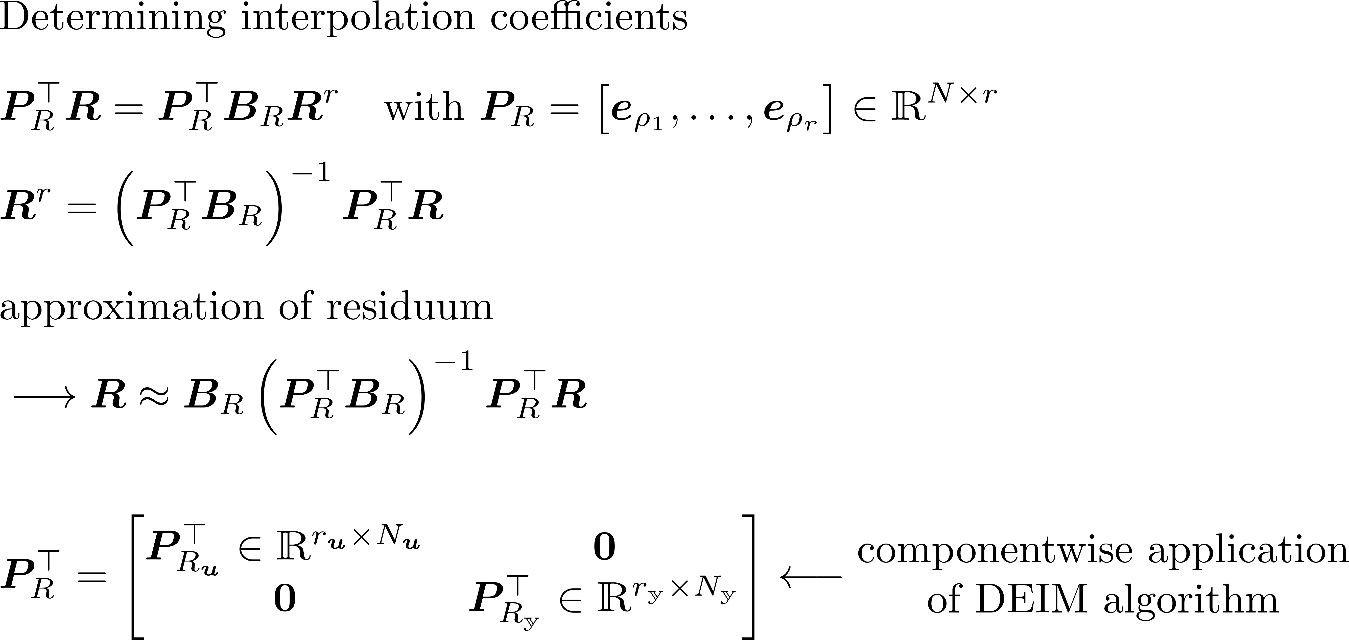
2.3 DEIM Reduced Model
Chaturantabut & Sorensen 2010
DEIM ROM

Slide 11
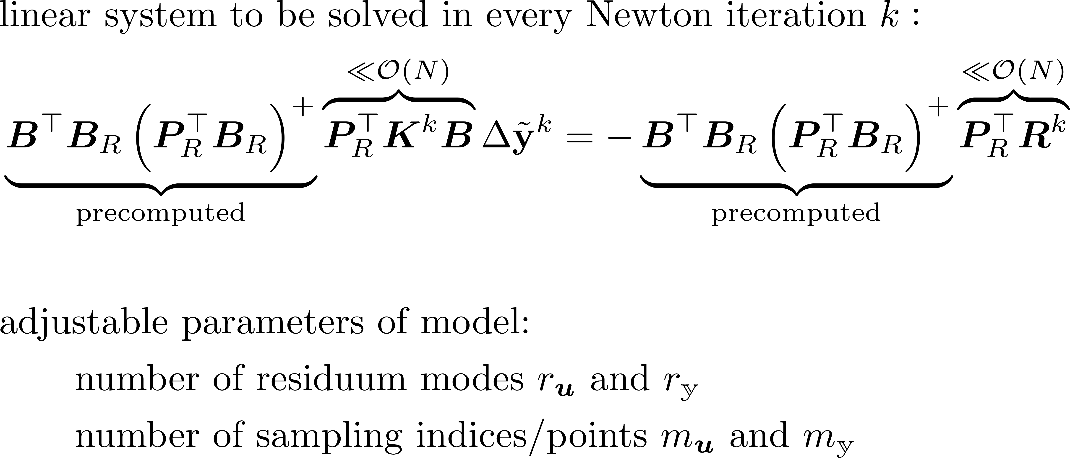
2.4 GappyPOD Reduced Model
Emerson & Sirovich 2007
GappyPOD ROM

Slide 12
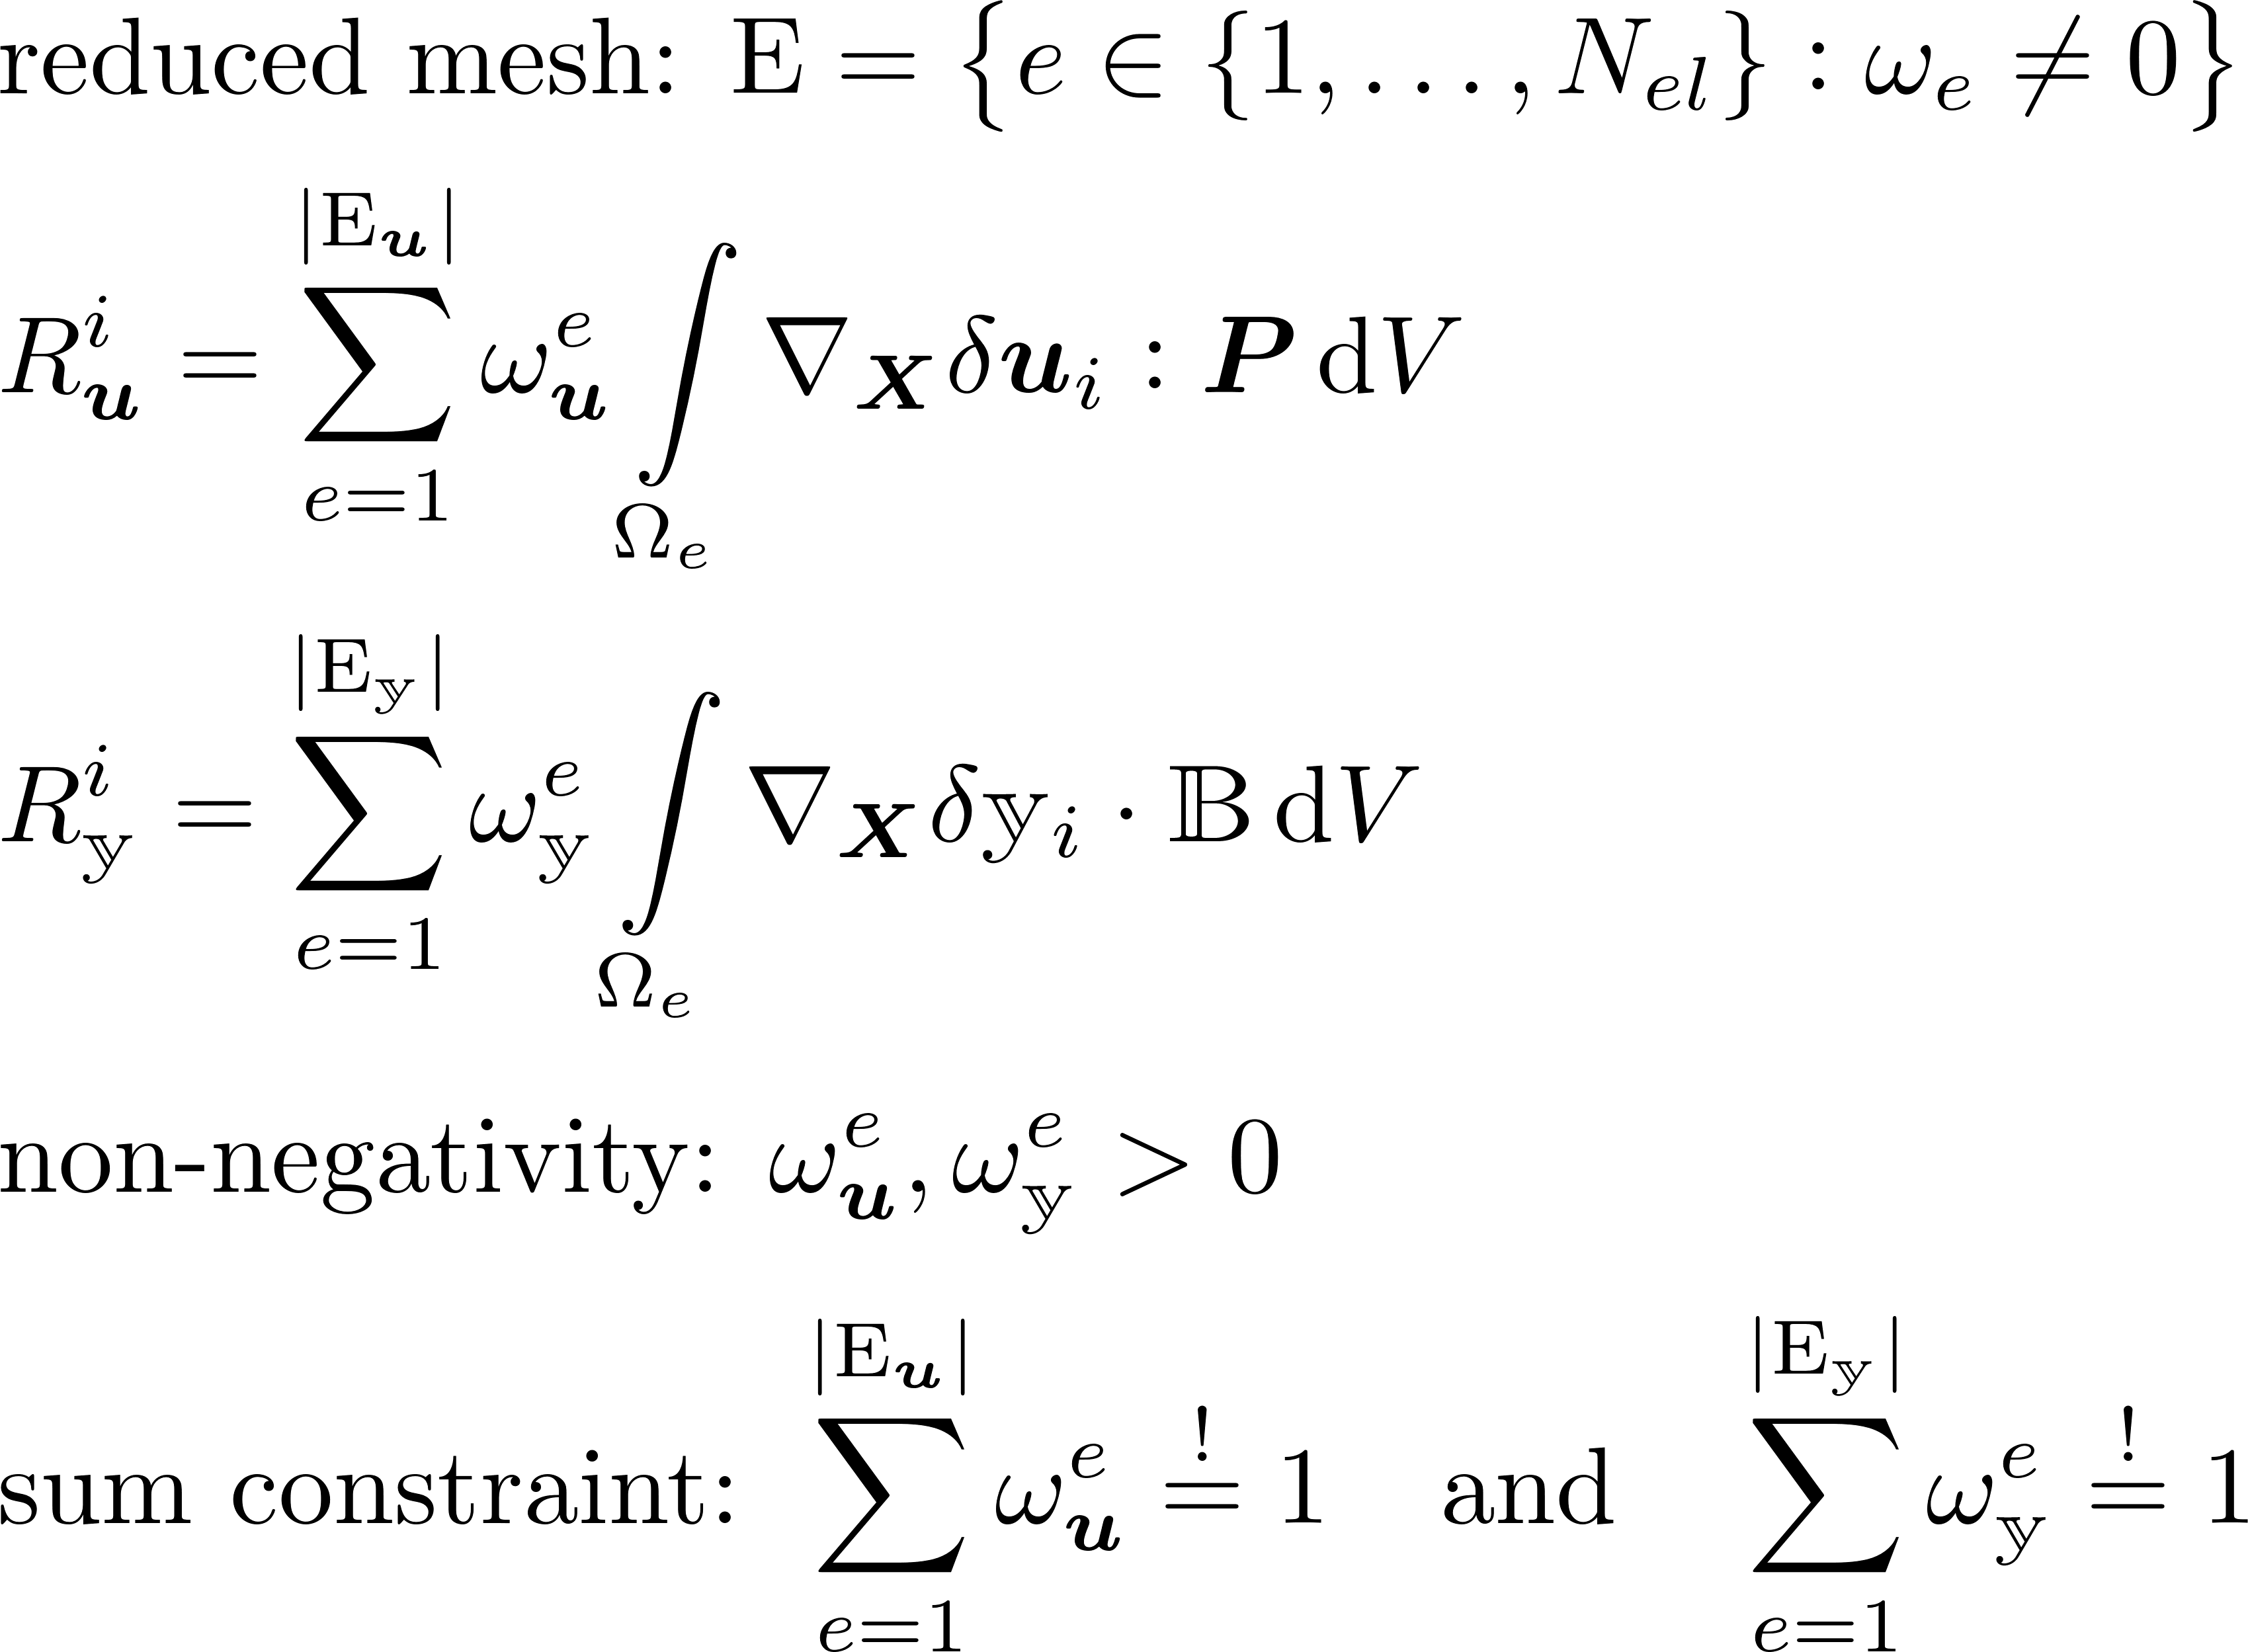
2.5 Empirical Cubature Reduced Model
Farhat et al. 2014,
Hernández et al. 2016

Slide 13
2.5 EC Reduced Model
EC ROM

Slide 14
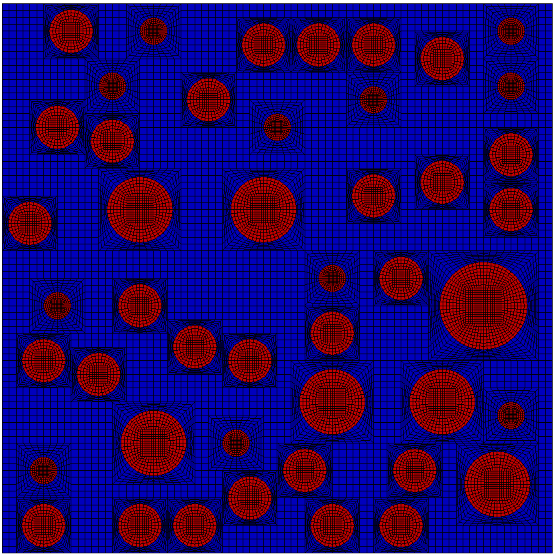
3. Numerical Studies: Problem Setting

Slide 15
3. Numerical Studies: Problem Setting

Slide 16
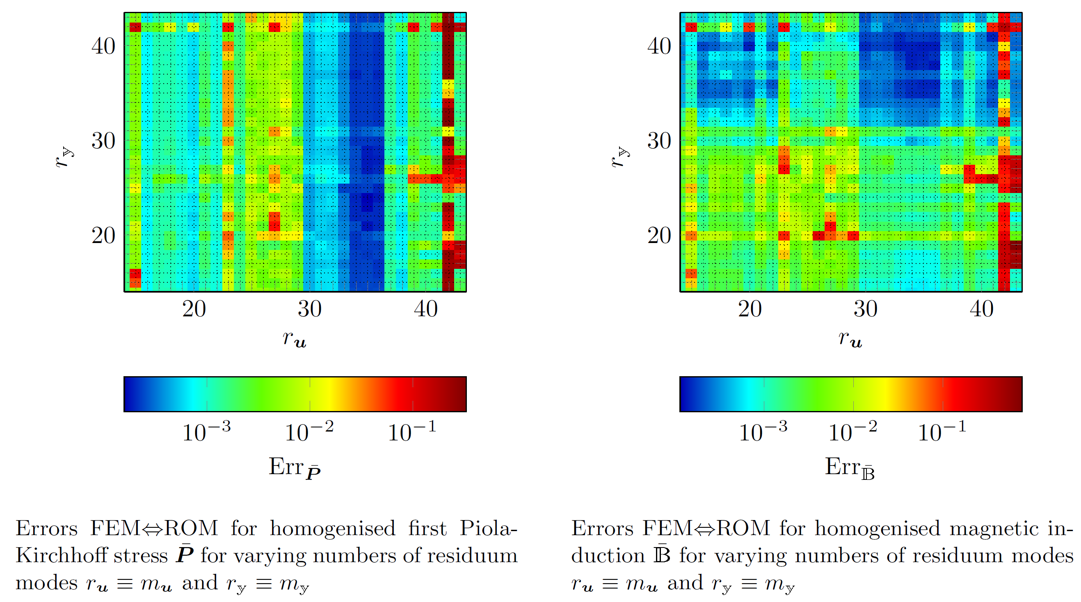
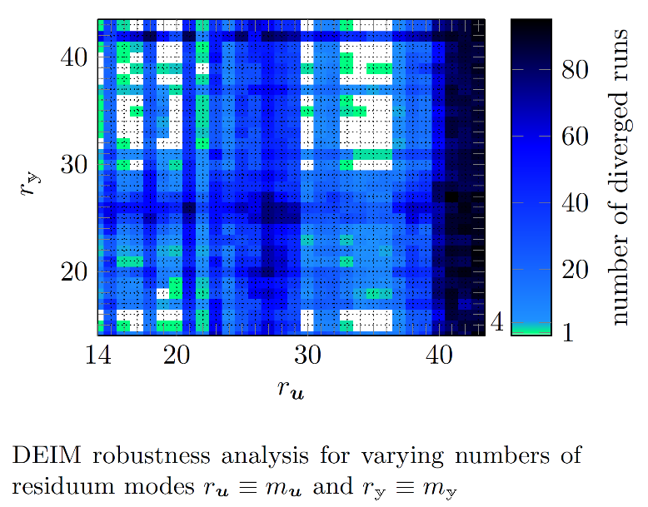
3.1 Numerical Studies: DEIM

Slide 17
3.1 Numerical Studies: DEIM

Slide 18
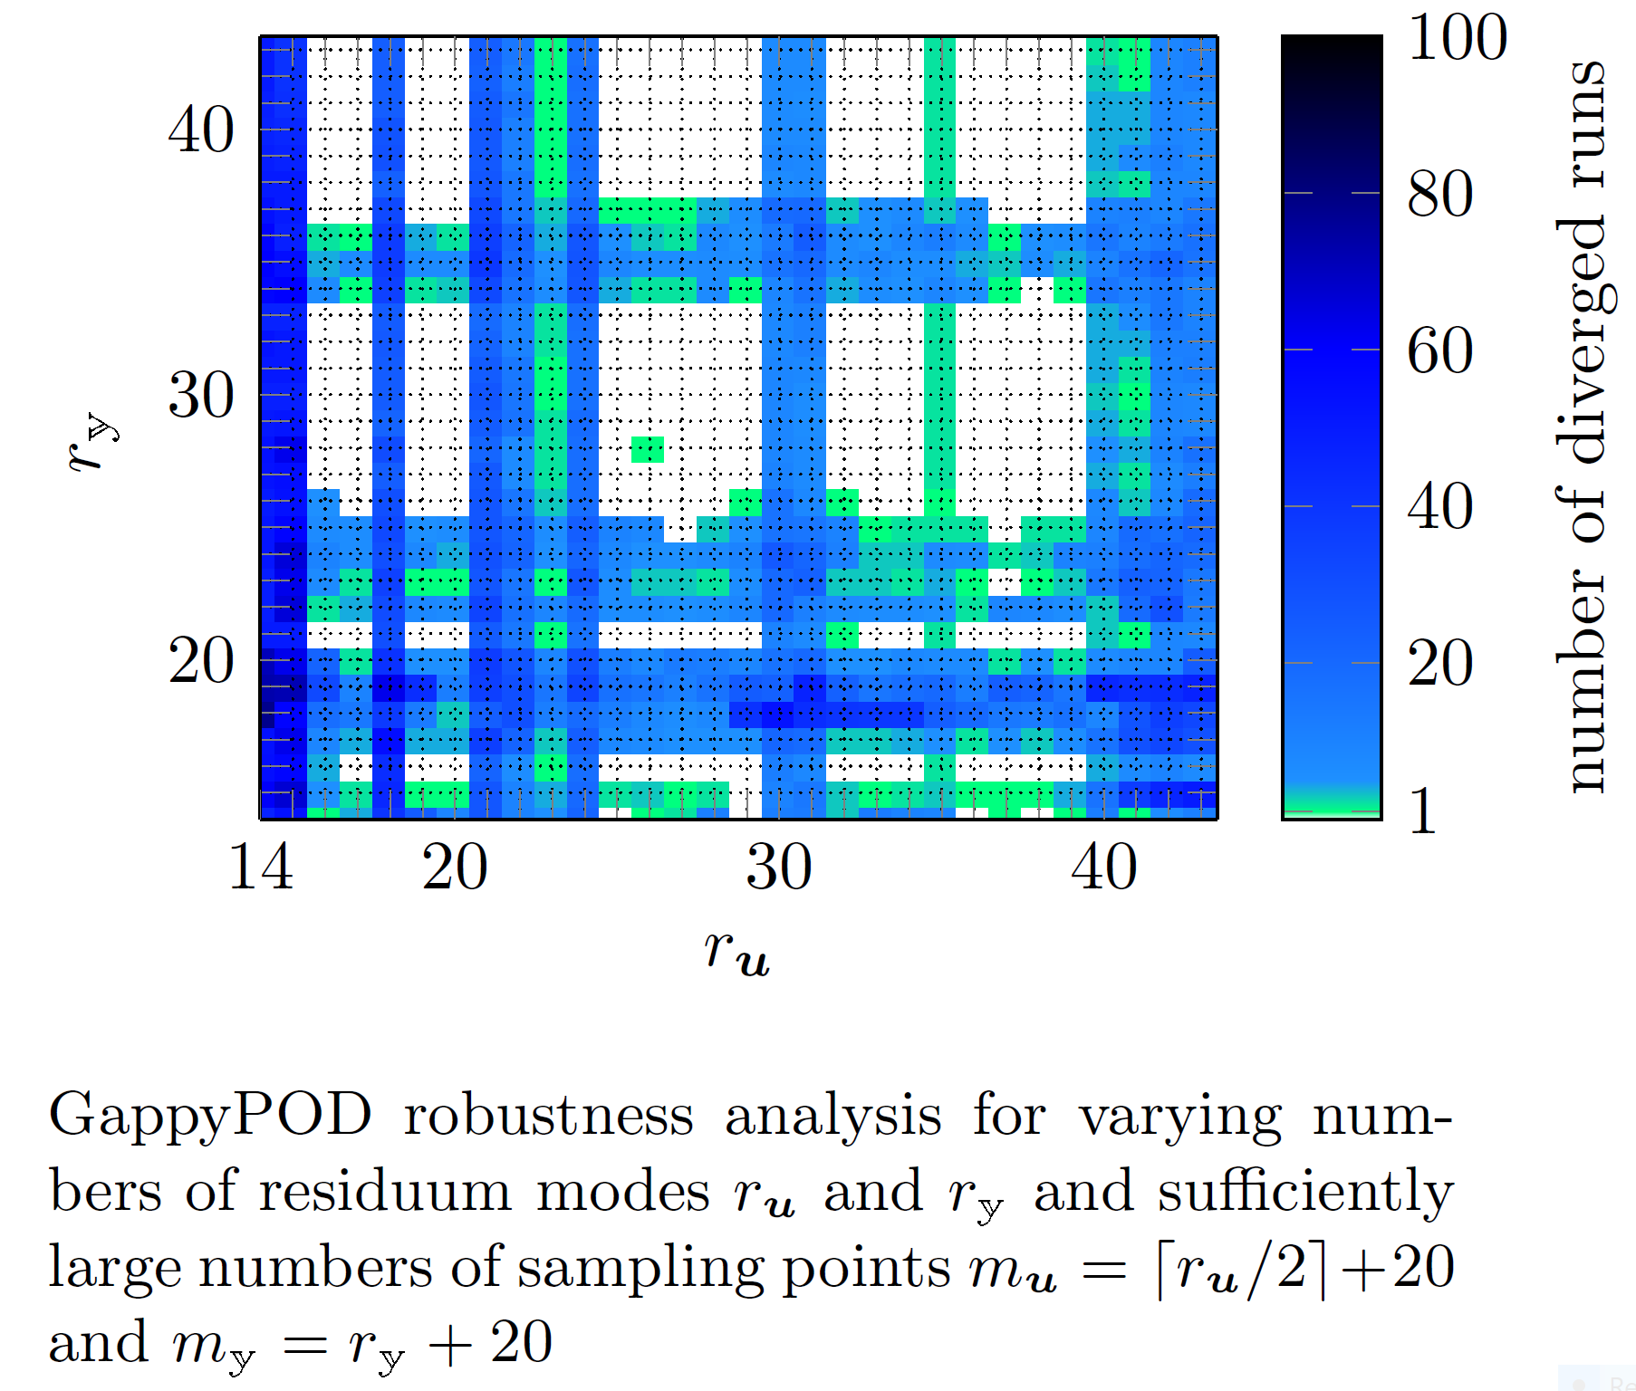
3.2 Numerical Studies: GappyPOD

Slide 19
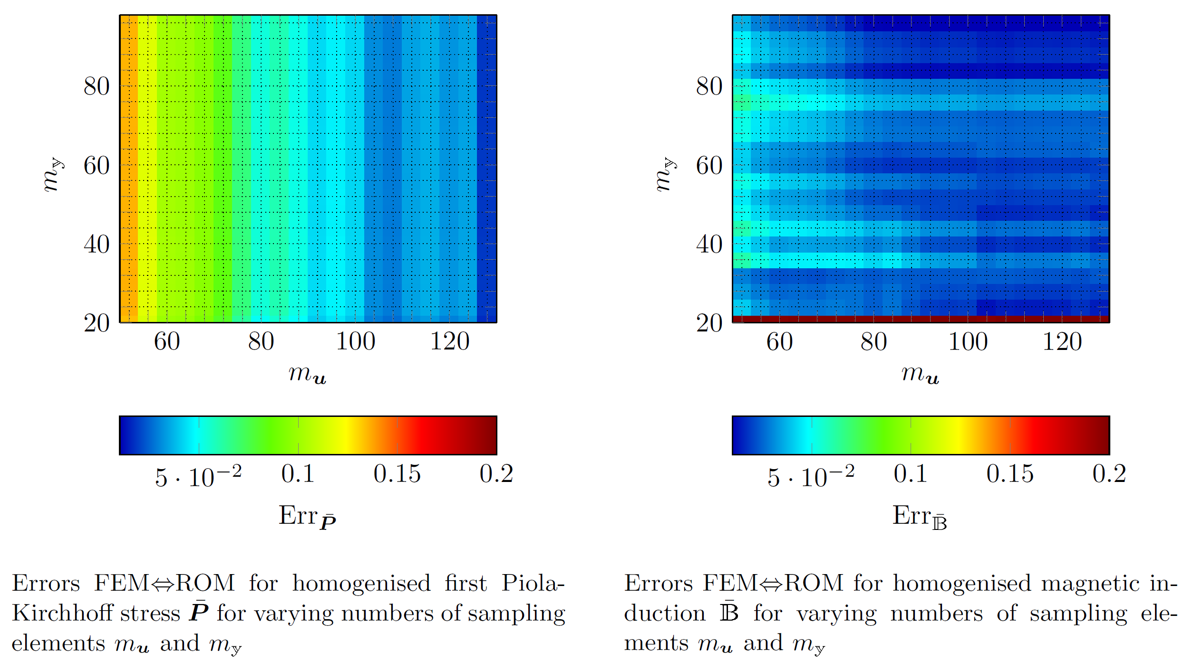
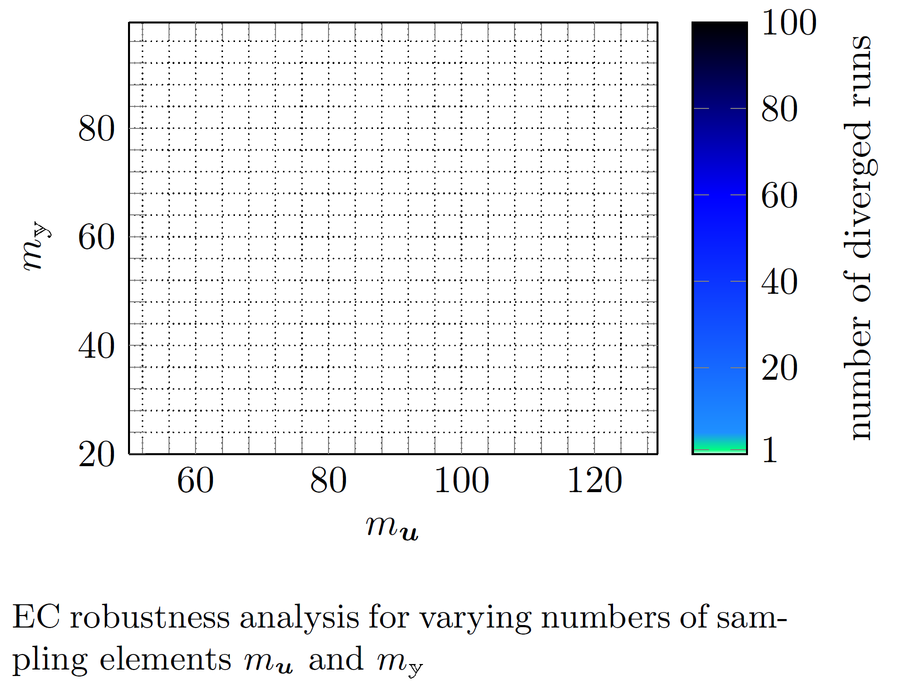
3.3 Numerical Studies: EC

Slide 20
4. Conclusion

Slide 21
Acknowledgement:
DAAD-UGC DIP Program
Thank you for your patience!
Questions?

