Slide 1
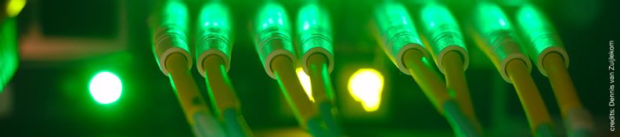
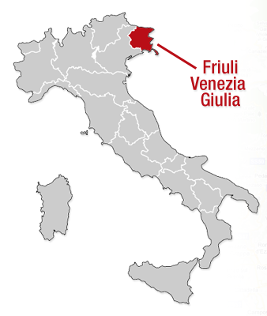

High-Performance Computing for
the FVG regional science
Sandro Scandolo (ICTP, Trieste)

Slide 2


The Friuli Venezia Giulia science system
5.5 researchers / 1000 inhabitants
10,000 visiting foreign scientists
47 Scientific institutions
3 Public Research Institutions (MIUR)
3 Universities
4 International Organizations
4 Technological parks
Chemistry, Material technologies, Nanotechnologies, Mechanical sciences, Genetic engineering, Biotechnologies and Diagnostic, Physics, Ecology and Environment, Oceanography, Marine biology

Slide 3
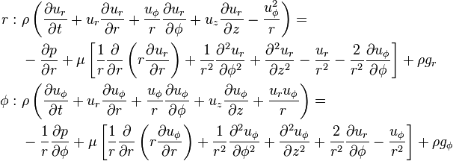
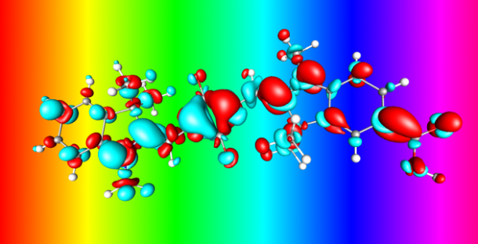
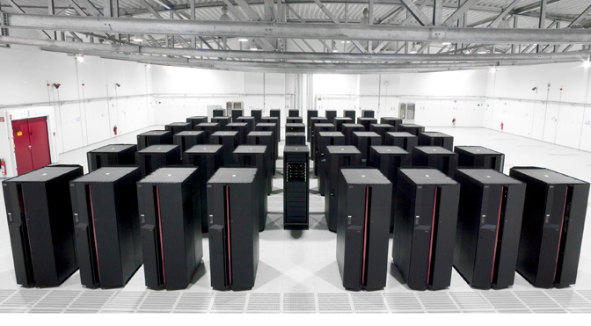
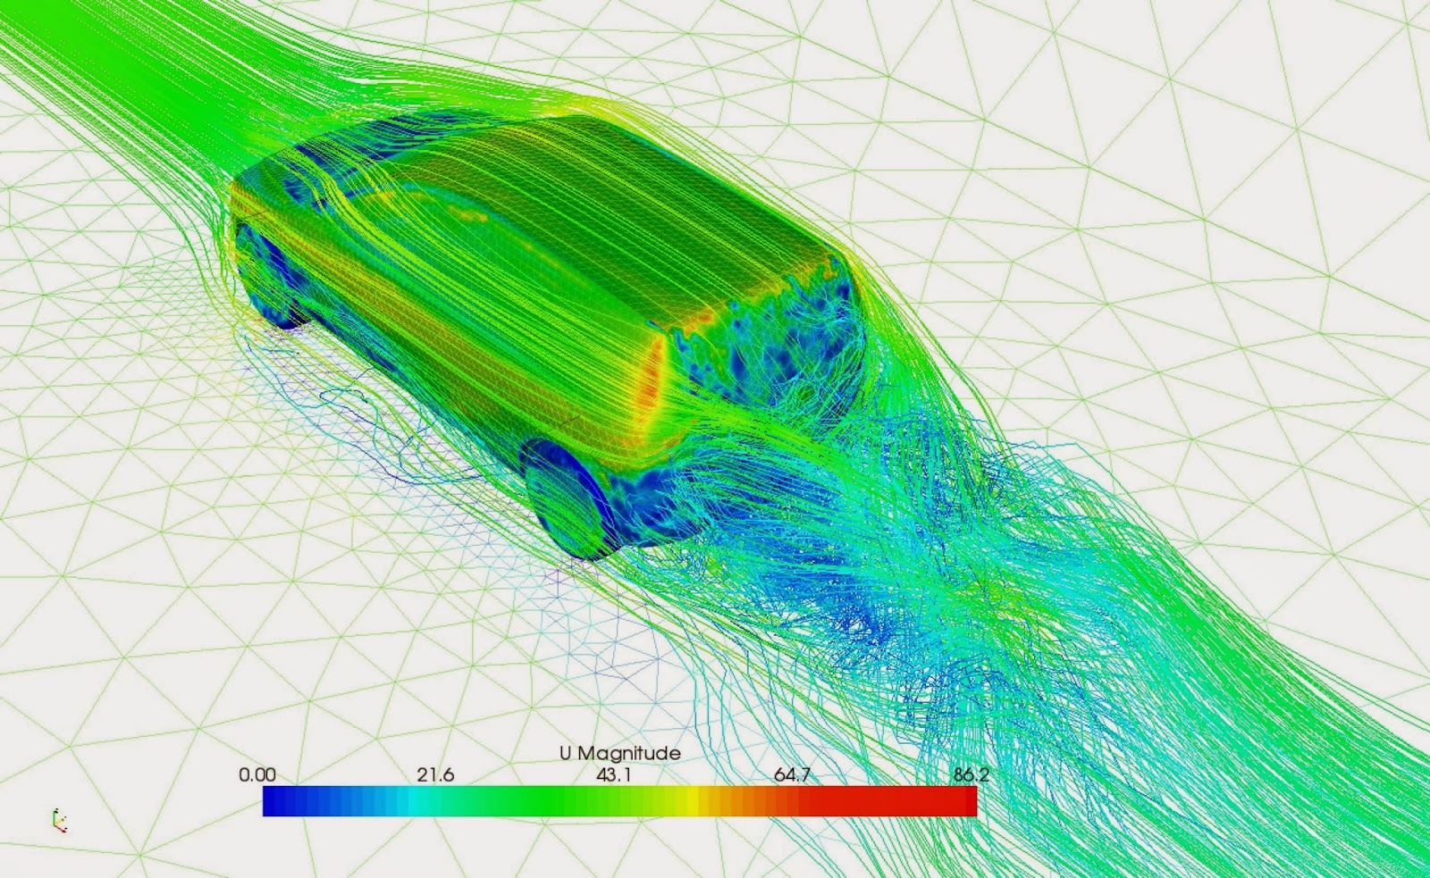
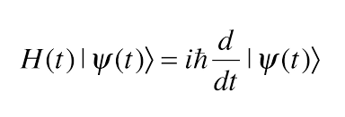
Scientific Computing
Fluid dynamics
Quantum mechanics

Slide 4
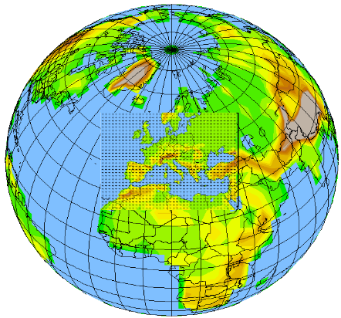
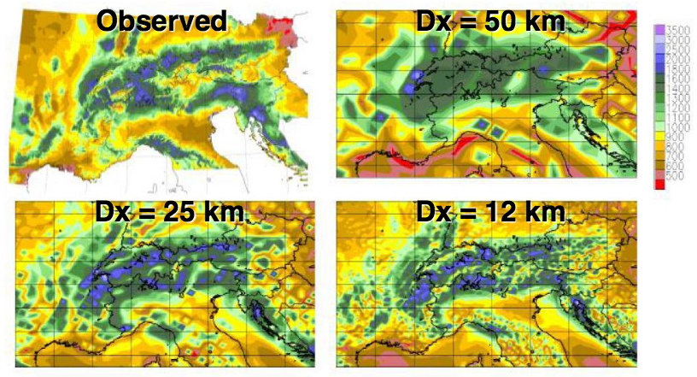
ICTP: “Regional” climate modeling
Precipitation 1960-1990

Slide 5
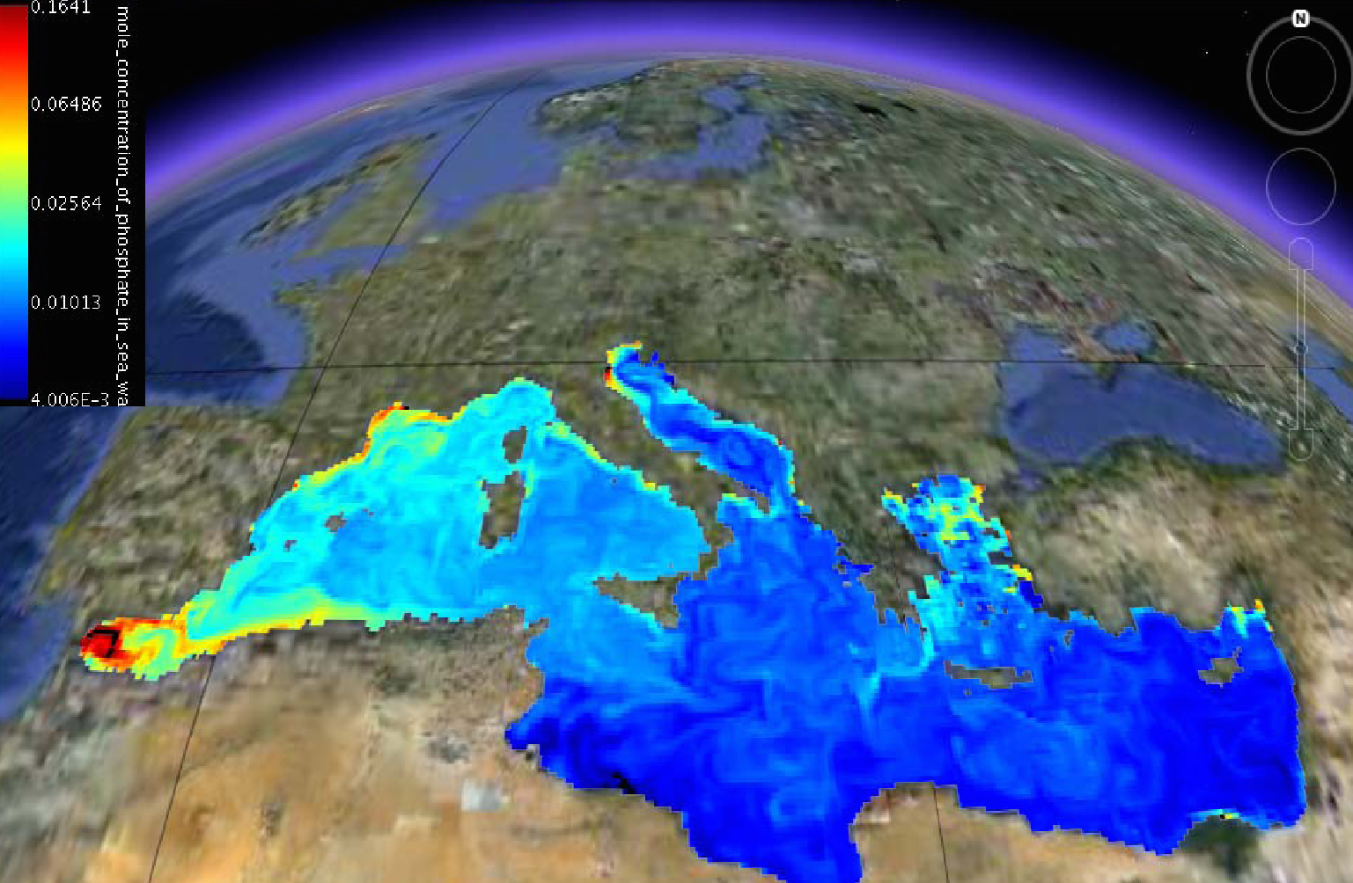
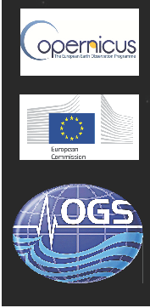
OGS: biogeochemistry modeling
OGS is part of the CMEMS Mediterranean Monitoring and Forecasting Centre (MED-MFC) and provides operational biogeochemistry products
6 variables:
chlorophyll,
phytoplankton biomass,
phosphate,
nitrate,
primary production,
oxygen
Validation of each
product-variable against
available data
Chlorophyll [mg/m³]

Slide 6
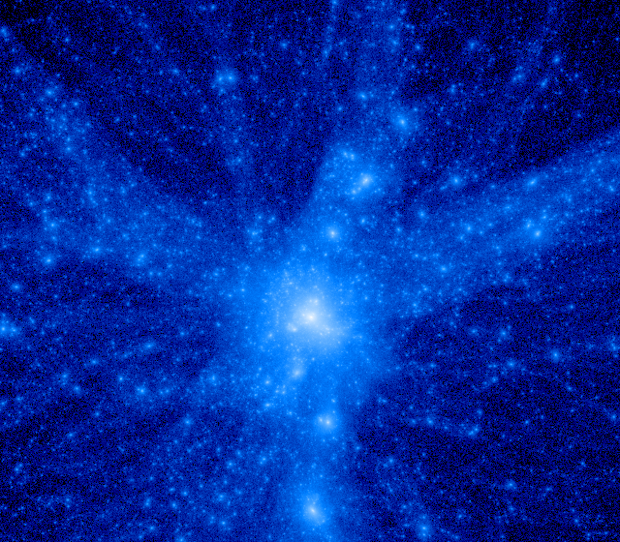
OATS/INAF: simulating galaxy formation
Simulations for the formation of cosmic structures: e.g. galaxies, clusters of galaxies
Codes used: N-body + hydrodynamics
➔ Universe expansion dominated by Dark Energy
➔ Follow the gravitational evolution of Dark Matter
The face of a cluster of galaxies
Computational resources required:
➔ Several thousands, up to few tens of thousands cores
➔ Up to several million CPU hours
➔ Several tens of TB of storage
Partners of H2020 FET-HPC ExaNeSt project (http://www.exanest.eu)
➔ To develop and prototype solutions on the way towards production of Exascale-level Supercomputers

Slide 7
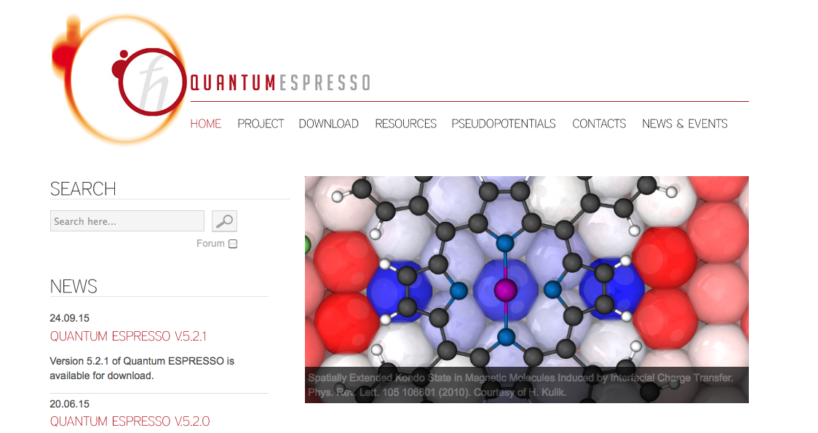

The “Quantum Espresso” project
open source
~500.000 lines
~50 developers
~2000 users
~1000 publications/year
~2-3 intl. schools/year
Partners of H2020-EINFRA-2015-1
project MaX (Materials design at the Exascale)

Slide 8
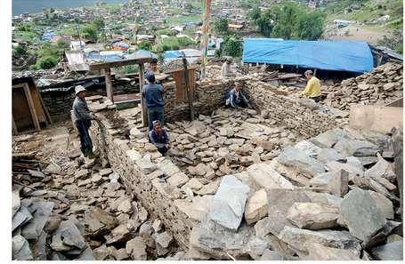
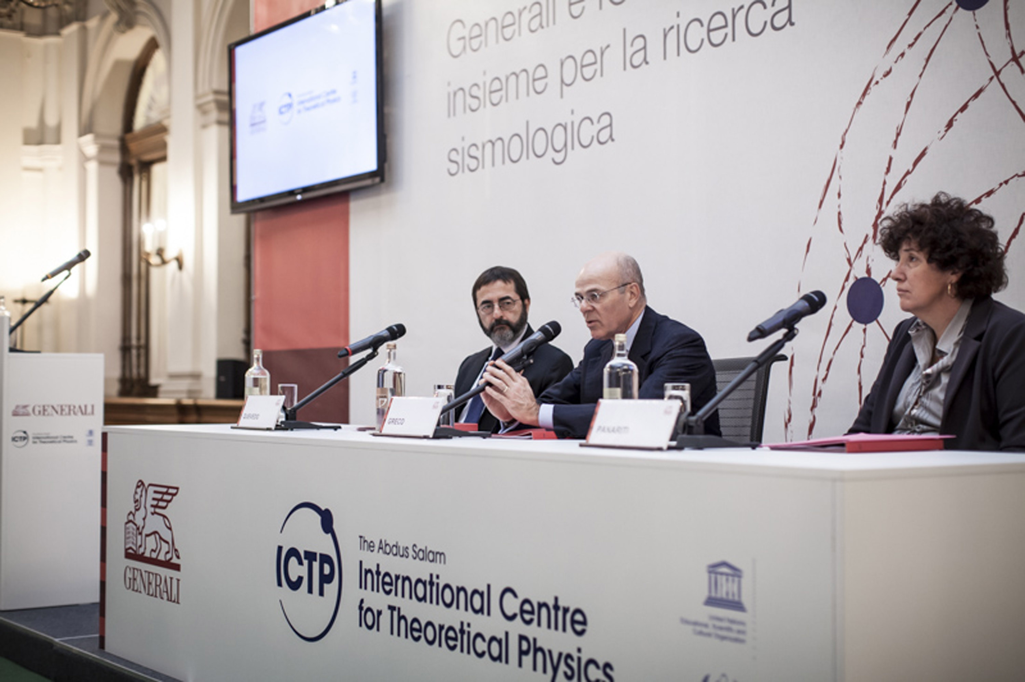
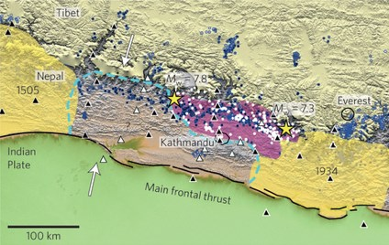
Generali e ICTP: HPC per l’industria
29/10/2015
Generali e ICTP siglano una partnership triennale per sviluppare un modello computazionale di mitigazione del rischio sismico

Slide 9

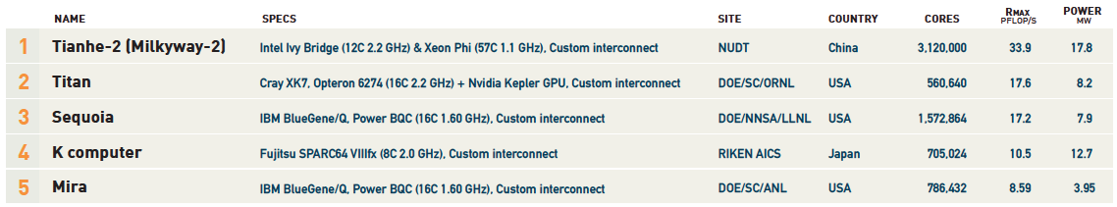
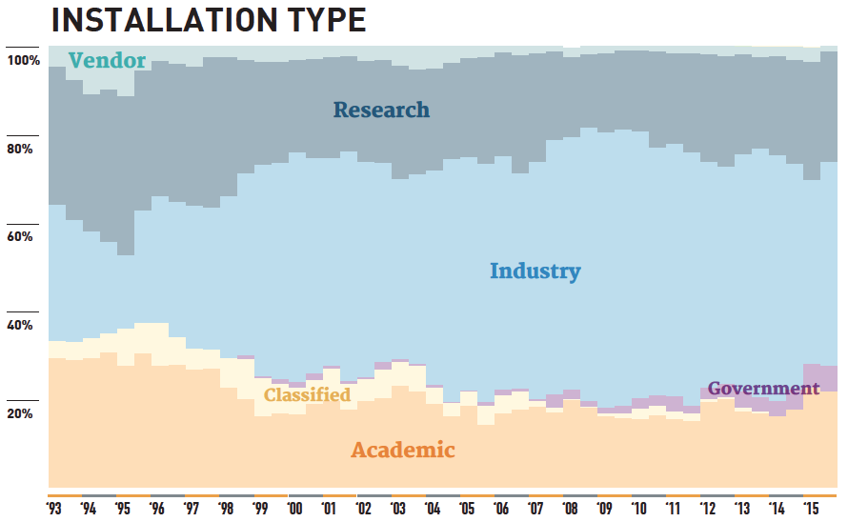
The HPC leaders

Slide 10
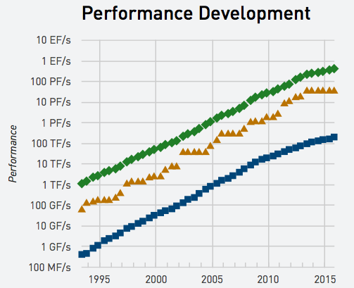
FVG and the “top500”
totale
Italia
19º Eni
37º CINECA Fermi
129º CINECA Galileo
1º
205º Eni
Ulysse (SISSA)
Argo(ICTP)
500º

Slide 11


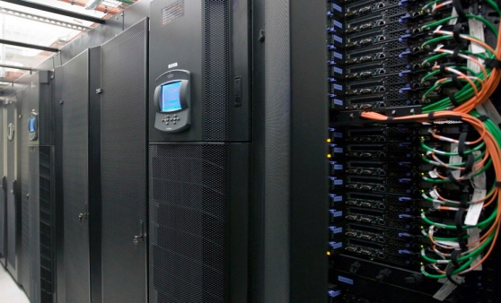
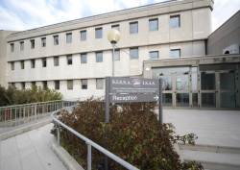
Ulysses: 100 Tflops for the regional science
Performance: ~ 100 TeraFlops
Storage: 5 PetaBytes
Network: 1 Gbps Lightnet (10 Gpbs tra SISSA-ICTP)

Slide 12
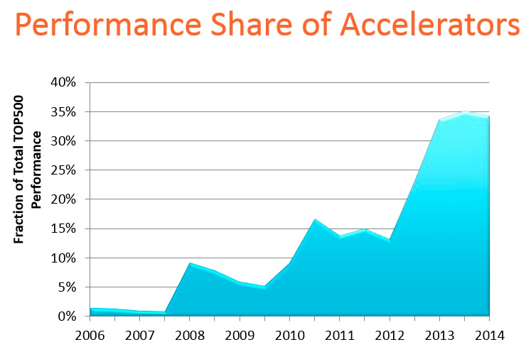
The GPU revolution

Slide 13
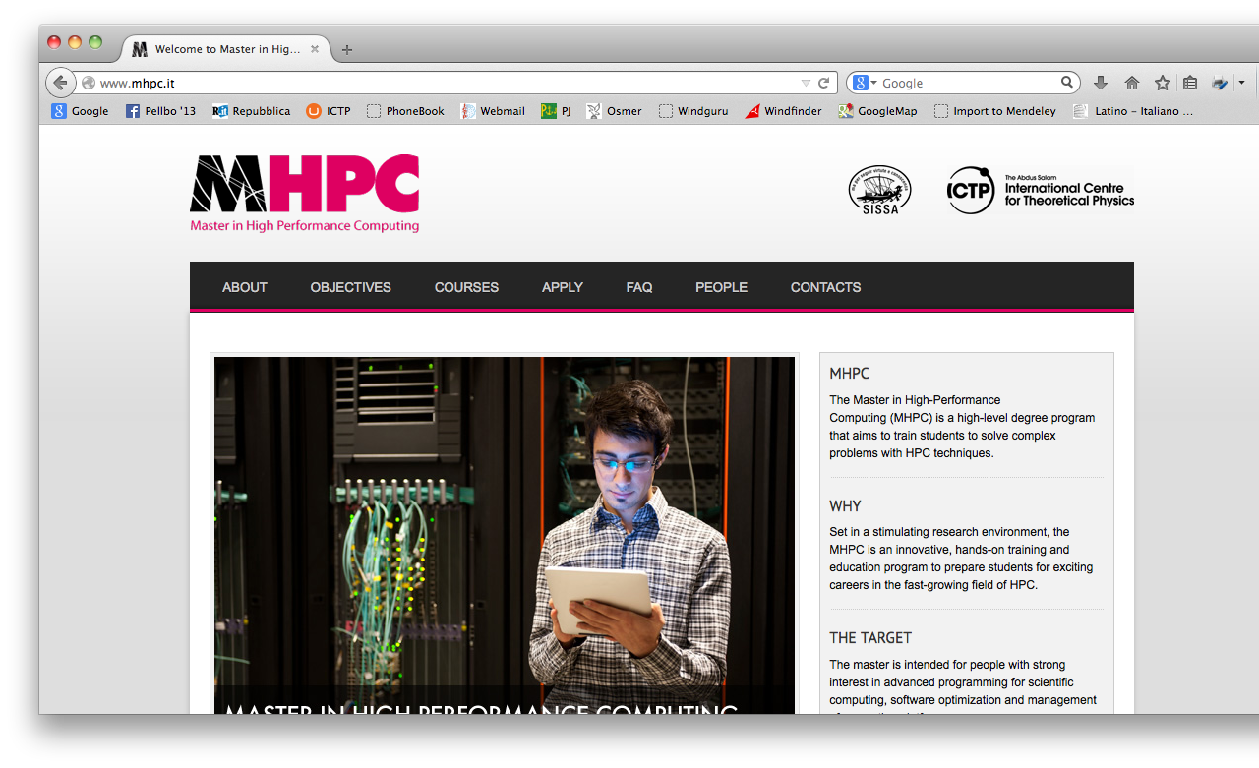
The Master in High-Performance Computing

Slide 14
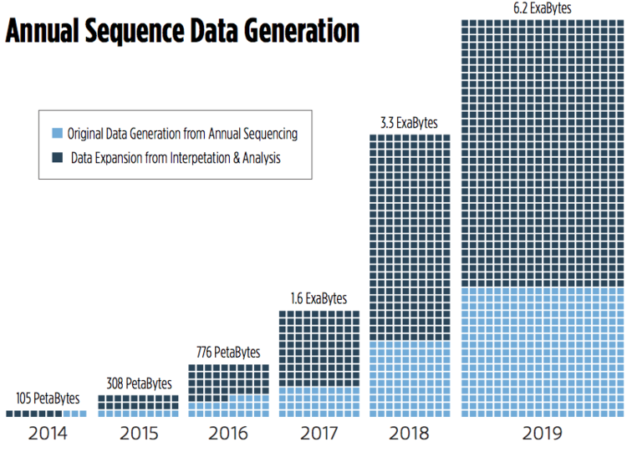
The “big data” challenge
Bioinformatics
Now:
LHC
Genomics
By 2025: Twitter
Youtube
SKA
Genomics
[Petabytes]
10/yr
100
10
1,000
1,000/yr
40,000

Slide 15




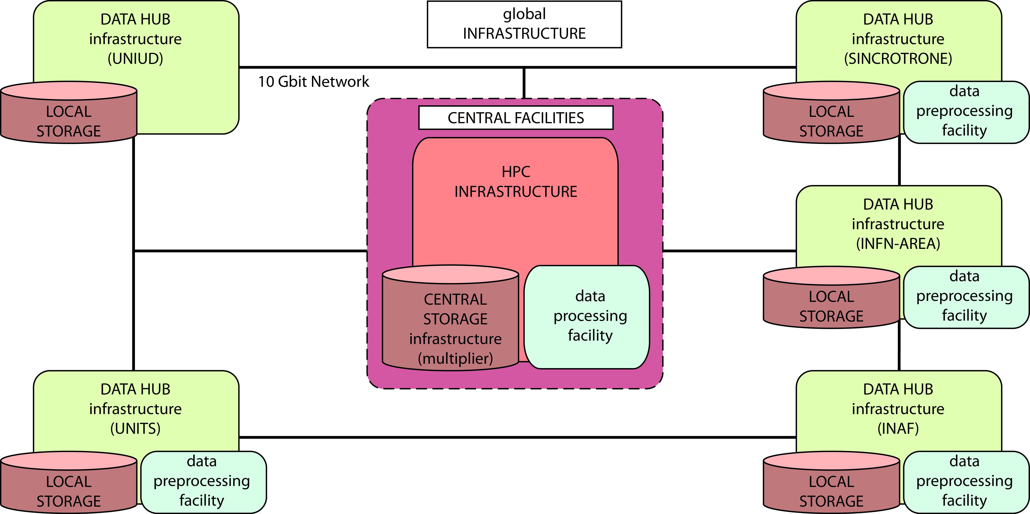



The outlook
Performance: ~ 1 PetaFlops
Storage: 50 PetaBytes ~2018
Network: 100 Gbps

