Slide 1
HPC, the new normal‎: the Personal Computer is dead. Long life the Personal HPC
Trieste 25 February 2016
Roberto Siagri

Slide 2
“it takes about the same amount of computing
to answer one Google Search query
as all the computing done
– in flight and on the ground –
for the entire Apollo programme!”
Udi Manber and Peter Norvig, “The power of the Apollo missions in a single Google search”, Google Inside Search, 28 August 2012.

Slide 3
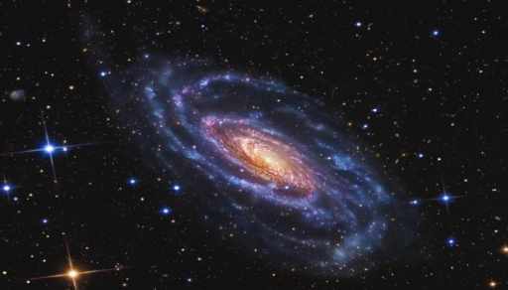
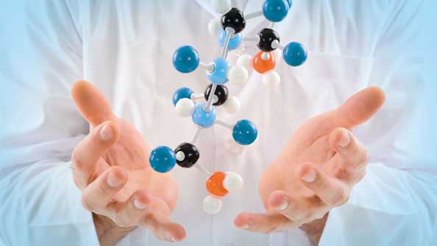
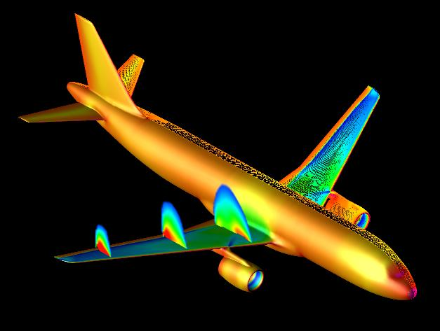
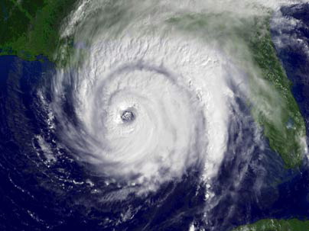
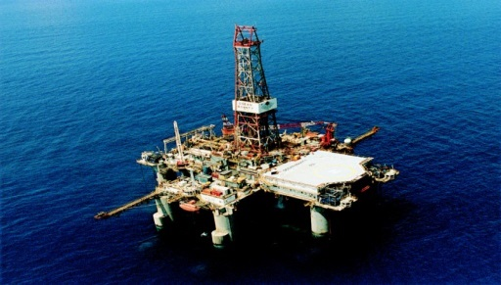
What do they have in common?
Physics and Astrophisics
Better quality of life
Safer and more efficient transportation
High speed trading
Weather forecasting
New oilfields
Notes:
THEY ALL NEED COMPUTATIONAL POWER AND USE HIGH PERFORMANCE COMPUTING TO DELIVER BETTER RESULTS FASTER

Slide 4
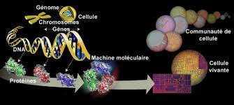
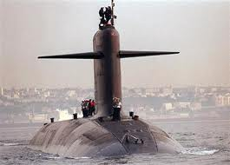
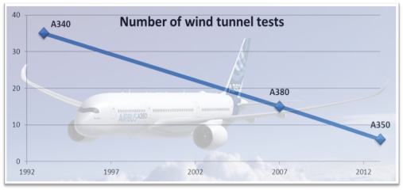
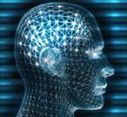
Why HPC is important
HPC is the engine of progress
Competitiveness
Humanity improvement
Sovereignty
Innovation
Time to Market
Cost Reduction
Life Science progress
Complex problems resolution
Entertainment
Intelligence activities
Combat environment simulation
Cyber security
Notes:
High performance computing (HPC) is important for national economies, because HPC, has been firmly linked to economic competitiveness as well as scientific advances

Slide 5
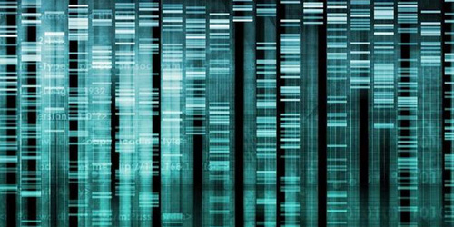
HPC in life science
News highlight changes and progresses in life sciences
« 25 Percent of Life Scientists Will Require HPC in 2015 (HPC Wire) »
«High performance computing-accelerate life sciences discoveries (Bio IT World)»
« Supercomputing Facilitates Breakthrough Cancer Treatment (HPC Wire) »
« The Future of Medical Care Are Tech Companies (Cheatsheet.com) »
Notes:
News highlight changes and progresses in life sciences
25 Percent of Life Scientists Will Require HPC in 2015 (HPC Wire)
Life science research has long been compute-intensive but requirements have largely been satisfied with traditional workstations and simple clusters. That’s changing: roughly 25 percent of life scientists, and this includes bench-level scientists, will require HPC capabilities in 2015, few of whom have ever used a command line.
This statement includes 2 important facts: the growing need for computation and the growing need for usability and simplicity
Why?
Other news I picked up show that the progresses that HPC enable in biology, medicine, chemistry and pharma are making the headlines.

Slide 6
Why it is important for nations
Progress, future, strategy
TO
OUTCOMPUTE
IS TO
OUTCOMPETE
97% of companies* that had adopted supercomputing said they could no longer compete or survive without it.
*worldwide IDC study.
Notes:
High performance computing (HPC) is important for national economies, because HPC, has been firmly linked to economic competitiveness as well as scientific advances
In one worldwide IDC study, 97% of companies that had adopted supercomputing said they could no longer compete or survive without it As the US COC (US - Chambre of Commerce) puts it: to out-compute is to out-compete

Slide 7
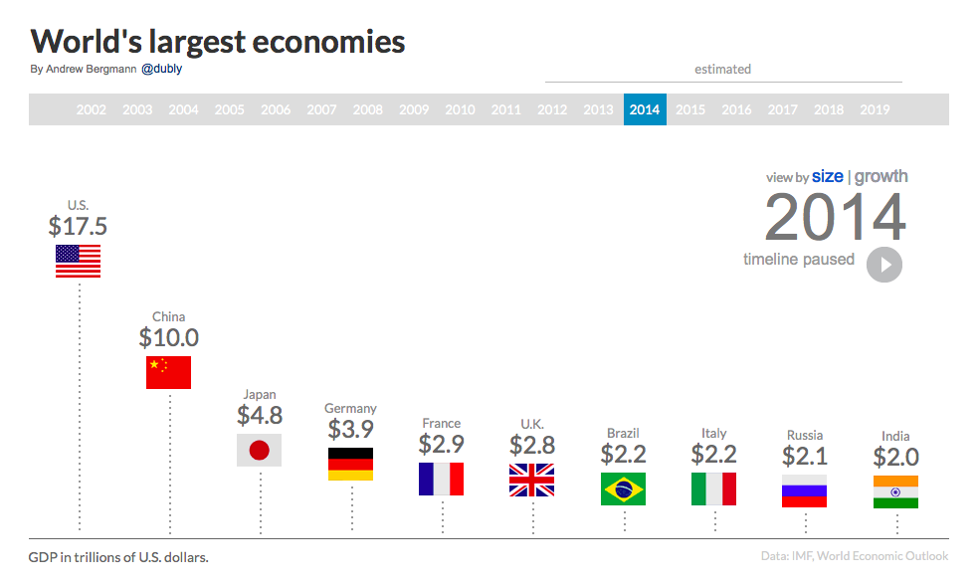
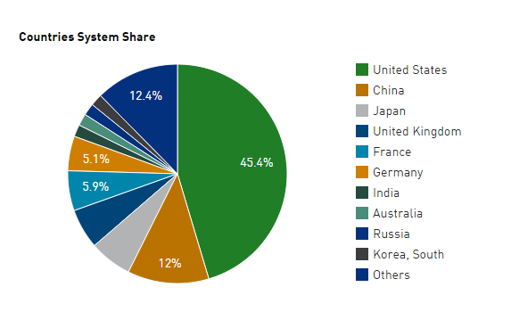
Why it is important for nations
Progress, future, strategy
Worldwide political leaders increasingly recognize this trend
USA, China, Japan, South Korea, India, Russia, UK, France, Germany. Huge investments for developing national supercomputing technologies.
Distribution of Top500 for nation
Notes:
Worldwide political leaders increasingly recognize this trend:
In his 2006, State of the Union address, U.S. President George W. Bush promised to trim the federal budget, yet urged more money for supercomputing
In 2009, Russian President Dmitry Medvedev warned that without more investment in supercomputer technology, “Russian products will not be competitive or of interest to potential buyers.”
In June 2010, Rep. Chung Doo-un of South Korea’s Grand National Party: “If Korea is to survive in this increasingly competitive world, it must not neglect nurturing the supercomputer industry, which has emerged as a new growth driver in advanced countries.”
In his 2011 State of the Union address, President Obama noted China's rapid progress in HPC
In February 2012, the European Commission announced that it has adopted a plan to double spending on HPC to €1.2 billion, with much of that money aimed at the installation of additional petascale supercomputer systems
In January 2013, the EU launched two 1+ Billion euro, 10-year research investments (in brain research and graphene)

Slide 8
Cartoon story
of portable computers
1980-2020
Credit Ted Goff
1980
1990
2000
2010
2020

Slide 9
Less
is
More
9
Notes:
9

Slide 10
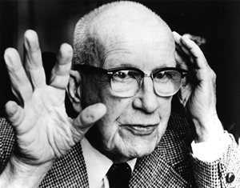
Innovation moves from material to abstract
“The principle of doing ever more with ever less
Space, Time, Matter
and Energy
per each given level of functional performance”
R. Buckminster Fuller
1895 - 1983
Malthus was wrong. He forgot a factor:
our continual ability to do more and more with Less and Less
because of Technological Innovation
Notes:
Malthus could not have conceived of modern refrigeration, transportation or electronics.
This is the so called "Ephemeralization"
Example: America and Europe telephoned, not long ago, via 175,000 tons of transatlantic copper cables
Now
a single 1/4-ton communications satellite does the job better, faster, with more bandwidth and a fraction of the energy.
Another example: Moore’s law is an example of doing almost anything with practically nothing, …. because of the software!

Slide 11
STEM compression : the Engine of Innovation
Space
Time
Energy
Matter
Information
Computation
Notes:
11
Malthus could not have conceived of modern refrigeration, transportation or electronics.

Slide 12
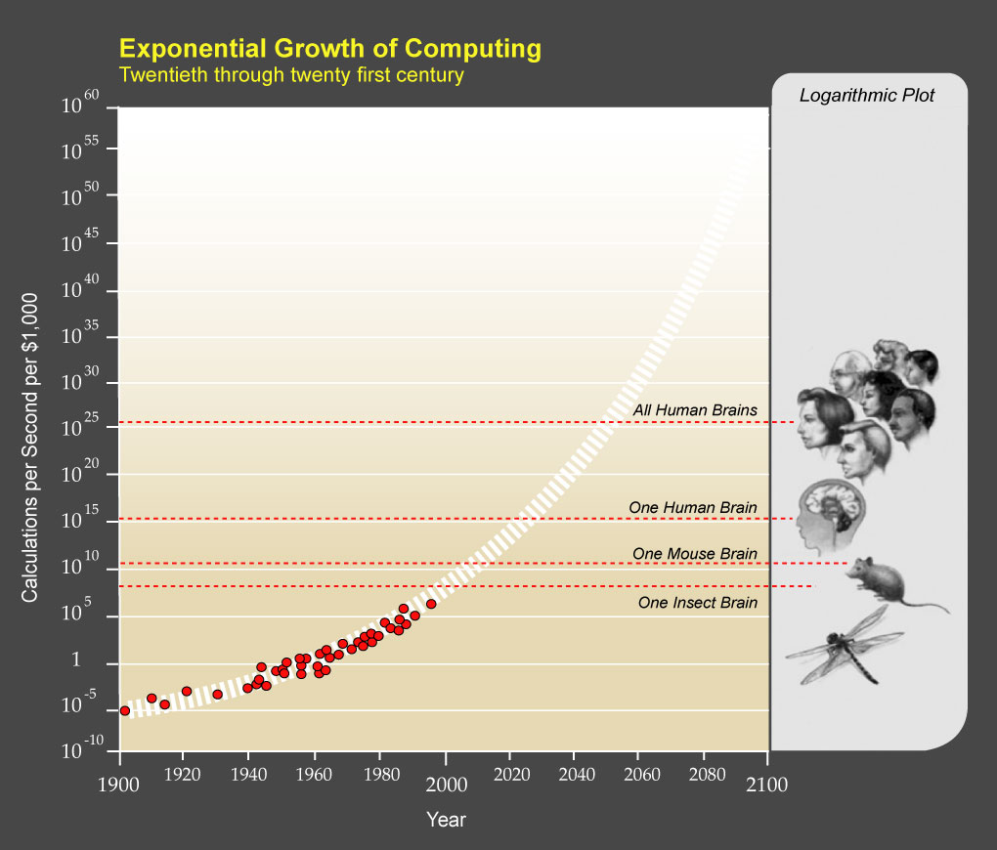
Future Evolution of Computation
Operations you can buy with 1000$
Kurzweil,
The Age of Spiritual Machines

Slide 13
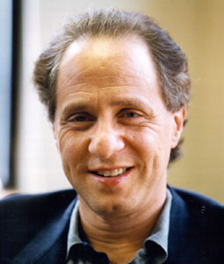
Law of accelerating returns
in the 21st century,
…we won't experience 100 years
of progress it will be more like
20,000 years of progress
(at today's rate)
Ray Kurzweil
The singularity is near
Notes:
The "returns," such as chip speed and cost-effectiveness, also increase exponentially.

Slide 14
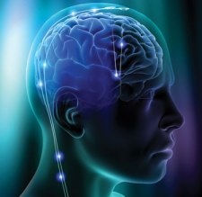
Exponential Growth of Computing 1900-2100
$1,000 of computing buys…
10⁴⁰
10³⁵
10³⁰
10²⁵
10²⁰
10¹⁵
10¹⁰
10⁵
10
10⁻⁵
Calculations per second
Quantum
All human brains
Molecular
Parallel
One human brain
One mouse brain
Chip
One insect brain
Transistor
Tube
Mechanical
1900
1920
1940
1960
1980
2000
2020
2040
2060
2080
2100
The Age of Spiritual Machines (1999), by Ray Kurzweil

Slide 15
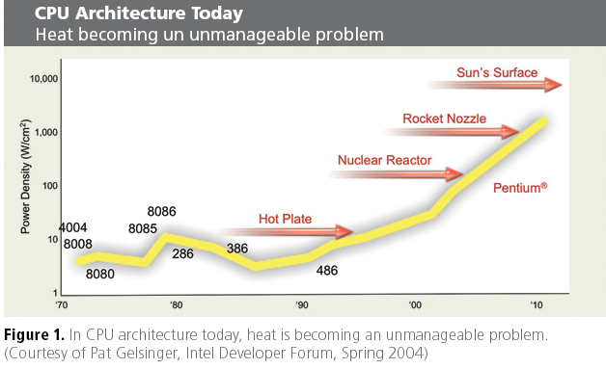

Slide 16
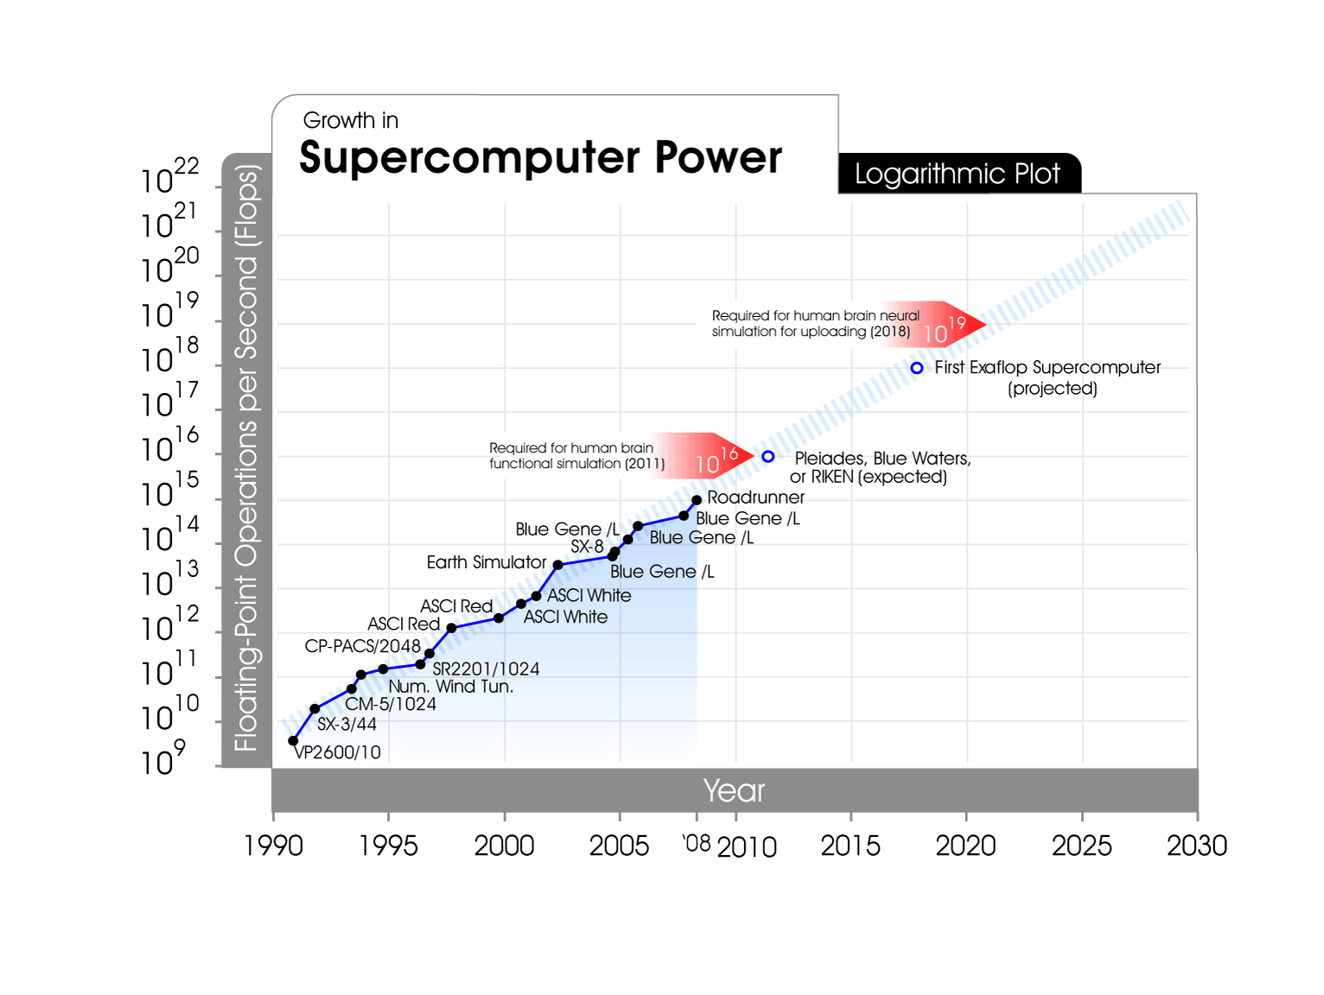
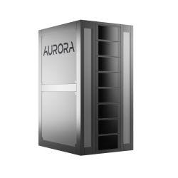
Eurotech is part of
EEP&DEEPER
the EU EXAscale Research Project
Aurora & Aurora Tigon
Eurotech PETAscale HPC
Notes:
From 1991 through 2008, peak performance of supercomputers has doubled about every year. IBM's Roadrunner in 2008 is more than 250,000 times more powerful than the top supercomputer in 1991 and more than 83 million times more powerful than the Cray-1 in 1983. Roadrunner is equivalent to 10% of my 10^16 flops estimate of a human brain. Various projects aim for a computer within the decade that will exceed the human brain's processing capabilities.

Slide 17
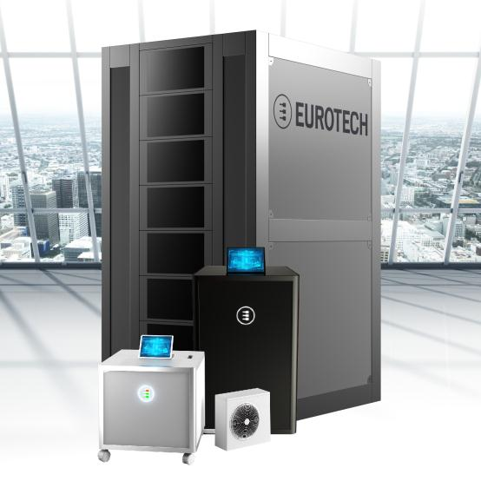
Aurora HPC
Greenest
Highest energy efficiency> 3.2 GFlops/W
(#1 and #2 on Green 500 June 2013)
Densest
Best-in-class density: > 0.6 PFlops per rack¹
Standard
Aurora systems use standard off-the-shelf components
Free cooling
All Aurora systems are hot liquid cooled
¹as of 1Q 2015
Notes:
Aurora systems are scalable from a single working unit to many computing racks with no performance degradation.
High density, power efficiency and noiseless operation, thanks to extensive liquid cooling and to advanced packaging. A wide range of configurations is available.
The node card is the main processing unit of every Aurora system. A blade hosting two Intel Xeon 5600 series processors (Six cores, up to 3.34GHz, TDP<130W), each connected to up to 24GB of 1333MHz DDR3 memory. CPUs are linked to peripherals via Intel chipset, using Intel QPI at 6.4GTps. One node has a computing power of 155Gflops and a typical power consumption of 350W.
A large, high end FPGA allows implementation of a point to point 3D-Torus network for nearest neighbor communications. 3D-Torus interconnect comes with low latency (about 1µs), 60Gbps bandwidth, high robustness and reliability, thanks to redundant lines. Nodes host one Mellanox ConnectX2 device, with 40Gbps bandwidth and <2µs latency, used to implement a QDR Infiniband switched network.
Reconfigurable computing functions such as acceleration, GPU-like co-processing are possible thanks to available logic resources on the FPGA (up to 700Gops per device).
Aurora nodes are hosted in chassis: each of them features also an IB switch, with 20 QDR ports for QSFP cables. All chassis feature two monitoring and control networks, for reliable operation. Maintenance is possible also using a touch-screen interface on a monitor showing diagnostic data.
Aurora Racks can contain up to 16 chassis each, and they provide mechanical support for access and maintenance, power distribution, cables routing, and piping infrastructure for heat removal via a liquid cooling circuit.

Slide 18
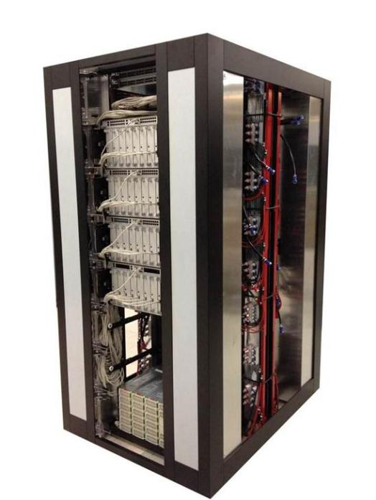
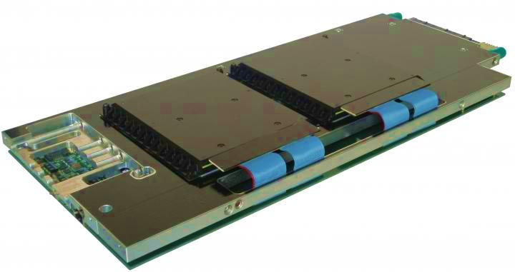
Aurora Tigon: 140 TeraFlops per Rack (2013)
2013: Sets World Record for Energy Efficiency
CPUs and GPUs power Aurora Tigon HPC cluster to 3.15 GFLOPS/W

Slide 19
The Aurora Tigon Unleash the hybrid power
Key Features and value (2015):
The most energy efficient– 3.5 Gflop/s per Watt – data center PUE of 1.05
Accelerated performance – over 430 Tflop/s per rack - 80% Rmax/Rpeak
Best density– 3072 CPU processor cores, 256 accelerators, over 430 Tflop/s in just 1.5 m2
Hot Liquid Cooling (18°C to 52°C) and variable flow rates : Free cooling enabled

Slide 20
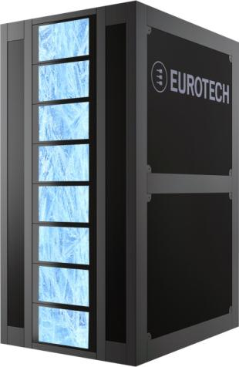
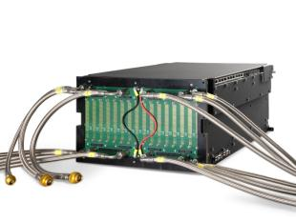
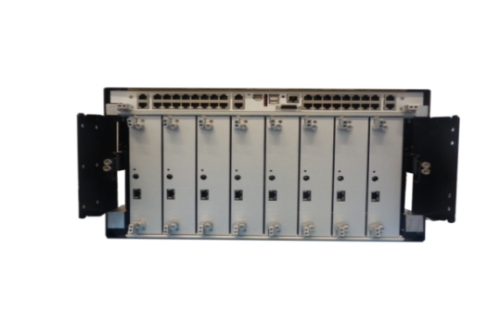
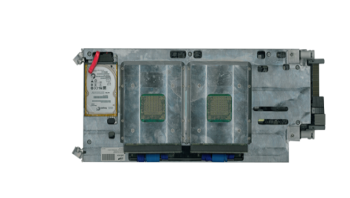
Aurora Tigon
Node
Chassis
Cooling
Rack

Slide 21
Commitment to HPC progress through R&D
Deep Project
“Cluster-Booster” architecture to enable high-scalability
Deep-er Project
Further development of Cluster-Booster architecture. Central research topics: I/O and resiliency
Q-Pace 2 Project
Highly innovative, modular, accelerated and energy efficient HPC architecture

Slide 22
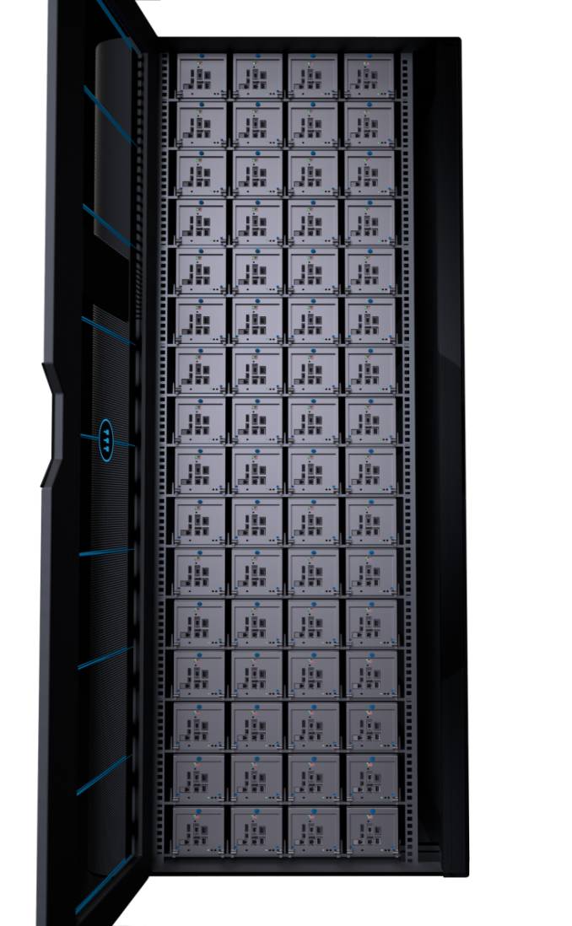
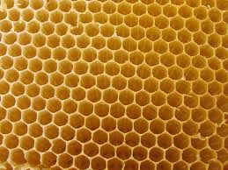
Less Space: the Hive
A commitment to high density to overcome the space challenge
HIGH DENSITY
COMPREHENSIVE LIQUID COOLING
RATIONAL DESIGN
Notes:
HIGH DENSITY
Aurora systems can perform at 430 Tflop/s per 1.5 m2 rack
COMPREHENSIVE LIQUID COOLING
Aurora Direct contact liquid cooling allows for very efficient heat extraction
Each part of the Aurora System is liquid cooled so no space is wasted for air
RATIONAL DESIGN
Optimization of system design from board to system (use of small form factor components…)

Slide 23
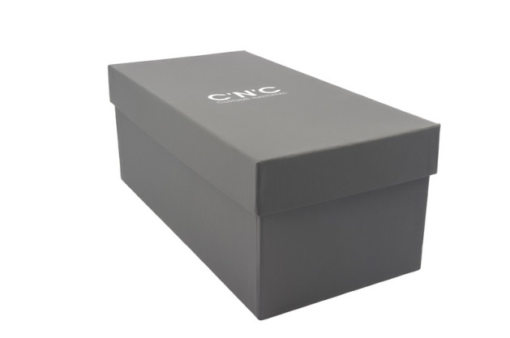
HPEC
Supercomputer in a shoe-box
ASCI White
4,9 Tflops
3 MW
4 TFlops
1K Watt

Slide 24
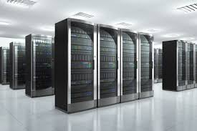
Datacenter in a Chip

Slide 25
New SW Containers

Slide 26
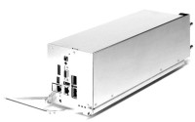
HPEC
Where will be needed
Autonomous Vehicles
Asset Identification & Tracking
Medical Imaging
Cyber-security & Networking
26

Slide 27
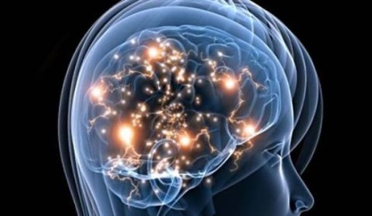
Challenges in HPC
10 PetaOps
With 20 W
The energy challenge
1 PF (1 MW)
3,000 people town
1000 PF (1000 MW)
3,000,000 people city
CHALLENGE
1000 PF in < 20 MW
Notes:
The most efficient large scale HPC system is today Piz Daint
It has a peak performance of 6.3 Pflop/s at 2.3 MW
If this system is scaled to 1 Exaflop/s, it will consume 370 MW!
This power consumption levels are not sustainable because of
Excessive costs
Difficult (or impossible) availability

Slide 28
Trends in HPC
Technological trends are driven by challenges
New Technologies…
New Architectures…
New Programming Models…
New Cooling Technologies
Density
Energy efficiency
Reliability
Scalability

Slide 29
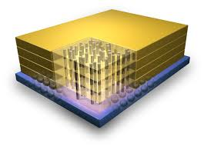
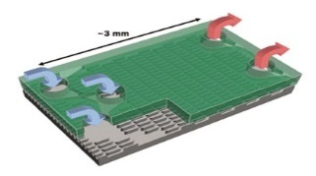
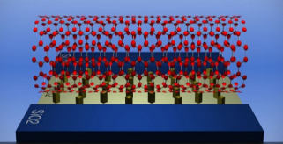
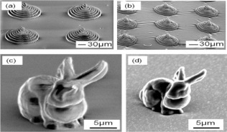
Many Paradigm Changes
Vertical Integration
High core-cache bandwidth (new scaling roadmap for 15 years)
Heat Removal
Liquid cooling and heat re-use
New Materials
Carbon Nanostructured
Supply and Cooling area vs. Transistors area
Electrochemical power supply
Production process
3D printing

Slide 30
Ultimate (zetta-wattaflop) Computing Machine according to Seth Lloyd
Quantum Physics Theory
a 1-kg computer : 10⁵¹ ops/sec
Super computers nowadays achieve
10¹⁵ ops/sec
with a pace of Moore’s law: x2 every 1.5 years
technology needs~ 250 years to reach these limits
Seth Lloyd - “Ultimate physical limits to computation” Nature, 2000
Notes:
It may also be that quantum computation will start pulling rabbits out of its hat
The physicist Seth Lloyd points out that any region of matter at all can be regarded as a quantum computer
the bits are stored as particle spins, the operations consist of the articles interacting with one another.
a kilogram-sized piece of ordinary matter is running a computation in which it updates a memory of 10^31 bits
at a rate of 10^20 updates per second.
And if the matter happens to be a black hole, the figures switch to a memory of 10^16 bits being updated at a rate of 10^35 updates per second.
In either case, if we multiply the two numbers together, we get 10^51 bit-updates per second, which is something like a sextillion nonillion instructions per second, or a zetta-wattaflop.
Lloyd suggests that a black hole computer could form for the tiniest fraction of a second, absorb computational input as mass and energy, carry out its vast computation, and dissolve into a pulse of energy containing the output.

Slide 31
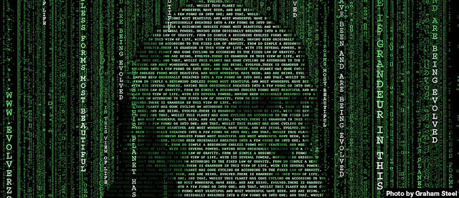
“The ones who survive are not the biggest,
but those who adapt better to changes”
Charles Darwin, Evolution Theory (1859)
faster you compute faster you adapt to changes

