Slide 1
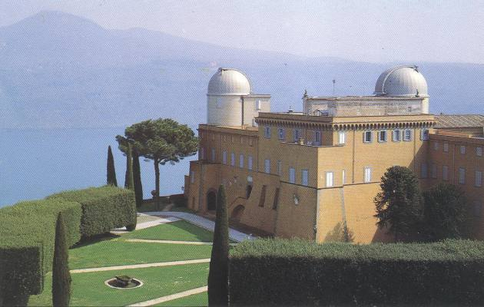
On the Canonical Equivalence of the Jordan and Einstein Frames
Gabriele Gionti, S.J.
XXV SIGRAV Conference on General Relativity and Gravitation,
SISSA (Miramare Campus), Trieste, Sep. 4 2023.
partially in collaboration with Matteo Galaverni and based on arXiv:2003.04304 Phys. Rev. D 103 024022 (2021) , arXiv:2110.12222 Phys. Rev. D 105 084008 (2022), arXiv:2112.02098 Universe 8 (2021), and more to come…

Slide 2
Jordan-Einstein Frames
Old paper: Dicke (Phys. Rev. (1962) 125, 6 2163-2167)
Suppose the proton mass is in mass units and, in “natural units”, we scale the unit of measurement by a factor (length)⁻¹
. In the new unit the proton mass .
Confronting the measurement of the proton mass in the two mass units
(Faraoni and Nadeau 2007)

Slide 3
Jordan-Einstein Frames
Since and , then the covariant metric functions scales as
Invariance under rescaling of units of measurement implies Weyl (conformal) invariance of the metric tensor
The starting frame is called “Jordan” frame and the conformal transformed the “Einstein Frame. One observable can be computed in both frames. Its measure, obviously different in the two frames, is related by conformal rescaling according to the observable’s dimensions.(e.g. ).

Slide 4
Scalar-Tensor Theory
In general, one starts from a scalar-tensor theory, with GHY-like boundary term, in the Jordan Frame
and passes to the Einstein Frame with the transformation
therefore, the action becomes
It is assumed that if is solution of the E.O.M also is
solution (True?). This reasoning seems to address that the transformation from the Jordan to the Einstein frame look like a canonical transformation in the Hamiltonian theory.

Slide 5
Brans-Dicke Theory
Brans-Dicke, with GHY boundary term, is a particular case of Scalar Tensor theory ( )
How to perform canonical analysis of this theory?
Deruelle, Sendouda, Youssef PRD 80, (2009). They still claim that the transformations are Hamiltonian canonical
Garay and Gracìa-Bellido NPB 400 (1993): the transformations are Hamiltonian canonical.

Slide 6
Brans-Dicke Theory
The Hamiltonian Weyl (conformal) transformations from the Jordan to the Einstein frames are
They are not Hamiltonian canonical
The Dirac’s constraint analysis of the Hamiltonian theory has to be done, independently, in the Jordan and Einstein frames. We have studied the Hamiltonian constrained theory in Jordan and Einstein frames for both cases $ω≠−\frac{3}{2}$ and , $ω=−\frac{3}{2}.$ In the case $ω=−\frac{3}{2}$ the theory has an extra Weyl(conformal) symmetry with an associated primary first class constraint $C_{φ}$

Slide 9
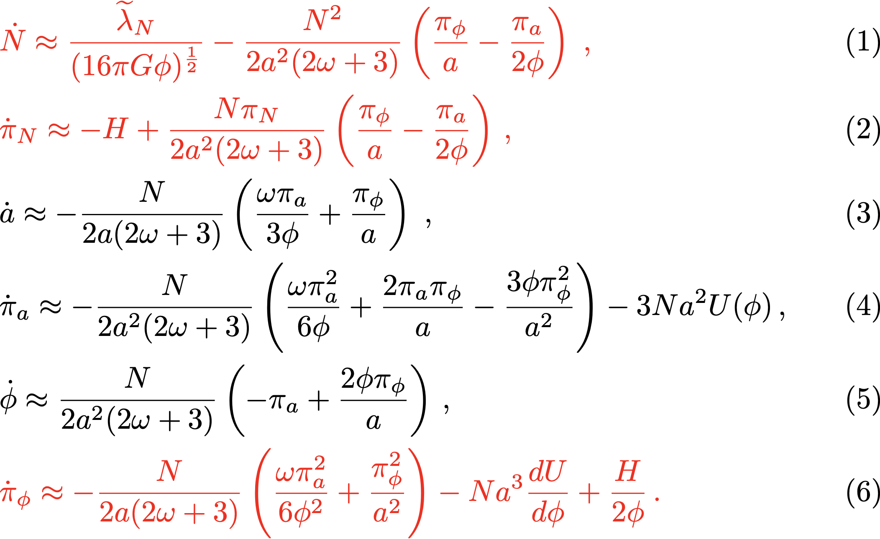
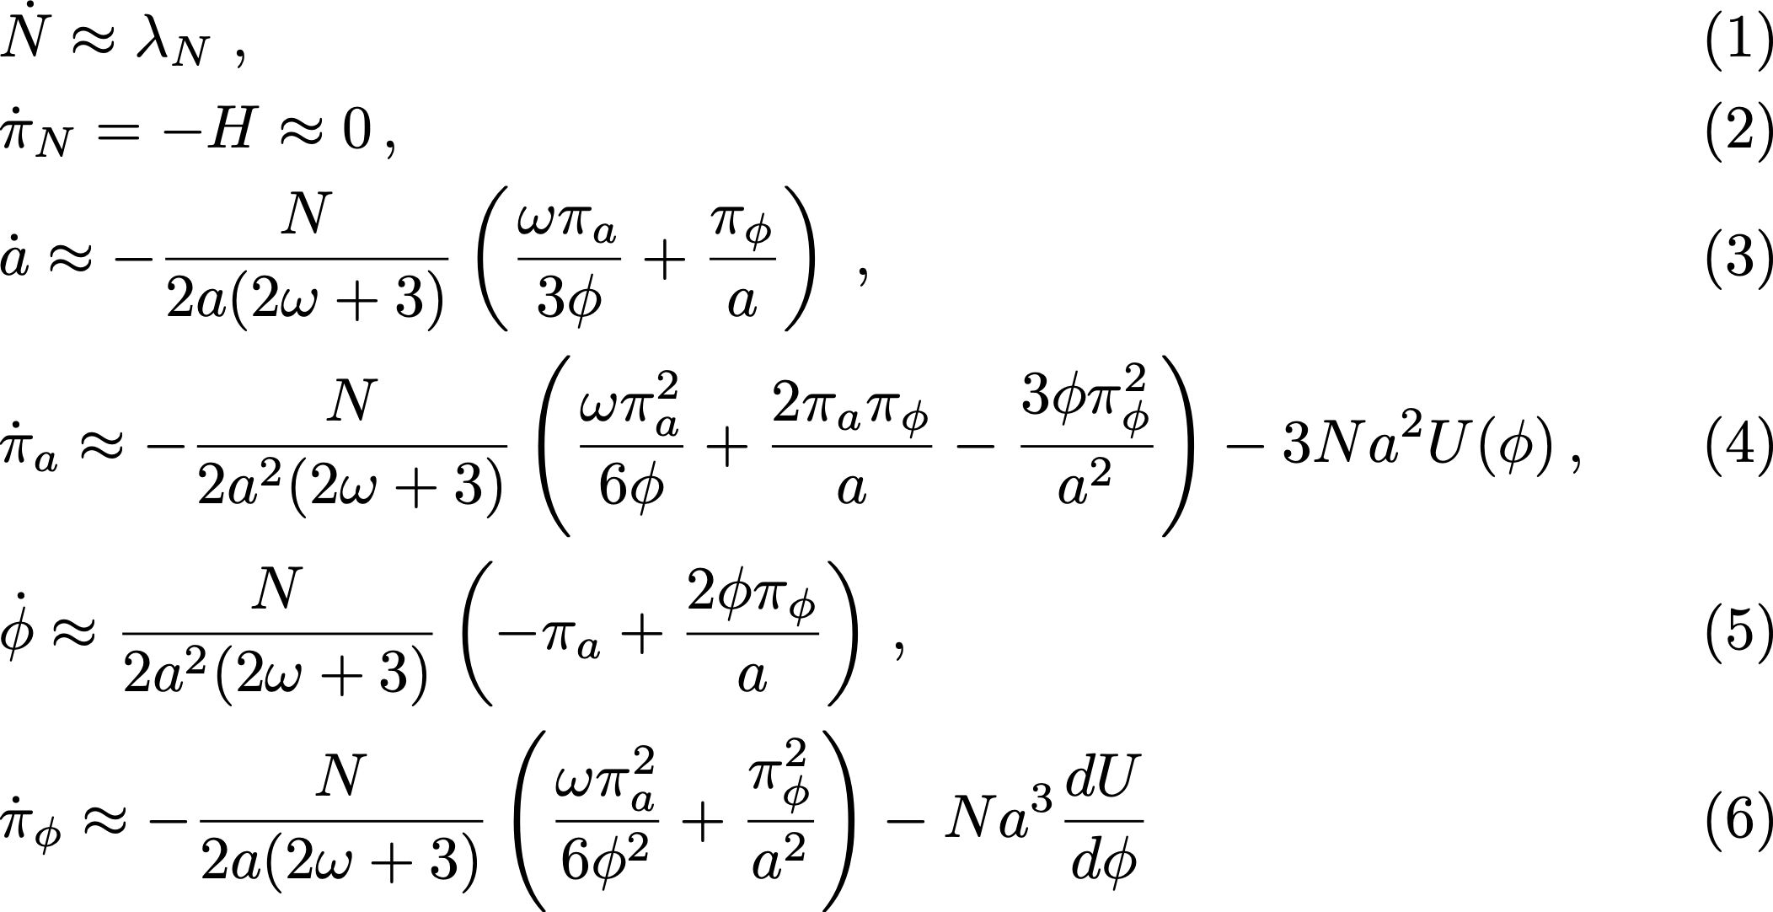
FLAT FLRW Brans-Dicke theory
JF -------> EF
$${\tilde{H}}_{T}$$
$$H_{T}$$
JF <--------EF
e.o.m.
e.o.m

Slide 10
CANONICAL EQUIVALENCE OF JF AND EJ VIA GAUGE FIXING
We have performed the following gauge fixing in the Jordan Frame and in the Einstein Frame
The secondary first class constraints $π≈0$and $π_{i}≈0$ become second class constraints
It is possible to define Dirac’s brackets and solve the second class constraints
The transformations from the Jordan to the Einstein frames result to be Hamiltonian canonical transformations. Remember: now the phase space is a reduced one, where we have gauge-fixed the lapse function $N$and the shift functions $N_{i}$ .
Does it mean that the two frames are physically equivalent?

Slide 11
CANONICAL EQUIVALENCE AND PHYSICAL EQUIVALENCE
Harmonic Oscillator (Goldstein )
Canonical transformations (not symmetry of the system…)
Therefore the Hamiltonian becomes
and then,
Notice that the harmonic oscillator is mapped into a free particle

Slide 12
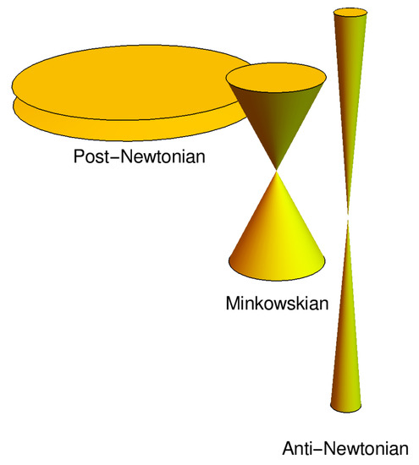
ANTI-GRAVITY TRANSFORMATIONS (Canonical Transformations)
There exist Hamiltonian Canonical Transformations on the extended phase space:
The Anti-Gravity transformations
In two dimensions, they look like
Since this theory is canonically equivalent to B-D theory, the constraint algebra of secondary first class constraints ( , ) is like B-D theory’s one.
Carrolian Gravity,
G$→∞ , c→$0
M. Niedermaier 2019

Slide 13
CANONICAL EQUIVALENCE AND PHYSICAL EQUIVALENCE
JF is canonical equivalent, via gauge-fixing of Lapse $N$ and shifts $N_{i}$ ,
to EF (structure of light cone preserved by JF-EF transformations).
JF is canonical equivalent to Anti-Gravity frame (light cone structure modified
by JF- Anti-Gravity transformations).
JF cannot be equivalent to two physically inequivalent frames. Therefore, Hamiltonioan canonical transformations represent, in our opinion, a mathematical equivalence. These transformations map solutions of e.o.m into solutions of e.o.m.

Slide 14
CONCLUSIONS
The transformations from the Jordan to the Einstein frames, in the extended phase space, are not Hamiltonian canonical transformations.
Gauge-fixing the Lapse N and the Shifts N_{i} and implementing the Dirac’s Brackets, Hamiltonian canonical transformations do exist from JF to EF.
This very fact does not mean, necessarily, that the two frames are “physically” equivalent.
The equivalence of the physical observables in JF and EF remains still to be studied.

